Slide 1
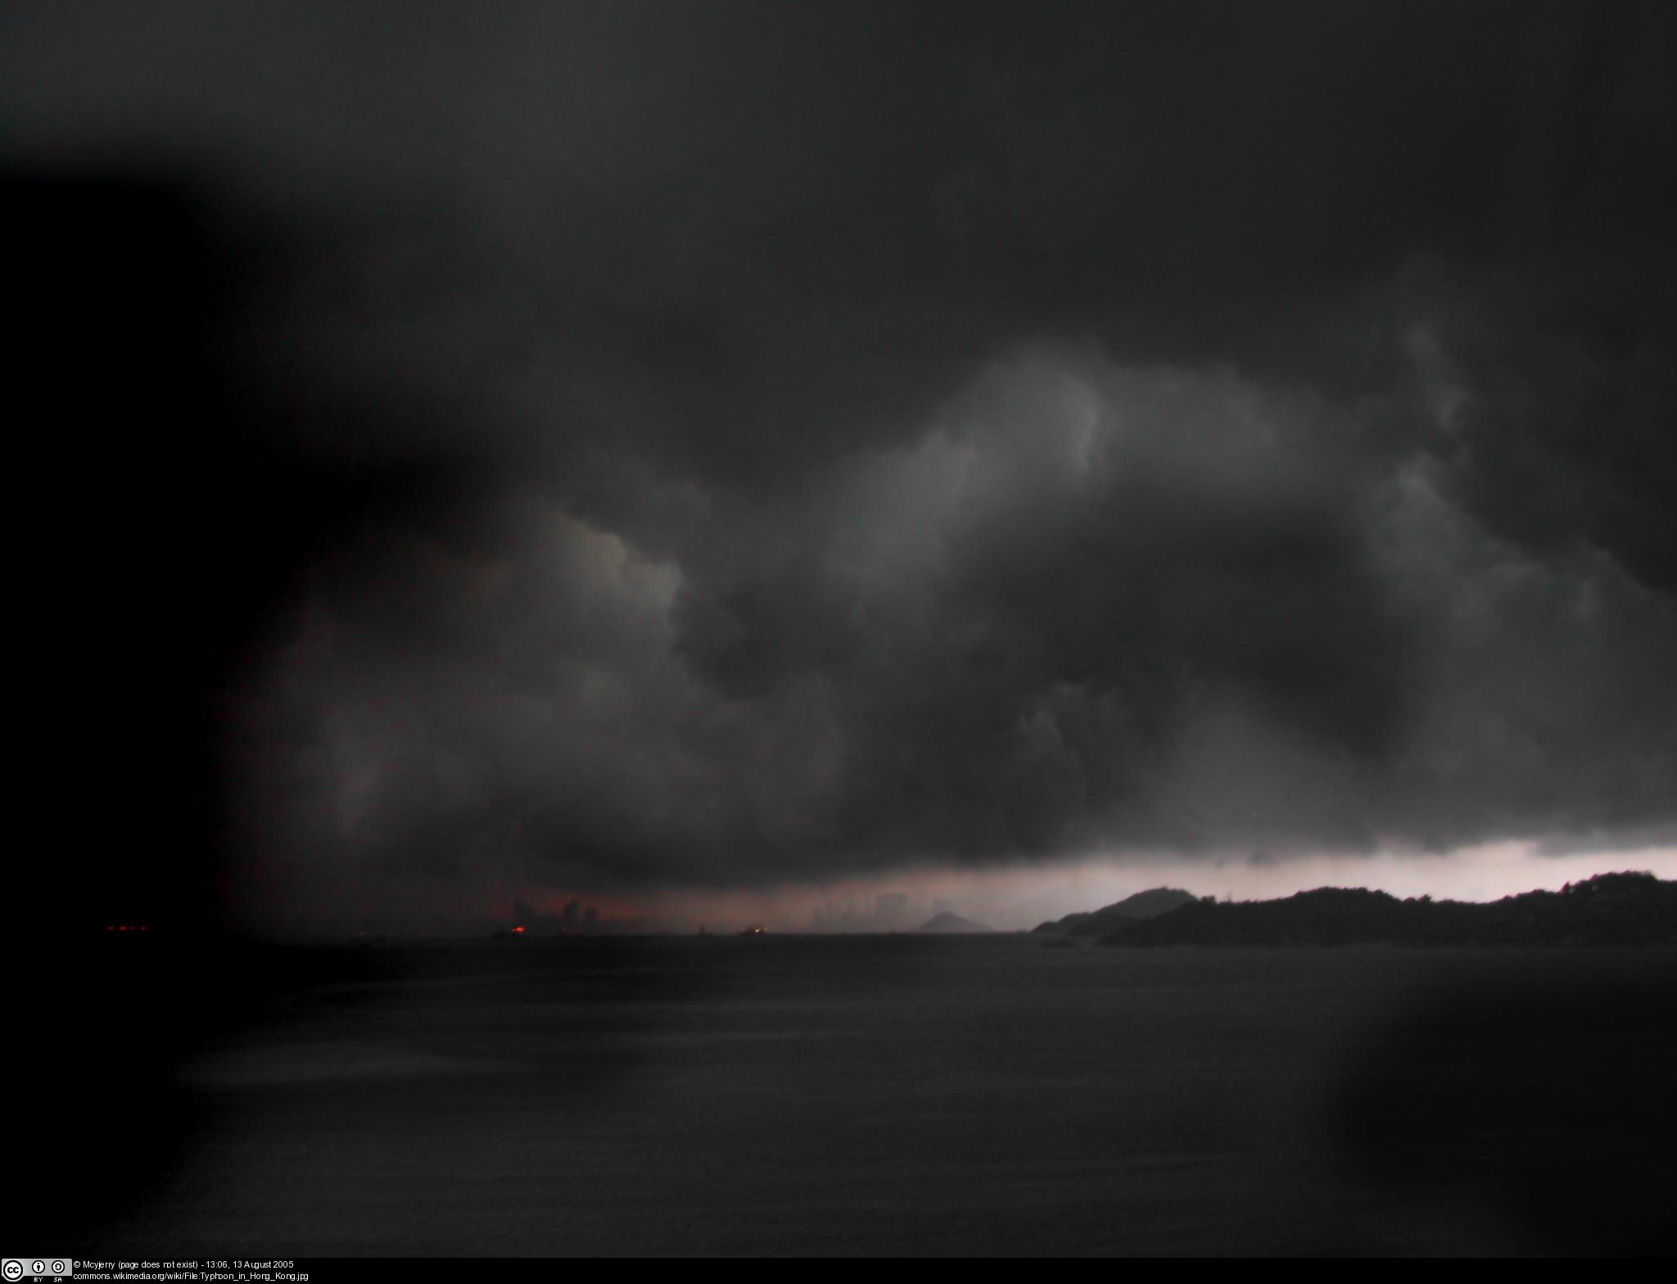
OER HERO
A presentation by David Kernohan for #0er11
Font: “Nightmare Hero” by _n30_ at dafont.com

Slide 2
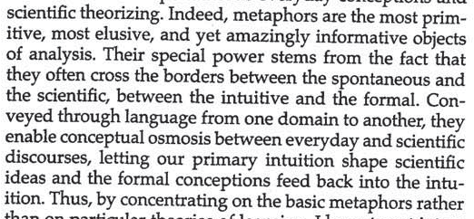
What @kavubob said
“Models and metaphors shape how we think”
Sfard (1996)

Slide 3
Guitar tablature
A) INTRO
Gtr.1 (clean elec w/ tremolo effect), let ring throughout
e |----------------------------------|----------------------------------|
B |----------------------------------|3-----------------------3---------|
G |--------------------4-------------|----4-------4---------------------|
D |--------5-------5-----------5-----|--------5-------------------5/----|
A |----5-------5---------------------|----------------------------------|
E |3---------------------------------|----------------------------------|
#----------------------------------PLEASE NOTE---------------------------------#
#This file is the author's own work and represents their interpretation of the #
#song. You may only use this file for private study, scholarship, or research. #
#------------------------------------------------------------------------------#

Slide 4
Guitar tablature – what is it?
Alternate means of transcribing music (non-standard notation)
Less accurate around precise note-timings
More flexible
More easily read, especially by new players.
Very easy to write,
Very easy to share.

Slide 5
Why tab?
Traditionally, (non-classical) musicians learn by listening to and watching each other
Commercially available transcriptions were generally in standard notation, and often inaccurate (or “rearrangements”)
Anyone can write tab, anyone can read it.
Can be represented in a .txt file

Slide 6
The technology was there, the language was there, the demand was there, so sharing happened.
Tablature is a critical analysis of and commentary on an art work. It is not a “copy” of the artwork.

Slide 7
Metadata
Permissions:
#----------------------------------PLEASE NOTE---------------------------------#
#This file is the author's own work and represents their interpretation of the #
#song. You may only use this file for private study, scholarship, or research. #
#------------------------------------------------------------------------------#
Attribution (auto-generated):
From: yrashid@gpu.srv.ualberta.ca (Berzerker)
Subject: TAB: RADIOHEAD "Creep"
Also (sometimes) date/time, version details and notes:
Hmmm, I saw a few replies for this one already, but here is the tab as far as I learned it anyway...
"Creep“ Words and Music by Radio Head
If you have any comments, questions, want the baseline, or whatever, leave me a message.
yrashid@gpu.srv.ualberta.ca

Slide 8
Sharing
Email
Newsgroups (alt.guitar.tablature, rec.music.makers.guitar … )
Newsgroup archives… online guitar archive (OLGA)
Other early websites.

Slide 9
Why share?
From Chesney 2006 – sample size was 259, 34% [72] usable response rate

Slide 10
Benefits realisation
“get my name out there”
“[o]nce I've transcribed them for myself, it's not hard to send them to OLGA or another site.”
“I have worked them out and someone else might want to learn that song”
23 of the 72 respondents claimed they received no benefit from publishing tabs. Referring to benefits, one respondent claimed he got “none. others benefit. i benefit from their work.”

Slide 11
OERish?
“The act of preparing (collecting, collating etc.) the material to be shared should have meaning in itself for the person who is preparing it. This was seen in the fact that most self motivations were motivations to transcribe a song and store that transcription in electronic form, and not motivations to publish the tabs. The publishing came later and all that publishing involved was emailing a file to OLGA. This result could be used by organizations with a little imagination.”
(Chesney, 2006)

Slide 12
Unobserved benefits (1)
As presented at OCWCglobal
This is not just an OER finding – we’ve seen this in content related work for 10+ years.
limited
evidence
Diagram adapted from David Wiley’s original idea
(which he himself critiques at http://opencontent.org/blog/archives/905)
Notes:
“It seems to me that open educational resource apologists have created a related construct that might best be called “dark reuse.” The difference between dark matter and dark reuse is significant, however. While the dark matter construct was created to explain unanticipated-but-observed behavior, the dark reuse construct is created to explain anticipated-but-unobserved behavior. Rather than accepting the message of data which indicate that reuse is occurring only very infrequently, the apologists imagine an unobservable space offline in which reuse must surely be occurring.” (David Wiley)

Slide 13
Industry response

Slide 14
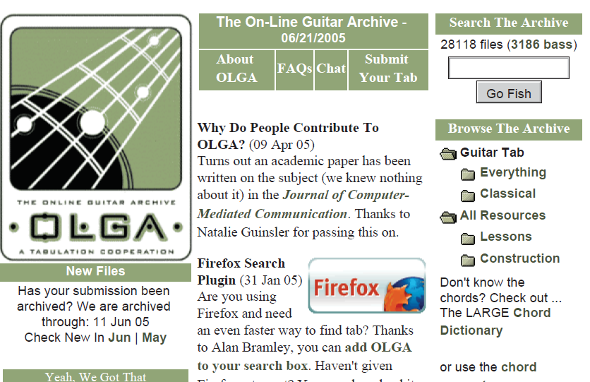
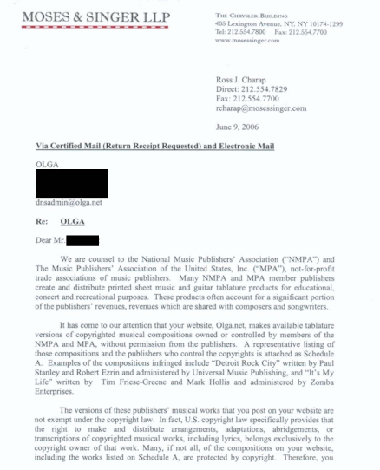
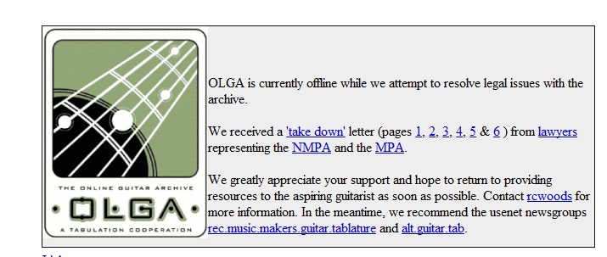

Slide 15
The case
The guitar tablatures found in OLGA are worked out by individual guitarists listening to recordings and represent individual interpretations and fingerings. As such they add unique value to both the recording and to sheet music where it exists. The important economic significance is that the tablatures are a complement to the sound recordings, not a substitute. Both the creator of the tablature and the user learning a song will start by listening to a recording.
Although guitar tabs may in some circumstances substitute for sheet music, they are overall a strong economic complement to the recordings.
As such, the distribution of guitar tablatures over the Internet probably constitutes a violation of traditional intellectual property rights. Certainly the record company EMI thinks so, for in January of last year it sent a letter to UNLV threaten to take legal action. UNLV promptly shut down the site and several mirror sites were shut as well. Some mirror sites have stayed open, although with a diminished ability to accept new guitar tabs.
Bessen & Maskin, (1997)

Slide 16
And…
"The versions of these publishers' musical works that you post on your website are not exempt under copyright law. In fact, U.S. copyright law specifically provides that the right to make and distribute arrangements, adaptations, abridgements, or transcriptions of copyrighted musical works, including lyrics, belongs exclusively to the copyright owner of that work."
(Specimen claim, reported in Red Hat magazine, September 2006)

Slide 17
Wait… WHAT???!!!
"At what point does describing how one plays a song on guitar become an issue of copyright infringement? This website, among other things, helps users teach each other how they play guitar parts for many different songs. This is the way music teachers have behaved since the first music was ever created. The difference here is that the information is shared by way of a new technology: the internet.“
"When you are jamming with a friend and you show him/her the chords for a song you heard on the radio, is that copyright infringement? What about if you helped him/her remember the chord progression or riff by writing it down on, say, a napkin...infringement? If he/she calls you later that night on the phone or emails you and you respond via one of those methods, are you infringing? I don't know.“
(Rob Balch, “GuitarTabUniverse”, reported in The Register (2006)

Slide 18
So…
Learning materials as commentaries on other works infringe copyright?
How-to guides infringe copyright?
Peer learning infringes copyright?

Slide 19
As usual with record company interventions, this was completely successful. There is now no free, unlicensed, guitar tablature anywhere on the internet.
The future is safe for us all.
God Bless America.

Slide 20
Tab request
Tab transcribed
Newsgroups
Other sites
OLGA

Slide 21
Tab request?
Tab transcribed
Make your own site?
Newsgroups?
Other sites
Other sites
Other sites
Other sites
Others…
Chordie
911Tabs
Register feed

Slide 22
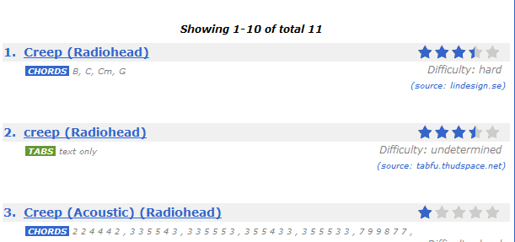
Paradata!

Slide 23
so far this year no tabs have been posted on alt.guitar.tab -- last year there was only one tab posted on rec.music.makers.guitar.tablature (and that was by me)
i've been posting to Usenet since 1993, and posting tabs for almost as long (rock, blues, folk, & classical) -- for over 10 years i've looked after one of the major guitar tab sites, and i used to encourage people who sent me tabs to also post them here -- but no longer...
------------------------------------------------
Oniscoid, rec.music.makers.guitar.tablature, Feb 26 2010, 2:00 am

Slide 24
Downes! (2007)
“it [is] important to think of OERs not in isolation, but with respect to the community that accesses them and uses them. […]Hence, the development of a sustainable open content community is an integral part of the development of a network of OERs.”

Slide 25
What can we learn?
Is “fair use/fair dealing” a waste of time?
Does “Request”/”Demand” needs to be a part of any OER cycle?
Are benefits are based around reputation, and the inherent benefits in materials creation.
Are multiple repositories and aggregator(s) “safer” than a monolithic model?
Does this lose the community aspect?

Slide 26
THE END
A presentation by David Kernohan for #0er11
Font: “Nightmare Hero” by _n30_ at dafont.com

Slide 27
References limited to those not included in full within the slides in question.
Sfard, Anna, “Of two metaphors for learning, and the danger of choosing just one”, Educational Researcher vol 27 no 2, 1997
Chesney, Thomas, “Sharing Guitar Tabs Online”, Journal of Computer Mediated Communication vol 10 no 1, 2004
Bessen, Jim and Maskin, Eric, “Intellectual Property on the internet: what’s wrong with conventional wisdom?”, in Lutterbeck, Bernd, Robert A. Gehring, and Matthias Bärwolff eds., Open Source Jahrbuch 2005: Zwischen Softwareentwicklung und Gesellschaftsmodell, Berlin: Lehmanns Media
Downes, Stephen, “Models for sustainable open education resources”, Interdisciplinary Journal of Knowledge and Learning Objects Volume 3, 2007

