Slide 1
Serendipitous dynamic aggregated remote searching for lo-carbon Open Resources
Mr. Rob Pearce Loughborough University Engineering Subject Centre

Slide 2
Low Carbon Engineering OER Project (EALCFO)
The Engineering a Low Carbon Future OER (EALCFO) project is taking a proof of concept idea (presented at OER10) of a search facility that is able to pull together appropriate OERs from a number of sources to a working service with a specific subject focus.

Slide 3
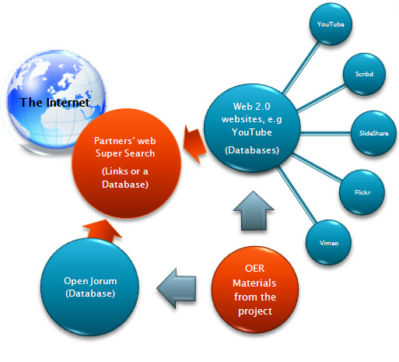
The big idea

Slide 4
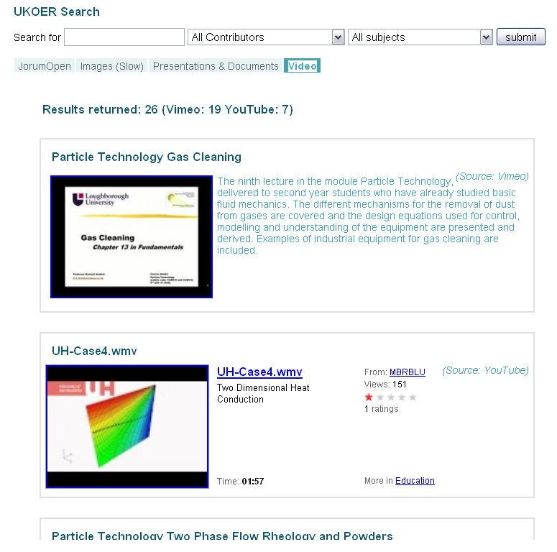
Example phase 1 OER search

Slide 5
Sustainability Subjects covered by the project
energy efficiency, sustainable development, renewable energy technology, waste minimisation, human issues and social responsibility, product lifecycle, total cost of ownership and recycling.
Guidance materials will include re-skilling the existing workforce, low carbon transition for business and education, ethics and embedding sustainability into the curriculum.

Slide 6
…project key points
project will form a pre-selected best-of-breed OER collection and a linked dynamic collection of Open Educational Resources relating to Lo-Carbon Engineering practices.
The pre-selected best-of-breed OERs collection will be selected by experts to ensure relevence
this will be combined with a fresh, dynamic source of current and new materials as they become available to ensure the collection remains up-to-date and connected to the broader community of practice.

Slide 7
…project key points
dynamic remote searching of multiple sources encouraging serendipity in recognition of the importance of this aspect of searching and discovery
The linkage with the pre-selected best-of-breed OERs will, it is hoped provide “serendipitous” opportunities to connect with OERs related

Slide 8
…but here’s the twist…
The pre-selected best-of-breed OER collection will consist of 10% NON-OERs as well: OERs are not the only way to find materials for teaching just yet.
These NON-OERs are resources considered by the project expert to be “industry standard”

Slide 9
…Why?…
If the non-OER resource gets used it was because it was better but if a similar featured OER is comparable then:
the association of the two may lead the searcher to a better solution and the originators of both resources to create a yet better resource.
This approach may help form a bridge for searchers from NON-OERs to OERs

Slide 10
…Why?…
… No-one wants a search tool with one eye closed, searchers need stuff and plenty of it; a few resources and a lot of evangelistic zeal isnt going to get a presentation ready for tomorrow.

Slide 11
…but here’s the twist…
The linkage with the pre-selected best-of-breed OERs juxtaposed with non-OERs mixed in with multiple dynamic searches will, it is hoped provide “serendipitous” opportunities to connect with OERs related

Slide 12
…key dev issues
Initiating searches involving multiple service providers, most of which are free-to-use commercial products and therefore with no service level agreements.
Technical stability and business longevity in a fickle, developing marketplace also mean added risk. Although the risk is high so are the rewards for such an approach.

Slide 13
The Sources
Static Collection of selected OERs and non-oers
List of resources describing OER how-to guides
Dynamic aggregated sources:
Nottingham University XPERT database – contains many thousands of feeds from key OER suppliers (MIT, OU, JORUM etc.)
Folksemantic (www.folksemantic.com) attemts to connect OER sources based on the contents of another OER
Google – a citation count based on the number of references to a specific resource.

Slide 14
Example searches

