Slide 1
Integrating ‘open’ throughout the University, the Open Nottingham story
andy.beggan@nottingham.ac.uk
steven.stapleton@nottingham.ac.uk
OER 11 11-5-11

Slide 2
Outline
About Nottingham
What is Open Nottingham?
Tools and Support
Impact Case Studies
Next steps

Slide 3
About Nottingham
Research led institution
Student numbers
40,000 students (postgrad and undergrad)
6,000 international (130 countries)
Six campuses (inc. China and Malaysia)
Learning Technology Support
Learning Engagement Team
VLEs
E-assessment
Learning Innovation Team
Video production
E-learning development (Xerte)
Open Learning

Slide 4
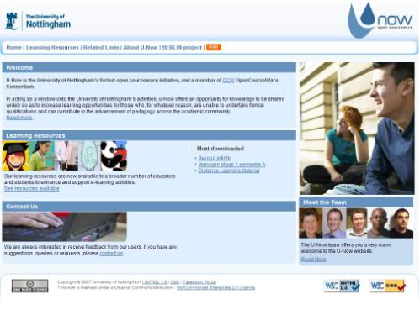
What is Open Nottingham?
U-Now – OCW/OER
Launched 2007
Member of OCWC (20% of referrals)
HEA/JISC funded through BERLiN project 2009/10
Open Nottingham
Open source tools
Open learning publication
OER discovery & reuse

Slide 5
University Strategic Driver
Social Responsibility: “Expand our U-NOW open courseware initiative, which provides an opportunity for sharing knowledge widely to increase learning opportunities for those who, for whatever
reason, are unable to undertake formal qualifications” (pg 46)
Notes:
Social responsibility
Promotional opportunities
Internationalisation
Cost efficiencies
Excellence in education
University investment in open learning

Slide 6
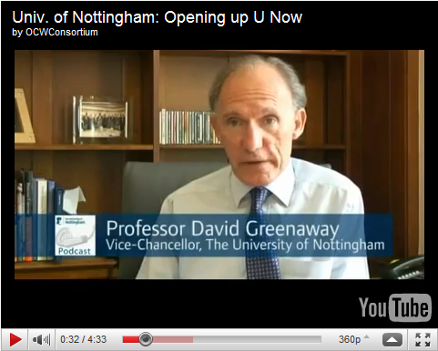
What support does it have?
Senior Support, Vice-Chancellor, Pro-Vice Chancellors, Director of Teaching and Learning
Opt-in, schools can pilot or provide as much content as comfortable
Approx 25% of schools have engaged (Boards/Committees)
Over 1500 credits have been offered this year
300% increase on last year
Notes:
Engaged is at 25% (around 17 schools)
In total around 15% have offered us content.
3 x schools have offered us 100% of module handbooks/outlines (Politics, Geog and Economics)
1 school (GE Nursing have offered us 100% of their course material, so everything the registered student gets will be made available on line.)

Slide 7
Tools and Support
www.nottingham.ac.uk/open

Slide 8
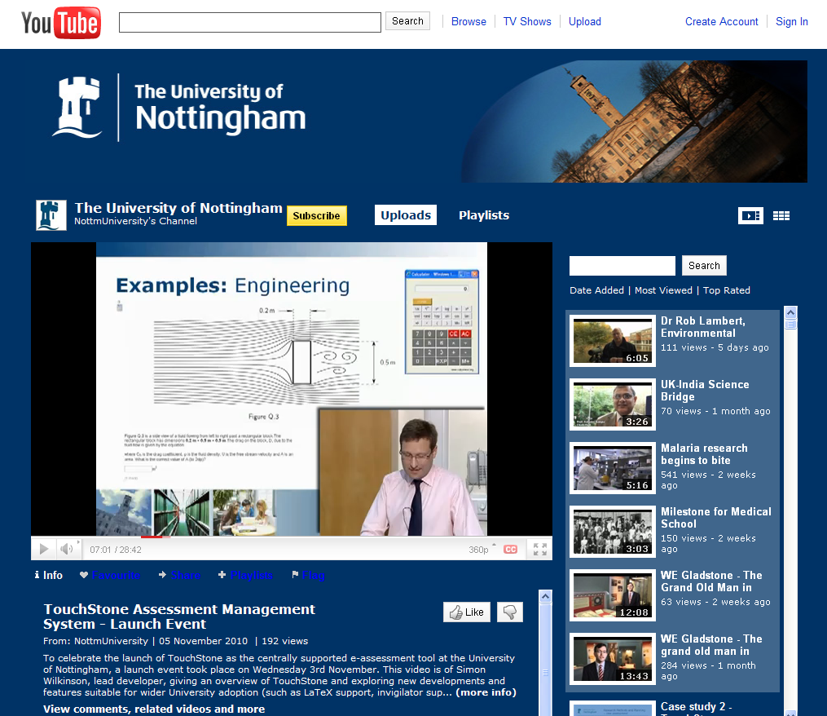
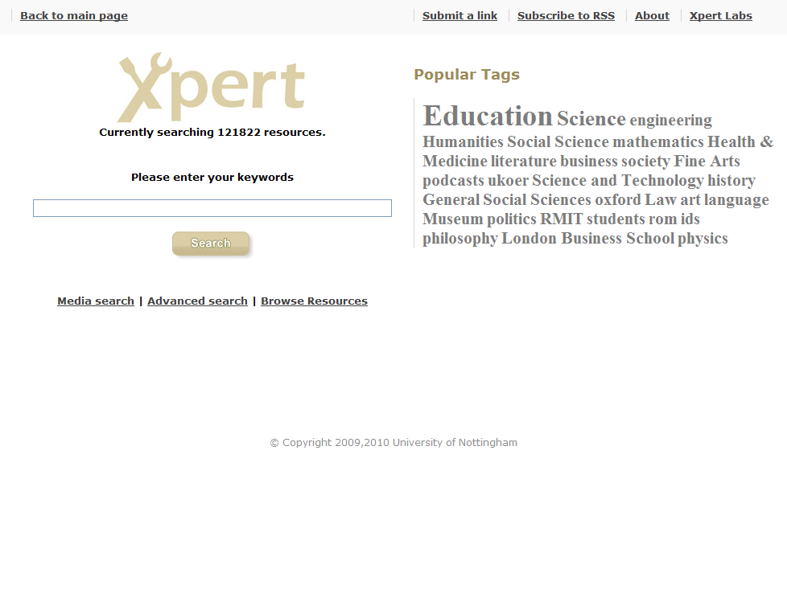
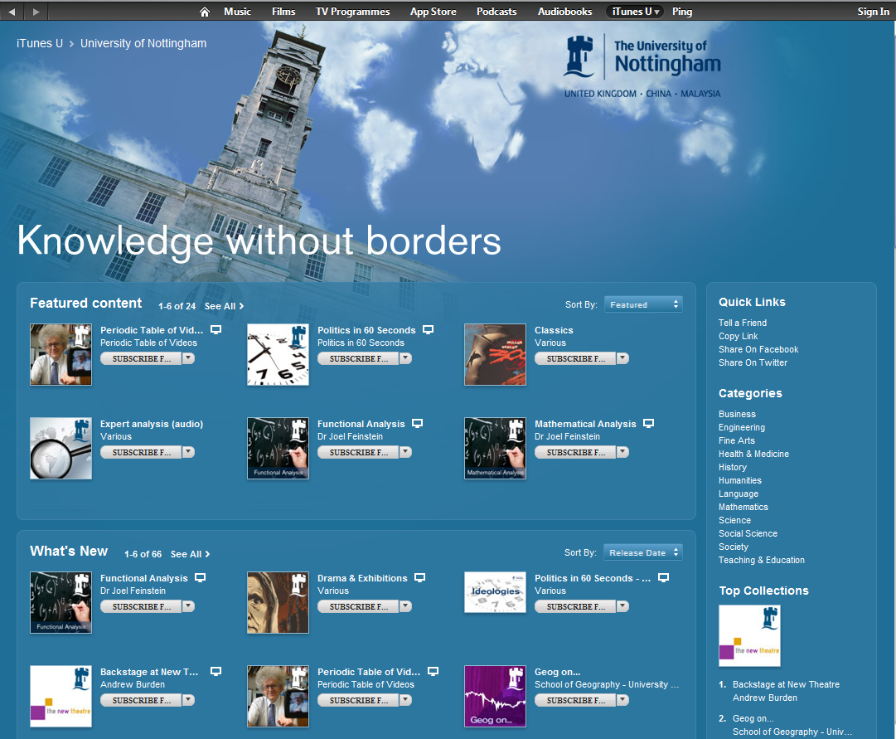
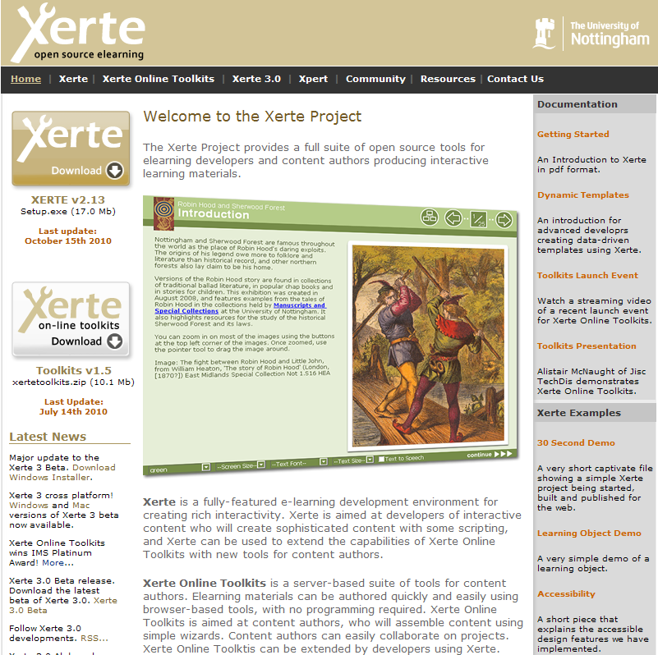

Slide 9
XPERT Media Attribution Service
http://www.nottingham.ac.uk/xpert/attribution/
Notes:
Over 700 images attributed a day
Time savings on appropriate citation by students and staff, but real savings come with items being published as OER!!!

Slide 10
What support is provided?
Learning Technology Support
Dedicated Open Learning Support Officer
Promote new tools/services
Provides support and advice
Upload and cataloguing within OER repository
Workflows to facilitate publication
Resources can be:
Sent to team directly by email
Submitted online via U-Now website
School based initiatives

Slide 11
Digital Literacy Workshop
Aim: to inform and promote re-use of OER
Discover or source Creative Commons educational resources and images
Use and attribute creative commons resources appropriately
Explore the process and licences involved in creating and publishing OERs as well as their own attitudes
Run 6 times over 18 months
Optional module on PGCHE since 2010-11
Open for Learning RLO
available on U-Now

Slide 12
Impact Case Studies
www.nottingham.ac.uk/open

Slide 13
Who is using/re-using it?
Schools, to promote and inform
Academic staff are using open resources to save time and to reduce costs
Students at Nottingham campus in Ningbo have been using U-Now to better understand how the University is connected as well as to support their studies
Notes:
Staff using it to save time– we have the geography case study, engineering also used the document, 20+ staff out of 100 that filled in the survey last year said they had used other peoples OER.
Several have confirmed that they use it for themselves and with students.

Slide 14
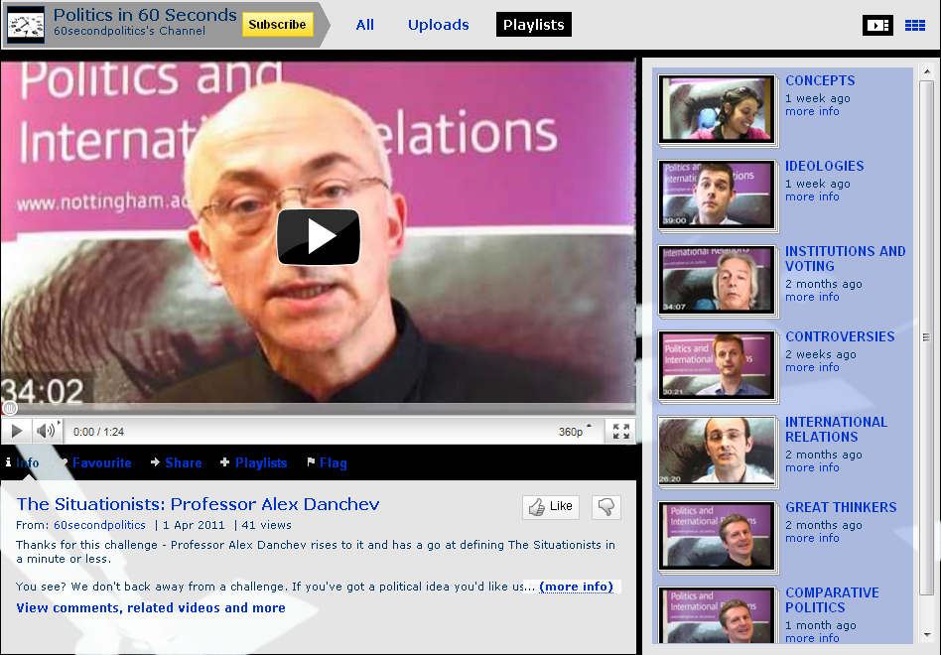
School of Politics and International Relations
Impact: School wide engagement
Over 12-18 months
Embraced new technology
Transformational change
Over 600 credits committed to U-Now
Pilot publishing open learning in online prospectus
RSS links to School website
iTunes U and YouTube channels
Notes:
To name but one school… recent notable inclusions is theology which is embracing YouTube and iTunes U
http://www.youtube.com/user/NottmUniversity#g/c/52C4CE0B7593CFC8

Slide 16
Academic reuse
Dr Richard Field (School of Geography – Nottingham)
Handout for SPSS
200 students
Had limited time to put it together
Open Nottingham team advised – try OER
Notes:
Colleagues in Open Nottingham team pushed him towards Xpert… and found something useful on the first page.

Slide 17
What was changed?
Context: Preference: Accessibility: Saved time: Student handout: | Changed some of the instructions Changed some of the English Changed font From 1 day (without screen shoots) to 30 minutes To provide support on the use of spss
Notes:
One day design time was text only…
Using this resource significantly saved time and produced better results!

Slide 18
Was it useful?
Surveyed 51 students who were given the handout:
Quality/Usefulness
OER specific – briefed on OER but not validated
Notes:
We explained what OER was to the students… but no actual validation that they understood the difference between OER and on the web.
Indication of how students use resources found on the web, in as much as how they use OER
If they assume they are talking about OER, do they understand the expectations of licencing around them?

Slide 19
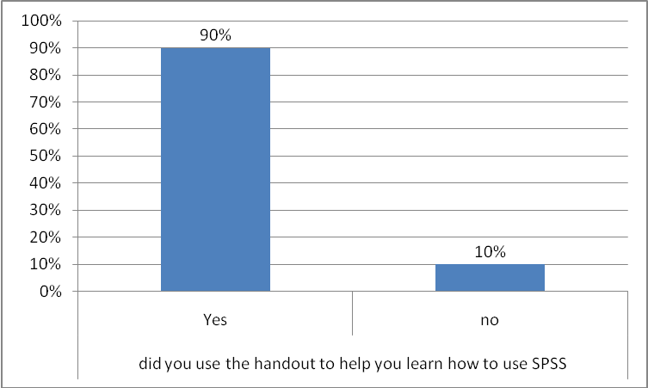

Slide 20
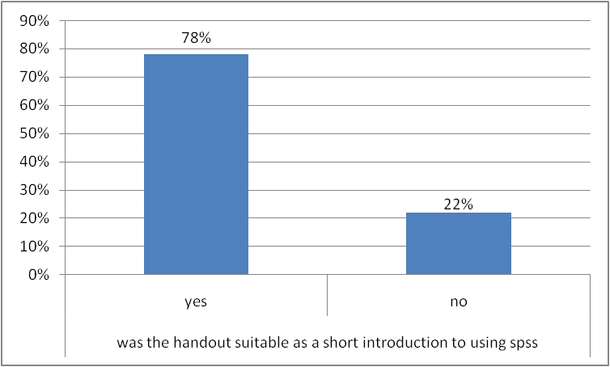
Notes:
Out of the 22% who said it wasn’t useful, the comments indicate that they wanted more detailed info than was provided rather than the resource was useless.

Slide 21
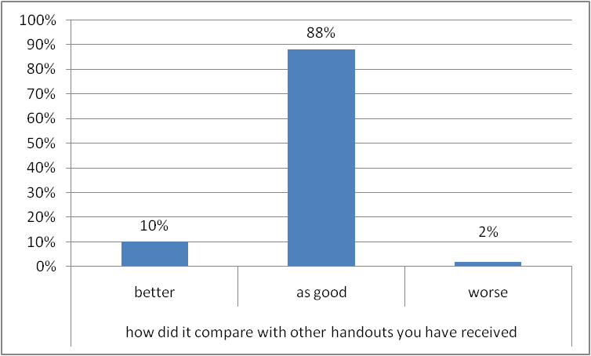
Notes:
Closes the circle. These stats show that the resources were as good or better than existing handouts, so no noticeable drop in quality with a significant saving in time.

Slide 22
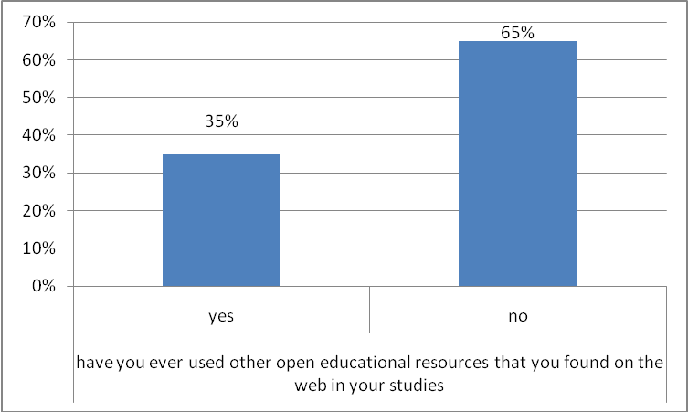

Slide 23
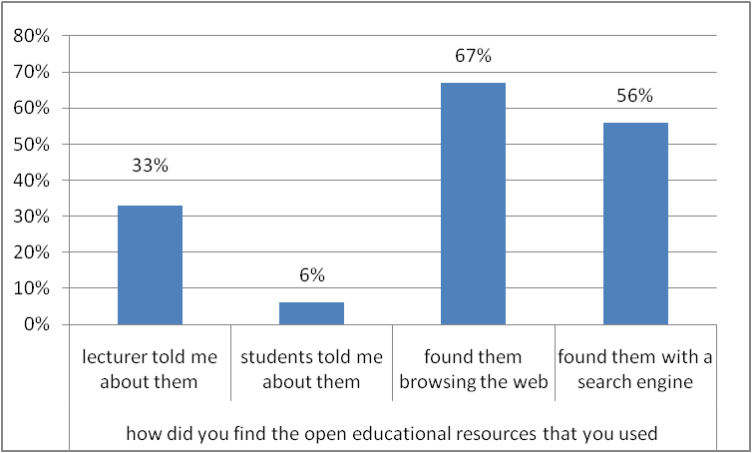
whe
r
e
wha
t
?
Notes:
If the lecture told them about OER, where did they tell them to go and what advice was offered around their reuse?

Slide 24
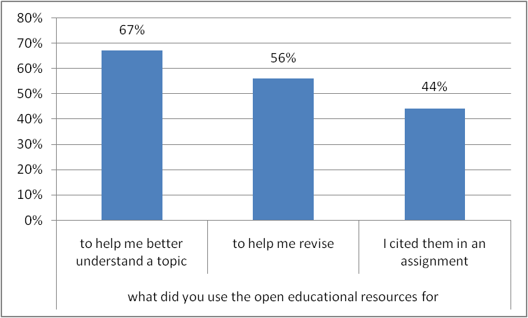
?
?
Notes:
Interesting to see how high web based resources were cited to help students revise and included within assignments.
If the students are talking about OER, how are they being cited and how is this being received by their academic tutors?

Slide 25
Key findings
Practical reuse (anyone can do this)
Reuse to be found in the everyday?
OERs can save time without compromising quality and students are using them
Economies of scale
Understanding how students use web based educational resources will help inform OER
Notes:
Practical reuse… does reuse happen all the time? Are these examples too mundane to capture?
There is much debate over whether demonstrating reuse is possible or important, and you will hear further about this today but at Nottingham of the courses submitted under BERLiN:
83% contained images without any associated attribution
17% included graphs or tables without associated attribution
34% contained referenced text, sourced and referenced correctly
Evidence that reuse does occur perhaps.

Slide 26
Knowledge Without Borders
International reuse @ UNNC
Giovanna Comerio and Dr Philippe Delcloque
Division of International Communications, Ningbo
Listening activities for beginners in French
http://tinyurl.com/ONCaseStudy

Slide 27
Student Use
Students given links to U-Now to access materials
“good results not only for the listening but also for the culture knowledge and the enhancement of students autonomy.”
Notes:
Not direct quotes, what the academic reported had been said to her.
We will be validating this feedback through focus groups in the near future.

Slide 28
Student Use
“….interested in using U-Now resources…because it was like a safe “sandbox”, before starting browsing and evaluating academic resources in the Web.”

Slide 29
Student Use
“…interested in the concept of “open” learning sources as learning opportunity for everybody.”

Slide 30
Student Use
Level 2 designing for level 1:
“they were pleased to collaborate….creation of free learning resources, as taking a responsible role in the community/society”
Notes:
Second year students were asked to ‘repurpose’ or build on the materials on U-Now for first year students, to help them understand the module better. These resources will be republished on U-Now and become part of the module in the following year.
For example, a personal experience of ‘shopping in France’ by a second year students will be added, to assist in listening skills for first year students, context and breadth of examples.
Example of peer support and student reuse through open learning.

Slide 31
Student Use
“….personal satisfaction in becoming an “author” in French for something official”.

Slide 32
Knowledge without borders
“they are now using some of the (unow.nottingham.ac.uk) resources created by other lecturers and they are understanding that we are one university for true!”

Slide 33
Student OER
Next phase includes student created materials being added as OER to a new U-Now module

Slide 34
Next Steps
Open Nottingham is a Learning and Teaching ‘Grand Challenge’
Online prospectuses
LMS (Moodle) integration
Update of U-Now
Promoting staff contributions
Understanding students use of web based resources
Reward and recognition?

Slide 36
