Slide 1
Technology for Open Education Training with Open E-resources TOETOE
http://www.flickr.com/photos/cherylharvey
Created by Alannah Fitzgerald
Research Fellow at the English Language Centre, Durham University
Teaching Fellow at the Support Centre for Open Resources in Education, Open University

Slide 2
Presentation Overview
Open Content
Building Web Corpora
Open Tools
Concordancing Digital Language Libraries
Designing Online Language Activities
Open Educational Resources
Developing Training and Guides
Open Access
Clearing Licensing Rights for OER Development

Slide 3
Greenstone
http://www.greenstone.org/

Slide 4
FLAX
http://flax2.nzdl.org/greenstone3/flax?page=home

Slide 5
Online Language Activities
http://flax2.nzdl.org/greenstone3/flax?page=activity

Slide 6
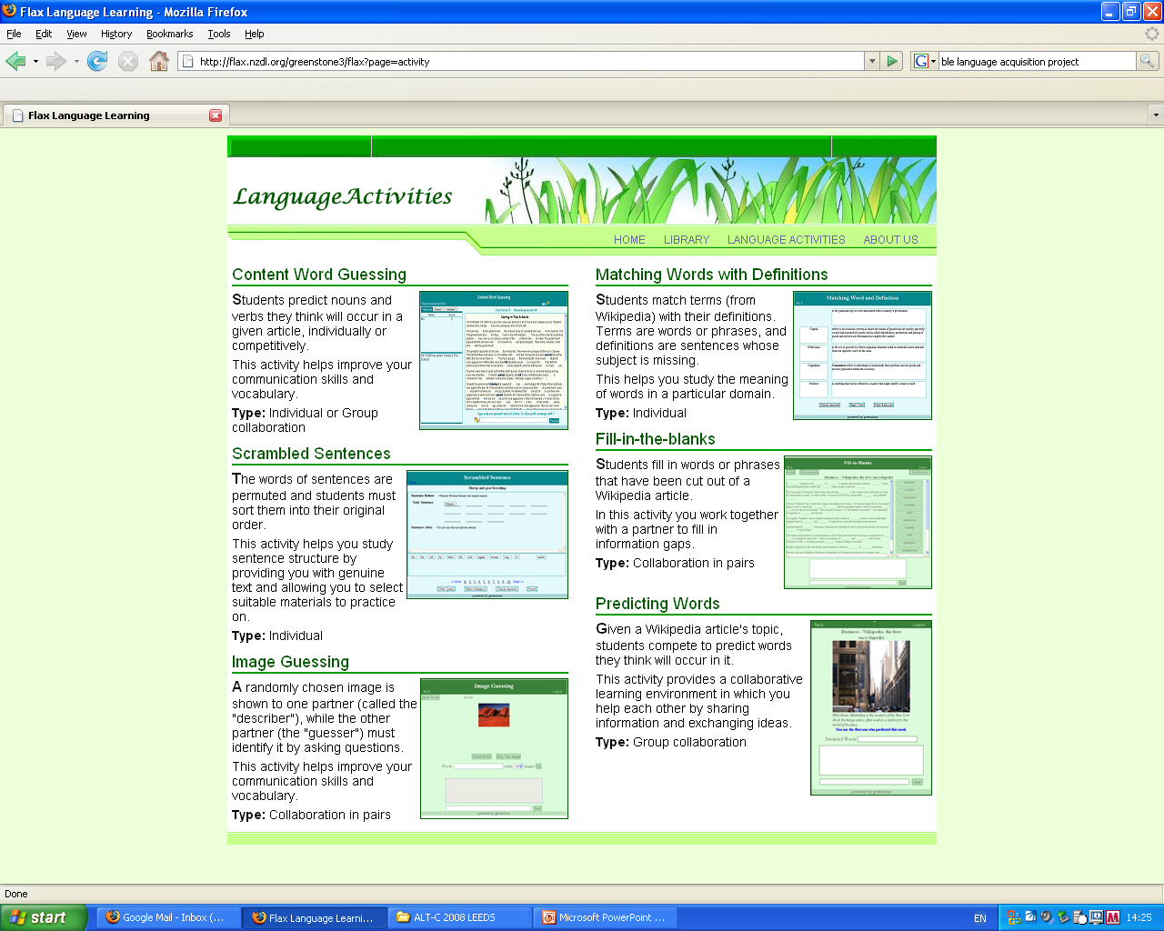
Notes:
August 16, 2010
6

Slide 7
BNCweb
http://bncweb.info/

Slide 8
Web Pronouns Phrases OER
http://www.youtube.com/watch?v=Ns4nXsZQmUA

Slide 9
Web Phrases OER
http://www.youtube.com/watch?v=n67FBqBFm6I

Slide 10
Compleat Lexical Tutor
http://www.lextutor.ca/

Slide 11
Web Collocations OER http://www.lextutor.ca/vp/
http://www.youtube.com/watch?v=iyZgZhHMovI

Slide 12
Future of FLAX
http://flax.nzdl.org/resources/flax_video/flax_video.html

Slide 13
English for Academic Purposes OER 1
http://resources.jorum.ac.uk/xmlui/handle/123456789/2963

Slide 14
EAP for the Social Sciences
Writing at Masters Level by Ursula Wingate, 2009

Slide 15
Signposting in EAP
Writing at Masters Level by Ursula Wingate, 2009

Slide 16
Use of Instructional Steps (Signposting) in Different Academic Disciplines
“…from Sociology and Anthropology, where IS steps appear to be avoided, through to Business and Politics, where they are optional, to Law, where they appear to be obligatory. Student essays do not show such specialisation... This suggests that, for these student writers, the decision to use an IS step is a relatively common one, regardless of subject area, whereas for article writers, the choice to use an IS step is strongly dependent on academic discipline.” (Durrant & Mathews-Aydınlı, 2010)

Slide 17
Open Access
The Directory of Open Access Repositories – OpenDOAR
http://www.opendoar.org/index.html

Slide 18
Gratis versus Libre
Open Access for zero price (Gratis)
Open Access with few or no restrictions (Libre)

Slide 19
English for Academic Purposes OER 2
Developing OER for EAP based on Open Access publications
Research-led teaching of EAP
Access to specific discourse communities and peer-review
A function-first approach to identifying formulaic language (Durrant & Mathews-Aydınlı, 2010)
Developing functional vocabularies as OER

Slide 20
TOETOE Research & Dev Territory
High
Open Tools
OER
Educational Design
Open Content
Open Access
Low
Educational Use
High
Corpora
Concordancers
Training
Learning Objects

Slide 21
TOETOE Research & Dev Territory
High
Open Tools
OER
FLAX
BNC
Vocabs
Educational Design
FLAX
BNC
Open Content
Open Access
Low
Educational Use
High
Corpora

Slide 22
TOETOE Research & Dev Territory
High
Open Tools
OER
LEXICAL TUTOR
FLAX
Educational Design
BNC WEB
Open Content
Open Access
Low
Educational Use
High
Concordancers

Slide 23
TOETOE Research & Dev Territory
High
Open Tools
OER
VIDEOS
OER 4 OER
GUIDES
Educational Design
Open Content
Open Access
Low
Educational Use
High
Training

Slide 24
TOETOE Research & Dev Territory
High
Open Tools
OER
ONLINE
ACTIVITIES
EAP MATS
Educational Design
Open Content
Open Access
Low
Educational Use
High
Learning Objects

Slide 25
TOETOE Research & Dev Territory
High
Open tools
OER
Educational Design
Open content
Open access
Low
Educational Use
High
Corpora
Concordancers
Training
Learning Objects

Slide 26
TOETOE Research & Dev Territory
High
Open Tools
OER
links
links
Educational Design
links
Open Content
Open Access
Low
Educational Use
High
Corpora
Concordancers
Training
Learning Objects

Slide 27
TOETOE Research & Dev Territory
High
Open Tools
OER
links
Educational Design
links
Open Content
Open Access
Low
Educational Use
High
Corpora
Concordancers
Training
Learning Objects

Slide 28
TOETOE Research & Dev Territory
High
Open Tools
OER
Educational Design
Open Content
Open Access
Low
Educational Use
High
Corpora
Concordancers
Training
Learning Objects

Slide 29
TOETOE Research & Dev Territory
High
Open Tools
OER
Educational Design
Open Content
Open Access
Low
Educational Use
High
Corpora
Concordancers
Training
Learning Objects

Slide 30
TOETOE Research & Dev Territory
High
Open Tools
OER
Educational Design
Open Content
Open Access
Low
Educational Use
High
Corpora
Concordancers
Training
Learning Objects

Slide 31
TOETOE Research & Dev Territory
High
Open Tools
OER
Educational Design
Open Content
Open Access
Low
Educational Use
High
Corpora
Concordancers
Training
Learning Objects

Slide 32
TOETOE Research & Dev Territory
High
Open Tools
OER
Educational Design
Open Content
Open Access
Low
Educational Use
High
Corpora
Concordancers
Training
Learning Objects

Slide 33
TOETOE Research & Dev Territory
High
Open Tools
OER
Educational Design
Open Content
Open Access
Low
Educational Use
High
Corpora
Concordancers
Training
Learning Objects

Slide 34
TOETOE Research & Dev Territory
High
Open Tools
OER
Educational Design
Open Content
Open Access
Low
Educational Use
High
Corpora
Concordancers
Training
Learning Objects

Slide 35
TOETOE Research & Dev Territory
High
Open Tools
OER
Educational Design
Open Content
Open Access
Low
Educational Use
High
Corpora
Concordancers
Training
Learning Objects

Slide 36
TOETOE Communities Of Practice
TOETOE
Open Source Tools
(Greenstone)
Open Content
(Corpus Linguistics)
Open Access
(BALEAP)
OER
(SCORE)

Slide 37
TOETOE Communities Of Practice
TOETOE
Open Source Tools
(Greenstone)
Open Content
(Corpus Linguistics)
Open Access
(EAP)
OER
(SCORE)

Slide 38
Thank You
Alannah Fitzgerald (TOETOE): a.t.d.fitzgerald@durham.ac.uk
http://www.slideshare.net/AlannahOpenEd
http://twitter.com/#!/AlannahOpenEd
Shaoqun Wu (FLAX): shaoqun@cs.waikato.ac.nz
FLAX Team: http://flax.nzdl.org/greenstone3/flax;jsessionid=7FCBCFCD8E838FC640141C17D9511175?a=fp&sa=about
Reference:
Durrant, P., & Mathews-Aydınlı, J,. (2010)
A function-first approach to identifying formulaic language in academic writing, English for Specific Purposes

