Slide 1
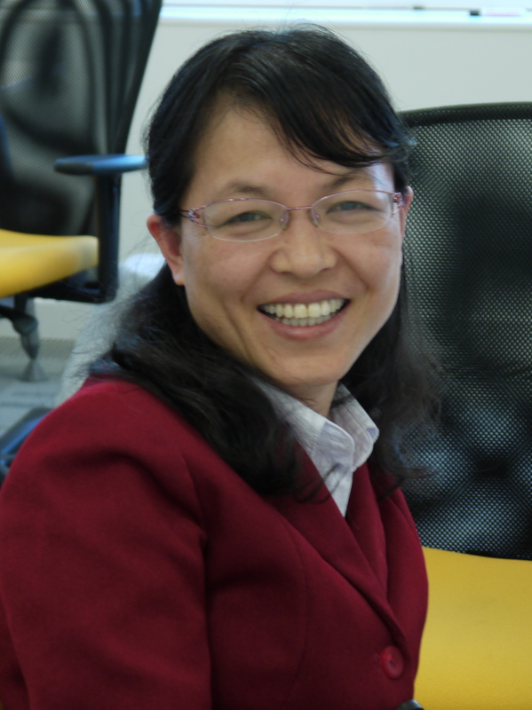
The National Courses of Excellence Program: OER for Higher Education in China
Elpida Makriyannis
I.E.T. Academic Team
The Open University
Jia Yimin
Future Education Research Centre South China Normal University
olnet.org
Notes:
1

Slide 2
http://www.flickr.com/photos/scissorhands33/3430164569/
Fellowships for researchers and
practitioners who wish to contribute to the understanding of the OER design and use worldwide
olnet.org

Slide 3
The National Courses of Excellence Program
Phase A: National Excellence Courses Program (2003-2007)
Phase B: The China Quality Project (2007-2011)
£225 million program
1,000 universities across China
3,900 National Courses of Excellence, 6,000 Provincial Courses of Excellence, and over 10,000 University Courses of Excellence
Levels: undergraduate, postgraduate & vocational
Disciplines: technology, science, agriculture, medicine, philosophy, law, management, education, economy, history, literature, politics

Slide 4
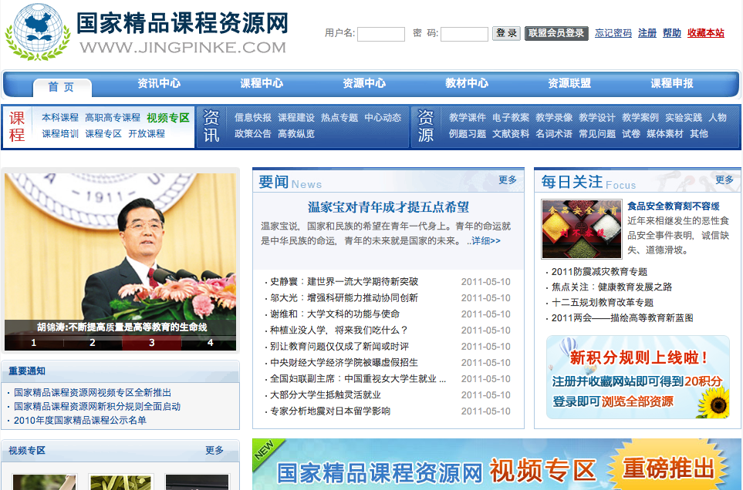

Slide 6
How to re-think traditional models and improve the pedagogy in higher education?

Slide 7
How to cater for the ever-increasing demand of young people across China to acquire
University education?

Slide 8
How to ensure that the highest quality teaching methods are practiced and resources used by teachers and students?

Slide 9
How to encourage professors to teach undergraduate courses and mentor young teachers?

Slide 10
How to equally share high quality teaching materials and methods from the East to the West?

Slide 11
Best Teaching Courses Selection Model
National Course of Excellence
Deposit Course Online
Voted by experts in relevant discipline
Experts meet for evaluation and selection
Evaluation and selection by experts
Course Suitability Verification
Recommended
by
professionals
Recommended
by
city / province
Recommended
by
teaching committee
Provincial Course
of Excellence
University Course of Excellence

Slide 12
Copyright Law on National Excellence Course Program
(Ministry of Education, China)
“All universities and chair lecturers, when applying for the title of Course of Excellence, are considered to have agreed to grant a license to use the online contents for non-commercial purpose during the time the course benefits from the title of Course of Excellence. A National Course of Excellence must be online as required and openly provided for free to all higher education institutions in China. Higher education institutions and lecturers must promise that the online content does not breach other’s Intellectual property rights.”

Slide 13
Teacher and Student Activities around the Resources (Cross-institutional)
Teaching teams from participating universities collaborate to improve and update the materials
Student groups from participating universities meet to discuss, select and work on research topics that will form the final resource
A community of teaching teams and students are responsible for sustaining and updating the teaching materials
A senior student mentors and encourages student group members, helping to control the quality of the final resource
Teachers take sections of the materials that are useful to their teaching and re-mix / re-use
Teaching teams select the best student resources and place them in the repository
Students select tasks depending on their interests and abilities

Slide 14
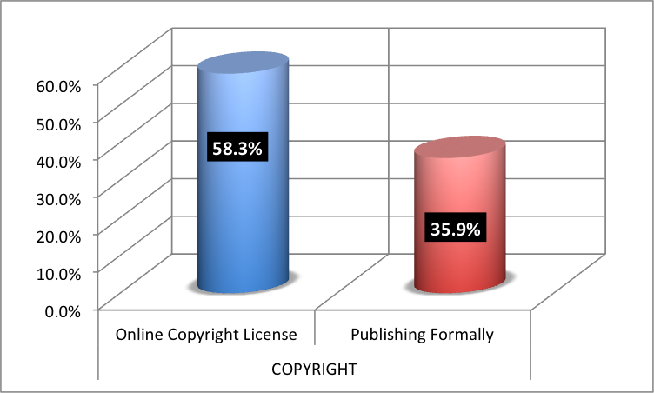
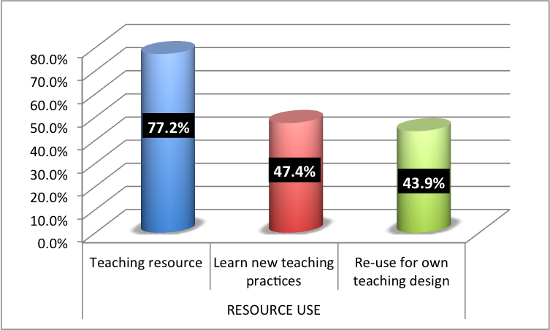
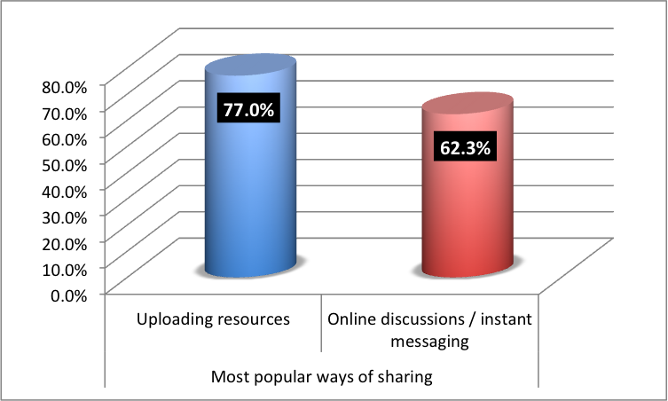
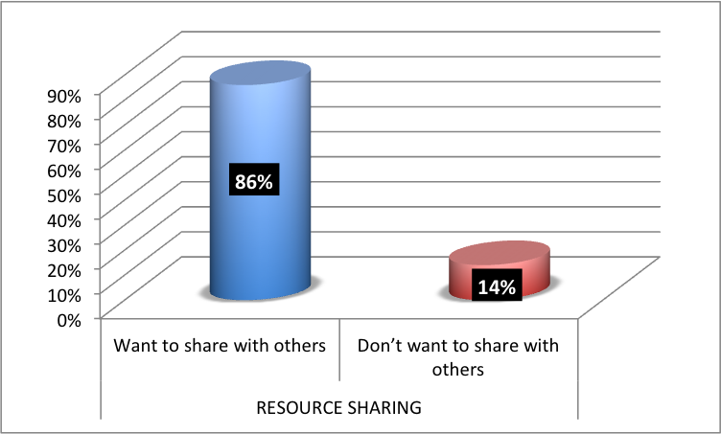
National Course of Excellence: What the teachers think

Slide 15
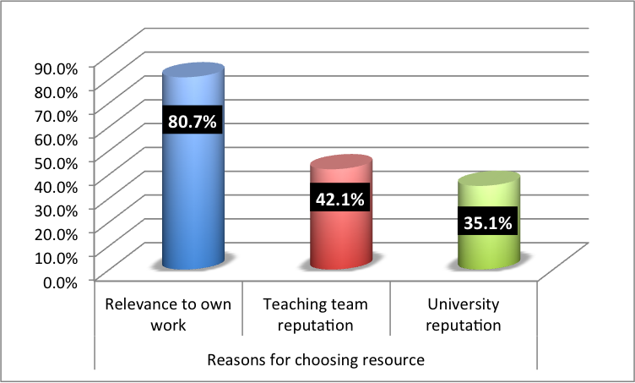
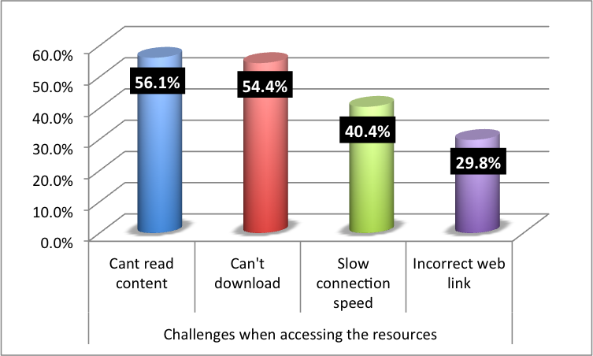
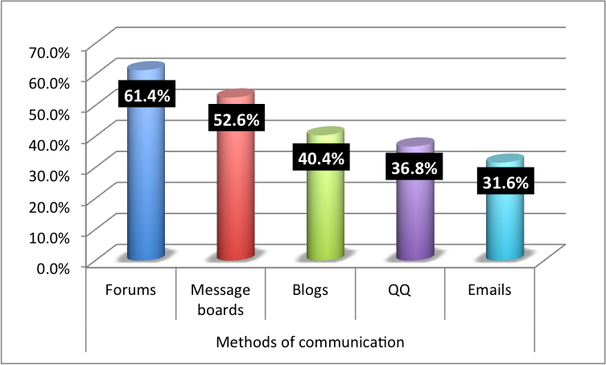
National Course of Excellence: What the teachers think

Slide 16
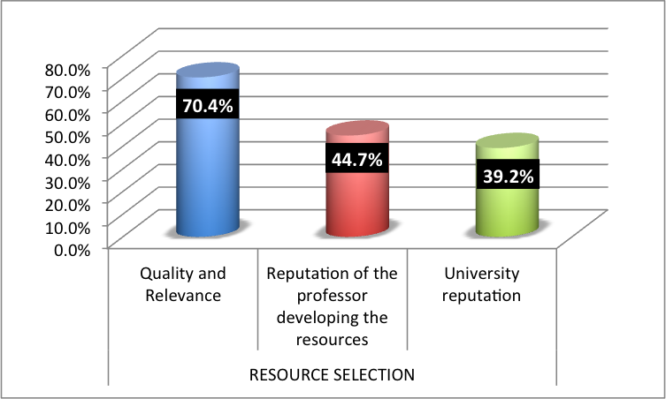
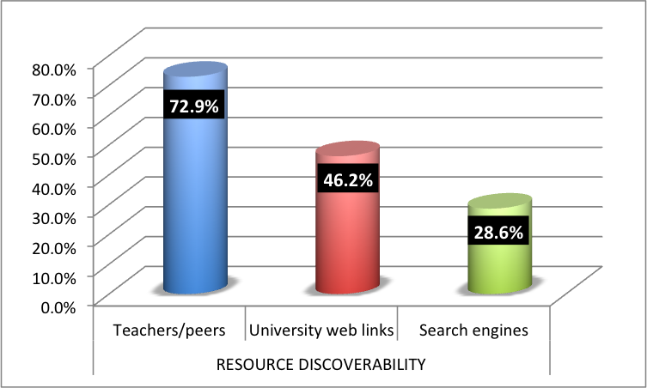
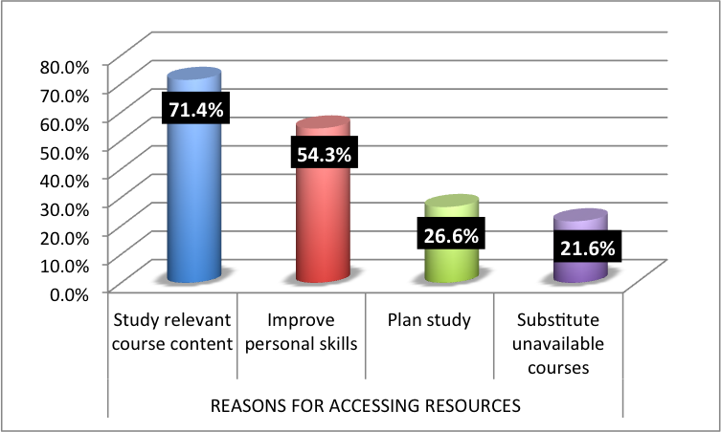
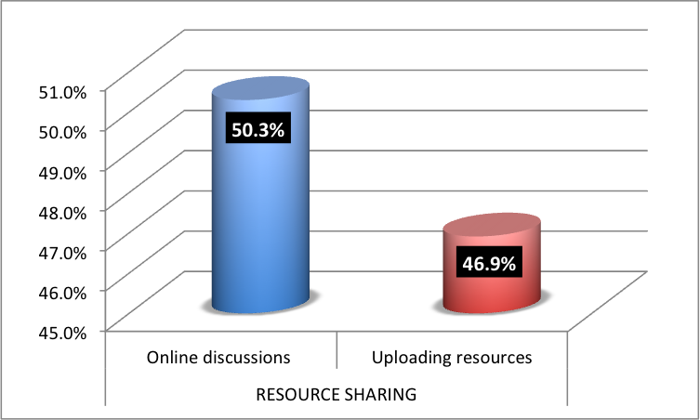
National Course of Excellence: What the students think

Slide 17
What Next?
Chinese National Excellence Courses now entering Phase C (2011-2015)
Main focus will be on distance learning, e-learning and long-life learning
In collaboration with our fellows and partners in China, OLnet plans to:
Strengthen the sharing of know-how and expertise
Collect, analyse and disseminate successful cases of using Chinese National Courses of Excellence
Use the resources and tools of OpenLearn for teachers and students at participating universities in China

Slide 18
谢谢 Xie Xie! Thank you!
Dr Elpida Makriyannis
e.makriyannis@open.ac.uk
QQ: 1279245453
Twitter: NovusNous
Skype: emakriya
Mrs Yimin Jia
jiaym2003@yahoo.com.cn
QQ: 41815983
Twitter: jiaym
Skype: jiayimin

