Slide 1
“New and Improved, Now Shared with You”
A Case Study Following the Lifecycle of
32 Nursing RLOs Developed with
Xerte for OER Release
Colleen McCants
Information Services Learning Technology
Andy Meal and
Heather Wharrad
School of Nursing, Midwifery and Physiotherapy

Slide 2
Background
Division of Nursing at Nottingham has been developing OER in the form of RLOs with UCEL and RLO-CETL since 2002
2006 University of Nottingham Nursing Students were reporting problems with with older Authorware-based CAL
CAL difficult to access on high-end machines, not working in various ways, i.e., broken links, content apparently moved.
Andy Meal, Heather Wharrad and others from Nursing met to assess problems with CAL and consider solutions
Subdividing the CAL into smaller bits as RLOs was a natural step, so bid was put forward to ISLT in 2007
Notes:
UCEL: Universities' Collaboration in eLearning
RLO-CETL: Reuseable Learning Objects created with the Centre for Excellence in Teaching and Learning
Authorware was a flowchart-based visual programming language.
Macromedia Authorware was absorbed by Adobe Systems in 2005.
Windows Vista released in 2007.
The Authorware player has issues with IE7, and later with Windows Vista, due to ‘protected mode’ and runtime errors due to a bug in AW’s implementation of ReadURL() Javascript function.
In 2007, Adobe discontinued development of AW, but continued with Director.

Slide 3
Ageing Computer-Aided-Learning
University CAL applications only run on campus or from disk
Established need to extract and improve on the content
Time and resources investment vs., paying yearly subscriptions
Achieving sustainability whilst avoiding future pitfalls
Solving the problem once, & for others facing the same obstacle.
New graphic content needs clear copyright trail
With additional effort, RLOs can be created for CC release, yielding free, quality, core OER resources.
Notes:
Some lecturers tried to develop CAL for release on CD for students to use off-campus.
A.D.A.M. medical image resource was meant to cost 3000£ / year site subscription cost, (and still looked outdated)
Why redevelop resources for the short-term?

Slide 4
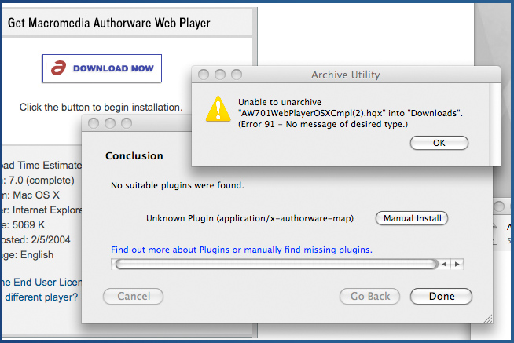
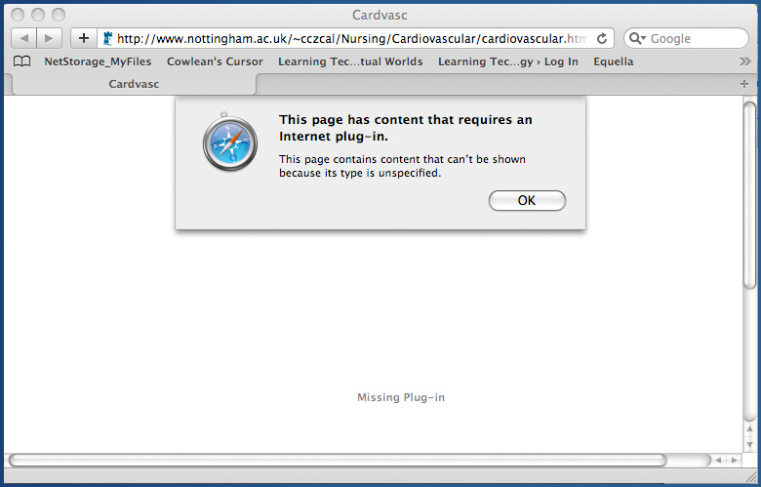
Typical student comments about CAL…
I can’t access CAL programs off campus
The links don’t work, has it been moved?
It won’t play on my Mac!
The network is so slow.
My new machine has trouble viewing CAL
Notes:
Authorware was a flowchart-based visual programming language.
Macromedia Authorware was absorbed by Adobe Systems in 2005.
Windows Vista released in 2007.
The Authorware player has issues with IE7, and later with Windows Vista, due to ‘protected mode’ and runtime errors due to a bug in AW’s implementation of ReadURL() Javascript function.
In 2007, Adobe discontinued development of AW, but continued with Director.

Slide 5
How lecturers saw the problem…
Comments about older CAL…
Content is complex, variable in detail, lacks clear focus.
Too much info in one place, have to ‘poke around’ and backtrack
I could go to a book and find the info in half the time.
Students must often guess answers in order to proceed.
CAL assumes prior knowledge or tests before info is provided
Standard of eLearning materials has risen.
Older materials now seem under-developed
Diagrams are not very good, not usefully illustrated.
Images and explanations need updating.
Clicking on bullet points to reveal new items gets tedious
Notes:
These are paraphrased snippets from a 2006 review of lecturer feedback, involving:
Andy Meal, Heather Wharrad, and Richard Windle

Slide 6
How the ISLT Section saw the issue
Managing older CAL, achieving sustainability.
Internal ‘Back Catalog’ update already underway, i.e., systematic extraction of all CAL text and images from Authorware
Project to recreate Nursing CAL was supported under the requirement for online study credits towards Berlin Project
Berlin Project’s goal was to enhance and expand Nottingham's existing Open Educational Repository, u-Now, one of the first OERs in the UK and a member of the international Open Courseware Consortium.

Slide 7
Assumptions about reformatting to RLOs
RLOs must stand alone, not refer to other RLOs or CAL.
Content should be clarified and subdivided by subject.
Subjects may be regrouped to make more sense in context.
RLO organisation should be linear and ‘directive.’
The scope, but not number of the RLOs is predefined.
Conversion to RLOs should entail raising visual standards.
Notes:
How do we get around problems existing before?

Slide 8
Xerte and collaboration
Using the XERTE Flash-based XML engine as the development environment enabled non-site-specific collaboration and straightforward updates by all contributors.
In-house-developed 'Xerte Toolkits' was considered optimal for sustainable delivery.
Toolkits is open-source and accessible, with a growing community of support.
Toolkits allows ongoing corrections/changes, unlike CAL created with Authorware.
Multiple authors can work on same set of RLOs, improving workflow.

Slide 9
Cloud collaboration
Using the University’s Workspace platform for project management enabled ‘cloud’ collaboration and reduced email proliferation later in the project when used to preview graphics.
Notes:
Who makes Workspace?-----The product is called 'Confluence' (which we have re-branded locally as 'workspace' produced by an Australian company called 'Atalassian'. It is the world's most popular collaborative platform - http://www.atlassian.com/software/confluence

Slide 10
Why use Workspace?
Accessible anywhere, anytime
Useful as a reference site
Track progress on actions
Handy place to make notes (personal space available)
Online discussions reduce travelling to meetings
Ends cycle of iterative emails - get update notices of changes, then delete
Search and version control
Collaborative writing
Post news, documents, share ideas
Ease of use
Notes:
Long email trails reduced – several with 20+ back and forth messages
Ease of use is most important

Slide 11
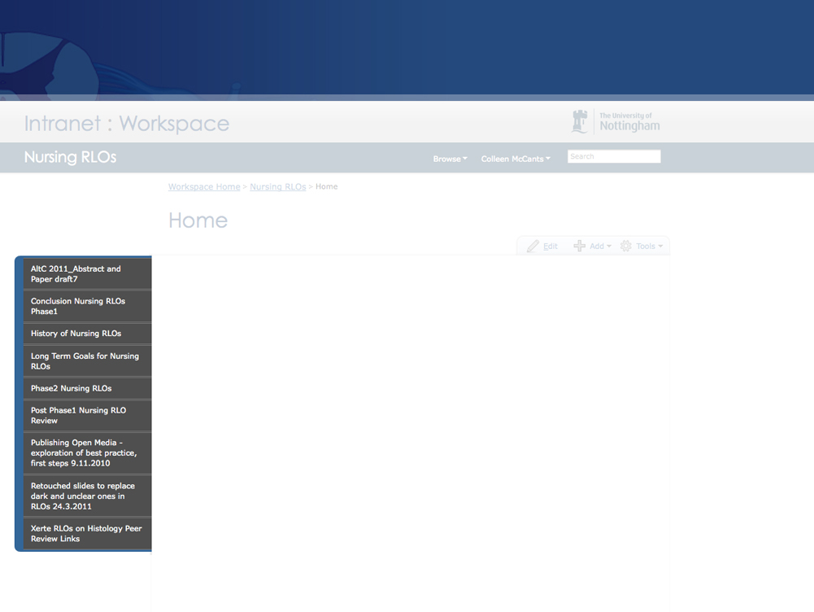
How did Workspace help?
Workspace allowed sharing of:
Updates, meeting minutes
Project timelines and task lists
Previews of graphics
Password-protected links to RLOs, for peer-review
Connected Campus project management documents
Exit strategies
Plans for the future
A promotional outward-facing front-end website http://workspace.nottingham.ac.uk/display/nursingRLO/Home
Notes:
Connected Campus, a term used by a number of HE institutions to mean different things, nor is it the ‘chat and flirt’ between students network, but in this case:
The Connected Campus initiative is a programme management framework led by IS and designed to improve the way the department supports the research, learning and business activities of the University.
The initiative consists of a series of developmental programmes, each made up of several projects. These projects aim to address specific strategic objectives for the University. Each project has a project manager who coordinates the activity across the different development teams.

Slide 12
Development
Collaboration over a two-year period resulted in 32 Exemplar-level RLOs, out of a projected number of 40, with new content incorporated.
Bespoke animations were designed for multiple reuse, with alterations to suit.
Extra development time on some graphics led to later efficiencies.
Accurate medical graphics are crucial to student comprehension of complex systems.
The structure was adapted to benefit from more detailed graphics, reducing number of RLOs needed to explain related concepts.
Need for novel solution led to addition to Xerte functionality – ‘morphing zoom’
Notes:
Exemplar=Top notch
Nervous system reused a number of graphics.
Exemplar: Webster's 1913
Something fit to be imitated; an ideal or model.
Something typical or representative of a class; an example.
A pattern after which others should be made; an archetype.

Slide 13
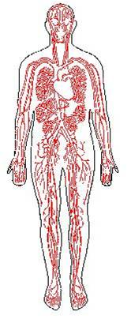
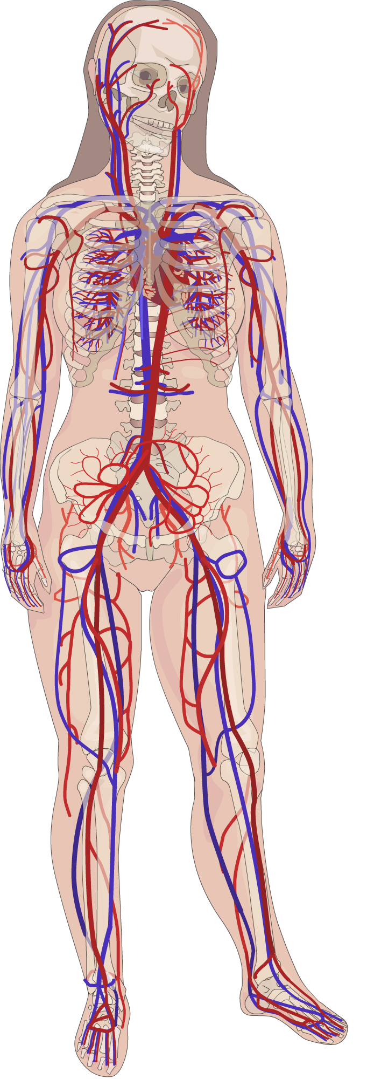
Improvements to Graphics
Older Authorware CAL
Unknown or lost source
Lo-res, non- scalable
Single use
New Flash graphics in Xerte
Bespoke graphics
Scalable to poster size
Potential for multiple use
Adaptable, can be animated
Layers of detail can be revealed
http://sonet.nottingham.ac.uk/cal/campuscal.html
Notes:
Pixel based to vector. Invest the time, reap the benefits of reusability.

Slide 14
CAL interface
Sonet pages
Notes:
First impression, Blood and guts, and a maze of pathways.

Slide 15
Xerte interface
Notes:
Fresh and clean, accessible, vector-based.

Slide 16
Challenges Met
Changes and revisions took up additional time, resulting in novel solutions
Lack of research assistant, change in project management
Change in project manager
BUT, project first phase was completed in original meeting's estimated number of days.

Slide 17
Timeline
Phase I
2006: Division of Nursing begin review of Anatomy and Histology CAL
June 2008: Andy Meal requests help updating old CAL graphics
Sept 2008: First work on Nursing templates in Xerte Toolkits
Sept 2010: First phase of project completed (work not continuous)
June 2011: Chance to revise RLOs following peer review + student feedback
Aug 2011: RLOs compiled w/ metadata for inclusion in u-NOW via Equella database
Sept 2011: Official CC release via u-NOW website, + standalone graphics via Flickr ®

Slide 18
Timeline
Phase II
Review and track student usage with Moodle VLE
Evaluate Toolkits for delivery of content
Educational evaluation, via CETL standard/route
Evaluate further Nursing CAL for conversion to RLOs via same route

Slide 19
Lessons Learned
Resized png files display better in Xerte than resized jpegs
Xerte needs a placeholder in first frame of Flash timeline to assess file dimensions
Don’t try to remain logged into Xerte toolkits simultaneously with collaborators
Determine level of detail required for animations.
Would a static image or simple concept drawing suffice?

Slide 20
Lessons Learned
Efficiencies can be gained by repurposing related graphics
Good project management streamlines workflow
Cloud computing can save a lot of time and grief
Weekly development meetings can expedite progress

Slide 21
How many of our students will use the RLOs?
Impact:
MNursSci students using 29/32 RLOs in 1st year = 60+
MNursSci students using 3/32 RLOs in 2nd year = 60+
MSc students using RLOs now = 15
BSc students (200-250), to be given access in Sept 2011
Potential use by Medical students (+200/yr), to be given access in Sept 2011
Veterinary Science and Archaeology are interested in using the RLOs, in sync with wider release via the University’s U-NOW website.
Notes:
VET science and Archaeology showing interest in the RLOs demonstrates economies of scale that OER can bring.
What is difference between MNursSci and MSc students?
MNursSci This course is the only undergraduate Masters degree in England for nurses and has been successfully running for over ten years. Although this is a 4-year course, delivery follows the University’s term timetable allowing students freedom to experience traditional university life. Qualification: MNursSci and RN
Duration: 4 years full-time, 50% study & 50% practice
MSc (Advanced Nursing Masters)

Slide 22
Results:
32 RLOs
http://www.nottingham.ac.uk/toolkits/

Slide 23
Conclusion
At the time of writing, student feedback data is being collated into a spreadsheet, but initial impressions are as follows:
Access was easy and trouble-free, certainly compared to the old Authorware packages.
Students liked being able to access RLOs anywhere, anytime.
The visual components and interactivity were perceived as important by most students.
The RLOs were easy to navigate.
Most students would like more RLOs.
There were no major, consistent criticisms of the RLOs.
The positive reception from students and via peer review has prompted the decision to use only the Xerte RLOs next year, and ignore the old CAL.

Slide 24
Letting go and sharing
The Nursing RLOs will be released via u-NOW , CC licence in Sept 2011.
Maximising on time and effort spent, the illustrations contained within the RLOs are due to be released on a simultaneous and standalone basis.
Using Flickr® with metadata will allow image repositories, such as in-house-developed 'Xpert Media Search and Attribution' service access via CC searches.
Release of RLOs and graphics together will provide high-quality core resources, enabling anyone to expand and adapt content for bespoke teaching needs.
Notes:
Medical graphics are limited in the OER world. This helps to improve that for us and for other institutions.
Economies of scale

Slide 25
Setting a precedent within an institution
The Nursing RLOs have served as an example of successful exemplar-level development with Xerte Online Toolkits, with the initial intention to release content via CC pathway.
The Nursing RLOs demonstrate a sustainable model of OER production, where outputs of projects are published as OER, rather than CC projects being funded because they are OER.
If other projects followed suit, cost of OER production would not be significantly higher than it is to produce course material already.
Since the outset of the project, Statistics and Healthcare of the Elderly series of RLOs have followed the same route, with more underway.
Notes:
This work was happening to satisfy a business need, the Back Catalogue Update, it wasn’t a commissioned OER creation.
by thinking about the design slightly differently the output became suitable for OER.
Development and OER release of quality RLOs can raise the profile of both University and lecturers.

Slide 26
Preview
Nursing RLOs
Workspace
XOT
Xpert
u-NOW
BERLiN
LT Blog
Notes:
Links will be updated in September 2011

Slide 27
Contact Us
Colleen.McCants@nottingham.ac.uk
Julian.Tenney@nottingham.ac.uk
The Innovation Team
Information Services Learning Technology Section
Andy.Meal@nottingham.ac.uk
Heather.Wharrad@nottingham.ac.uk
Division of Nursing
School of Nursing, Midwifery and Physiotherapy
University of Nottingham
Nursing RLOs
Workspace
XOT
Xpert
u-NOW
BERLiN
LT Blog
Open Nottingham

