Slide 1
Developing an OER Resource for Methods Teaching
Isabelle Brent: C-SAP (Higher Education Academy Subject Centre for Sociology, Anthropology and Politics)

Slide 2
Project Overview
Key objective: to improve the discoverability of OER materials to support research methods teaching
Project is divided into two parts:
1. Exploring how teaching staff search and use methods resources through:
Survey of practices
Expert workshop
2. Development of Front End which incorporates elements identified as important
Notes:
The project has taken a deliberately broad approach to OERs to include ‘Grey OERs’ – materials that are openly available but may not have the Creative Commons License.

Slide 3
Survey Key Findings
Most people make specific searches for resources rather than engage in general searches on an ongoing basis
Who created the resource is important
Knowing the disciplinary context of a learning resource is useful
Quality is more important than format
Mixed views on user ratings
Copyright not regarded as important if used for educational purposes
Most popular sites are Google, Google Scholar, YouTube and Wikipedia
Notes:
The online survey was sent to a number of lists and to a targeted list of methods teachers in higher education.
There were 99 responses

Slide 4
Sites used most often to search for resources
Notes:
Additional sites mentioned by individual respondents included:
Yahoo
iTunes U
Subject gateways (e.g. Web of Science)
University-based gateways
MERLOT
ESRC methods hub
Subject networks

Slide 5
Key Findings of Expert Workshop and User-Testing
Workshop
Trust key issue – people prefer in-house or resources from known universities (or publishers)
Own data sets preferred for teaching methods
Licensing not seen as an issue within academic institutions
Disciplinary origin of resources less relevant than using examples that connect to students
Most participants not keen to submit OERs
User-Testing
User problems with all OER sites
Number of irrelevant results weakened trust
Presentation of sites was confusing
Not enough information given about resource author etc.
Slow download time of resource plus additional barriers
Usefulness of teaching exercises questioned
Google considered more effective for finding resources
Notes:
An expert workshop was held in Birmingham on 25th February 2011. Participants included Kate Orton-Johnson (University of Edinburgh), Alan Bryman (University of Leicester), Antje Lindenmeyer (University of Warwick), Sean Moley (NCRM, University of Southampton), Sara Ryan (University of Oxford) and Dave Harris (MARJON, University College Plymouth).
The event was divided into two parts; the first was a discussion of issues relating to finding and using resources to support teaching research methods in the social sciences. The second part was an informal ‘user-testing’ session where participants were asked to search for resources on a particular topic using a number of OER sites including JORUM, Xpert, MERLOT and Connexions.

Slide 6
Search Criteria Identified
Ways of searching
Tags, Topic, theme, keyword,
Subject or method
Classification of resources
Theoretical, historical, case study, materials, data-sets, module outlines, seminar plans
Other criteria
Usability, Recommendation from a trusted source, Popularity index, Up to date, Easy to download, Clear licensing
Notes:
Tags were identified by both the survey and workshop as a popular means of searching for resources. Tag-clouds were popular and the ability to select multiple tags rather than using hierarchical taxonomies

Slide 7
Suggestions for a Front-End
‘Gateway’ of vetted materials – single search box like Google
Case studies’ (or practical examples that support methods)
Videos
Web2 features (Amazon style recommendations, ‘listmania’ ‘readers also bought’, Facebook page, blog)
Resources for comparing different methods

Slide 8
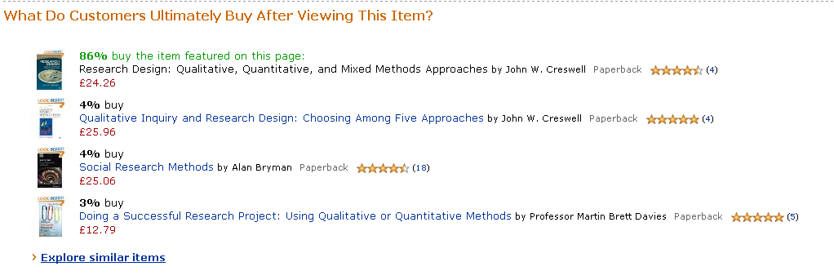
Notes:
This shows examples from the Amazon website of some styles of recommendations that users like.
When looking at a book result on Amazon there are on average 10 different types of focused searches and recommendations including:
Listmania
Look for similar items by category
Look for similar items by subject
Customers viewing this page may be interested in these sponsored links
Frequently bought with:
What do customers ultimately buy after viewing this item?
Customers also bought items by:
Web 2 Features include:
Customer discussions
Add tags to item

Slide 9
Four Ideas for a Front-End
Drawing on the key themes that have emerged four proposals for discussion are suggested:
Video Resource
Methods Gateway
‘Examples’ Resource
Blog/Website Resource
Notes:
1. VIDEO RESOURCE
Proposal: Construct a website that is a resource for open-sourced videos on methods. Pay particular attention to meta-data and base it on tags. Allow users to search by multiple tags (subjects, methods and topics). Include Web2 elements. Allow members to share playlists modelled on Amazon’s ‘listmania’
Target Audience: Teaching Staff, Research students, undergraduates
Problems: YouTube Edu too similar? But not open and difficult to search. Not enough videos? Limited
2. METHODS GATEWAY
Proposal: To provide a proof of concept for a methods portal that links to resources. Links to websites offering OERs. Organised by tabs, able to filter resources
Clear description, author, date, type of resource. Emphasis on presentation, usability
Target Audience: Teaching Staff, Research students
Problems: Too many problems associated with portals. How does it connect to existing OER repositories? General dislike expressed of ‘lists of lists’. Difficult to incorporate Web2 elements
3. ‘EXAMPLES RESOURCE’
Proposal: A web based resource that links to practical examples and case studies within social science methods. A narrower version of the Gateway model? Might be possible to incorporate Web2 elements
Target Audience: Beginning Teaching Staff, Teaching Staff
Problems: Defining and finding this sort of resource. Do these examples exist?
4. Methods Review Blog/Website
Proposal: A WordPress site that connects general topics associated with Methods with OER Collections. Website to focus on reviewing OER resources. Incorporate Web3 elements like Amazon’s ‘listmania’, ‘featured video’. Include links to OER resources through use of Xpert, Jorum widget, OER Recommender. Use blog to encourage reviews of OERs which would contibute to building of larger set of recommended resources
Target Audience: Beginning Teaching Staff, Research students
Problems: Who contributes to it and maintains it? Reliance on Xpert/Jorum widgets may not provide satisfactory search results

Slide 10
Blog Elements: Front Page Page
Resource Review
Cloud Tag
Video of the Week
Events
Xpert/Jorum/Google Custom search
Student Review
OER Recommender
Notes:
Darker blue boxes indicate content that needs to be added on an ongoing basis whilst the light blue boxes are generated automatically, for example through RSS feeds
It is intended to ‘pre-populate’ the videos with a rotating list
Elements:
- Jorum, Xpert, OER Recommender, Google Custom Search Widgets
- ‘Featured Resource’ blog post
‘Student Review’ blog post – review of methods teaching resource from student perspective
- Methods Events/courses adverts
List of Journals, other sources listed (Inside page. Gradually added)
Purpose
To provide a small number of recommended resources
To identify what meta-data is required to make resources findable
To experiment with a number of ‘recommendation’ type of Web2 elements

Slide 11
Current Challenges & Questions
Identification of videos
Refinement of search widgets
Web 2 features?
Meta-data
Notes:
Videos
Extremely difficult to locate videos on YouTube (even harder from other sources) and to evaluate and describe contents
How can we get more video resources? Are we missing sources?
Search Widgets
Xpert and JORUM did not produce relevant results in the user-testing. Looking into possibilities of making results more relevant (e.g. TRITON method of weighting UK results). Also exploring possibility of combining the widgets into one using Google Custom search
Web2 Features
The demand for Web2 features revolve around issues surrounding recommendation. However sites like Amazon have a customer sales information to base recommendations on. We are exploring what possibilities exist outside of a commercial setting to personalise searches.
Is the demand for web2 feature that significant?
Would people prefer a good search?
Meta-data
Many of the difficulties in identifying resources to contribute to the front-end results from inadequate meta-data. We are considering what information is necessary to collect that will make resources more findable in future.
Can people be persuaded to add meta-data when submitting information?
What is the minimal amount of information that can be collected?
Will widespread tagging change people’s approach to meta-data?

