Slide 1
Bringing together open resources for fieldwork education
Mike Sanders & Alison Stokes
GEES Subject Centre

Slide 2
Open Fieldwork Project
Thematic collections strand of OER 2
“Projects identifying, collecting and promoting collections of OER and other material around a common theme”
Notes:
This is an overview of the Open fieldwork project – funded under OER 2 thematic collections strand

Slide 3
What do we mean by ‘fieldwork’?
“…any arena or zone within a subject where supervised learning can take place via first-hand experience, outside the constraints of the four-walls classroom setting”
(Lonergan and Andresen, 1988)
Notes:
Compulsory activity in GEES disciplines (geography, earth and environmental sciences)
Pedagogic strategy in other disciplines, e.g. archaeology, bioscience (ecology), anthropology, arts, engineering

Slide 4
Fieldwork resources
Location-specific (e.g. virtual field trip)
Generic:
Skills or techniques-based
General information or guidance (e.g. safety briefings, good practice guides)
Notes:
Fieldwork resource: used to support teaching / delivery of fieldwork. Does not include physical equipment, e.g. measuring devices.
Three main types of fieldwork resource:
Location specific: activity is linked to a particular location, e.g. virtual field trip, or online field guide. These vary widely in their degree of interactivity
Skills based: focus is on developing a particular field skill which can be applied at a range of localities
Generic: applicable to any fieldwork regardless of location or activity

Slide 5
Fieldwork resources
Range of possible formats:
Photographs / images
Slides / PowerPoint presentations
Websites
Maps
Documents / spreadsheets
Databases / datasets
Movie clips
Notes:
Can either be used in the classroom, or accessed in the field using mobile devices.

Slide 6
Fieldwork resources
Key issues:
What is a fieldwork resource??
Licence / permissions for use (OER vs NOER)
Quality
Relevance
Out-dated resources
Notes:
Already specified that fieldwork resources are used to support fieldwork – should they be explicitly linked to a particular field activity, or can they be more general resources? (e.g. presentation about regional geology in Scotland…better example than this?)
More significant issue concerns the licences and permissions for use attached to a resource:
Many are publicly available but have not been released under a CC or other open licence
Out of 160 freely-available resources, less than 30 have a CC or equivalent licence
Quality assurance:

Slide 7
Fieldwork education collection
How do we bring together and present fieldwork education resources?

Slide 8
http://www.openfieldwork.org.uk/api/map.php
Notes:
http://www.openfieldwork.org.uk/api/map.php
Fieldwork resources appear as pins on the map according to the location they refer to (not where the owner / university is located) – e.g. Svalbard
Where resources are present in large numbers the google API allows clustering Blue circles (allows quicker loading and makes things a little less crowded)
You’ll also notice marker pins are different colours to reflect the level of “openess” permitted in the licence attached to the resource. Green, yellow,red – but all these resources are publicly available
The map is produced using the GoogleMaps application programming interface (API)
Very flexible and functional – e.g. clustering, scale, overlays, integration with streetmap – can capitalise on some vey powerful functionality if you want to switch it on in the API
Open - community maintained and developed – sustainable part of the technology (not so many years ago this would have taken a large budget just to develop the map functionality)
fieldwork related resources you see on the map are collected manually (by cataloguer) and dynamically (by scanning RSS feeds) – if they are about a place they can appear on the map or if they don’t have a location specifically, users can search for them. So what you see on the map is made up of machine collected resources and human collected resources
There are not many “open” resources currently. It would be remiss to ignore very good resources that are publicly available but not under a cc licence + we’d only have a small number of pins on the map. By broadening the scope to Non OER we can engage colleagues who are not aware of OER and CC and also provide a collection that has enough critical mass for our community to want to look after it and keep contributing to

Slide 9
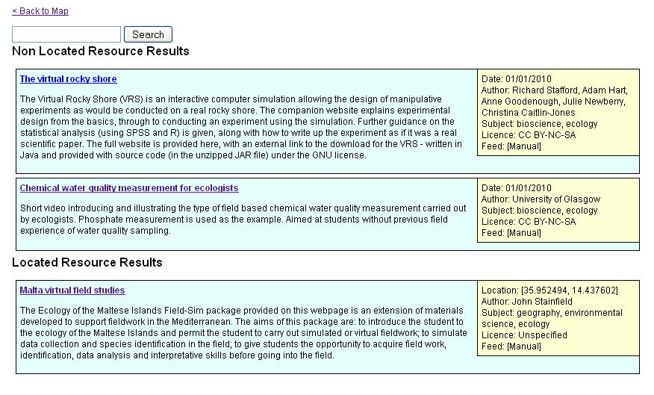
Fieldwork education collection
Notes:
Users can also use the free text search – this e.g. pulls skills records

Slide 10
Fieldwork education collection
Dynamic collection of resources:
Open repositories with RSS
Fieldwork terms
Is it location specific Y/N?
Add to map and/or collection
Notes:
How does the dynamic part work?
Titles, descriptions and keywords from open repositorys are searched for fieldwork related terms
Once these are identified a location is scanned for – if it finds one the resource is added to the collection and placed on the map
If there is no “place” associated with a resource then it does not appear on the map but is still added to the collection that can searched e.g. free text search

Slide 11
Fieldwork education collection
Manual collection of resources:
Allows collection of good educational resources that are not strictly OER
Cataloguer may have to establish coordinates, make judgements on quality and aggregation
Permits moderation / checking of resources identified by machine for relevance / placement
Notes:
Manual entry – allows collection other good educational resources that are not strictly OER. Cataloguer might have to establish coordinates, make judgements on aggregation of resources. In addition the human moderation / checking of resources identified by machine is necessary to ensure resources are relevant and in the right place.

Slide 12
Fieldwork education collection
Points of interest
Dynamic placement of location-specific resources
Indication of “openness”
Community engagement
Notes:
Discussion Points:
How a location is resolved for a resource
“Openish” resources
Sustainability of this work

Slide 13
Fieldwork education collection
Dynamic placement of location-specific resources
Notes:
This is Jorum RSS made up of titles and descriptions – we look for fieldwork terms to identify potential resources for the collection

Slide 14
Description: This is a gigapan image of thrusting and folding at Broad Haven, Pembrokeshire, Wales [51.785461,-5.10323]. Carboniferous Coal Measure strata are deformed by Variscan ….
Notes:
If the description contains coordinates as decimal degrees in square brackets a pin can be placed exactly on the map in this position (as part of our community of practice work we ask colleagues to use decimal degrees in square brackets in their description if they put resources into an open repository). Decimal degrees for a location are easily found by right clicking in GoogleMaps and selecting “What’s here?” – so this approach is accessible to contributors without a geospatial background.

Slide 15
Title: The Cryosphere : Svalbard Virtual field class
Description: This resource combines maps, photographs and video to provide a Virtual Fieldclass for Svalbard from the perspective of a Physical Geographer. The trip is split between Longyearbyen and the arctic science base at Ny-Alesund. The trip is supported by a detailed bibliography available for download.
Notes:
If there are no coordinates available in the desciption then we can still resolve a location using geoparsing

Slide 16
Notes:
What is geoparsing?
EDINA Unlock service is a geoparser and can analyse text for place names, rank what it finds and provide coordinates which can be placed on the map – clever: uses linguistic /semantic rules to identify text that is likely to be place names then looks up these place names in an online gazetteer to resolve coordinates. These are ranked and we take the top ranked to be the location.

Slide 17
Fieldwork education collection
Displaying different levels of openness
What about good educational resources that are not strictly OER (NOER? / “Openish”? )
Not in formal open repositories
Publicly available
Notes:
missed opportunity to exclude useful, publicly available resources that are not CC licensed or that are only available through formal open repositories (This may also disengage our subject community). Inclusion of NOER allows us to bolster a fairly small “CC-open” collection and might encourage Non OER authors / owners to re-licence under a more open arrangement or at least provide some information on how their resources might be used.
Our map shows all publicly available resources so we need a way to display the different levels of openness.

Slide 18
Fieldwork education collection
Displaying different levels of openness
The author of this resource has made it available under an open licence. The resource can be used, remixed or built upon. If you follow the licence requirements you do not have to contact the author.
This resource is publicly available on the web but check the resource licence / terms and conditions for restrictions on its use. You may need to contact the owner for details of how you can use the resource.
Copyright or assumed copyright – you can refer to the resource but you will need to contact the author for permission to copy or reuse this resource.
Notes:
how to display resources with different licensing arrangements. Having a marker for every type of licence would be rather cumbersome
Marker pin design / colour (zoom into west wales – e.g. 3 options - very open, open, no clear info/copyright)
Green (e.g. BY, BY-SA, BY-NC, BY-NC-SA, Zero) - Free to use and repurpose but check licence to see if you need to attribute the author, whether you can use commercially or need to release anything you derive from the resource under a similar licence
Yellow (BY-ND, BY-NC-ND, other licence only allowing use in education) - Free to use but check licence to see if you need to attribute the author, for non derivative and educational use only restrictions
Red for Copyright - The author retains all copyright on this work – you can refer to it but you will need to contact the author for permission to copy or reuse this resource
The conundrum is where to put NC - we grouped it in the green category because it currently seems to encourage open release in communities (and most of the phase one resources were released under NC). However in phase 2 JISC would like to develop the idea of open a little further and view NC as a more restrictive licensing element, therefore it could appear in the yellow category.
What about resources containing a mix of licences? Have to be labelled with the most restrictive licence present in the resource

Slide 19
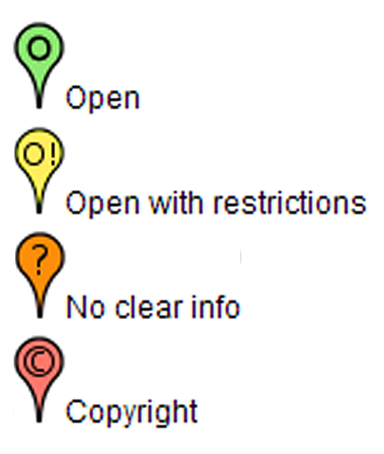
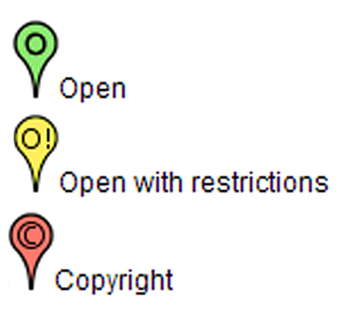
Fieldwork education collection
Displaying different levels of openness
Notes:
Originally had 4 categories of openess which included orange ( No clear licensing information - there is no clear use information associated with this resource – you can refer to it but you will need to contact the author for information on how you can copy or reuse this resource)
We consulted with Naomi Korn “OER IPR support” team and advised that in the absence of any licensing information one has to assume copyright all rights reserved (i.e. Berne Convention grants automatic copyright without the use of © or "All Rights Reserved“). The orange and red category was merged.

Slide 20
Community consultation
Sustainability of project outputs
Findings will guide development of database
Searching habits
Characteristics of ‘good or ‘effective’ fieldwork resources
Attitudes towards sharing and open resources
Role of community of practice
Notes:
Sustainability of project outputs
Role clarified through consultation survey
Build on existing and established GEES networks

Slide 21
Consultation findings
1. Use of online fieldwork resources
Most commonly used: images/photos, maps, and slides/PowerPoint presentations.
Most likely use: pre-fieldwork preparation and post-fieldwork follow-up or debriefing.
Important characteristics: ease of access, up-to-date, and quality.
Notes:
Respondents mainly from GEES community (geographers, geologists, and environmental scientists) but some other disciplines.
Majority currently involved in teaching and / or supporting fieldwork
Most commonly used:
Most likely use: over half also indicated that they would integrate fieldwork resources into existing fieldwork activity, e.g. using mobile devices
Important characteristics: accessibility addressed through database, up-to-date and quality will be addressed later

Slide 22
Consultation findings
2. Searching for online fieldwork resources
Initial approach to search: mixing phrases or keywords.
Common search tools: Google/search engines and YouTube.
Key issue: locating resources which are relevant.
Most likely search criteria: subject/major, location of field site, and type of activity.
Notes:
Interested in people’s search habits when they try to find online fieldwork resources – this will help with development of the search facility on the database.
Majority of respondents had previously attempted to find online resources.
Initial approach: Varied, but most common is to mix phrases or keywords, e.g. focus groups sociology undergraduate. Around a quarter do not have a clear idea what they are looking for before they begin their search.
Common tools: when people do begin searching the majority use search engines, specifically Google sites, and around a third using YouTube.
Of the respondents who have not tried to find resources online, most indicated that they would try a search engine in the first instance **need to make sure that database appears in search engines**
Key issues: apparent lack of relevant material, and quality of resources
Search criteria: these findings are interesting – conflicts with other findings re. originating discipline (i.e. this is unimportant as long as resource can be repurposed).

Slide 23
Consultation findings
3. Sharing and re-use of online fieldwork resources
General feelings: positive
Important factors influencing re-use: relevance, adaptability, level of interest/engagement.
Sharing habits: mainly with colleagues in own department or university via email, personal contact, or VLE.
Main reasons for sharing: to help learners, and a belief in open education.
Notes:
Practitioners are generally positive about sharing and re-using resource.
General feelings:
Important factors: when people choose an online resource the most important considerations are that they are relevant, they are engaging / interesting, and are easily to adapt and repurpose.
Sharing habits: around two thirds of respondents share their teaching and learning materials, mainly with academic colleagues both within and outside of their institution. Most common means of sharing are through personal contact, email, or a virtual learning environment.
Main reasons: people are most likely to share resources to help learners, i.e. help them gain access to a broader range of reasources, and to reflect a belief in open education.
Those who do not share resources cite lack of time and never having considered it as the main reasons.

Slide 24
Consultation findings
4. OER and their use in fieldwork education
Role of fieldwork OER community: forum for resource sharing and re-use, guidance on creating and developing OER, and maintaining an OER database.
Perceived advantages or benefits: sharing of ideas, saving time, and supporting learners.
Perceived disadvantages and barriers: quality of submissions, time required to develop resources, and copyright/IPR issues.

Slide 25
Expert seminar
12 expert field practitioners from GEES disciplines
Aims:
showcase FERC to representatives of GEES community
test guidance materials for uploading resources
identify and explore options for sustainability

Slide 26
Questions?
Project Blog: http://openfieldwork.org.uk/
Collection: http://www.openfieldwork.org.uk/api/map.php

