Slide 1
Evidence from the OER Landscape
OER 11, May 2011, Manchester
Patrick McAndrew, Tina Wilson & Karen Cropper, Open University UK
Cathy Casserly, Creative Commons

Slide 2
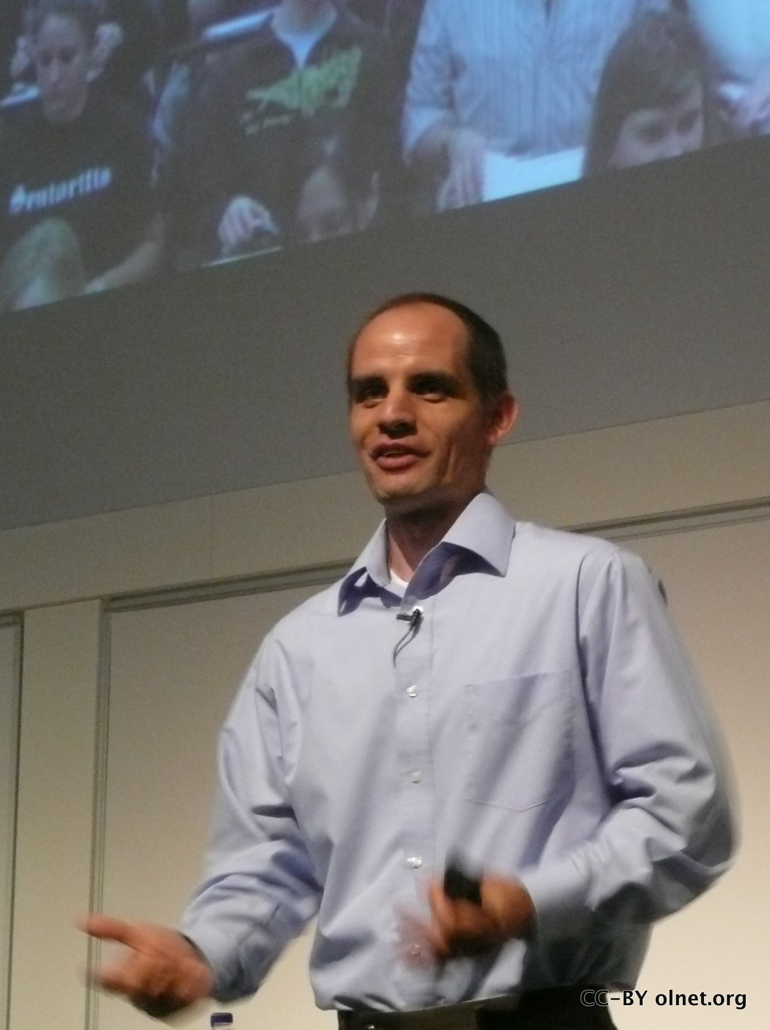
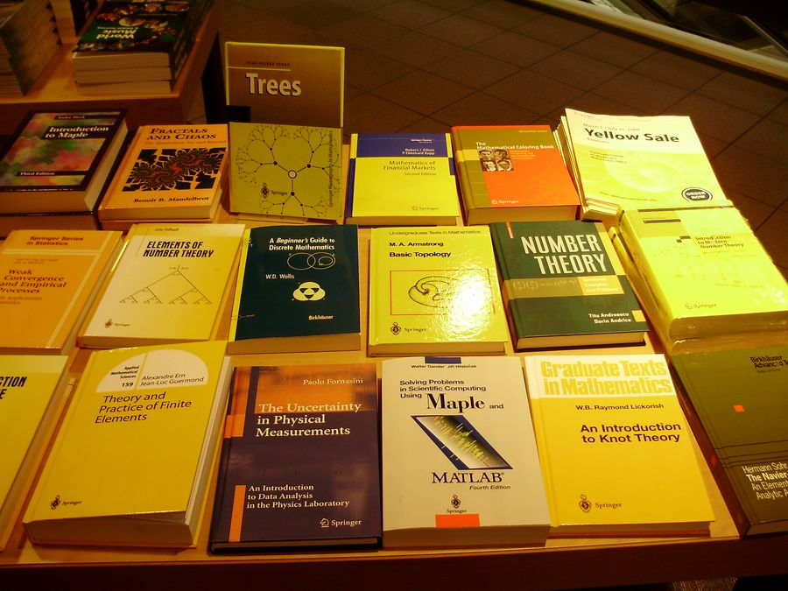
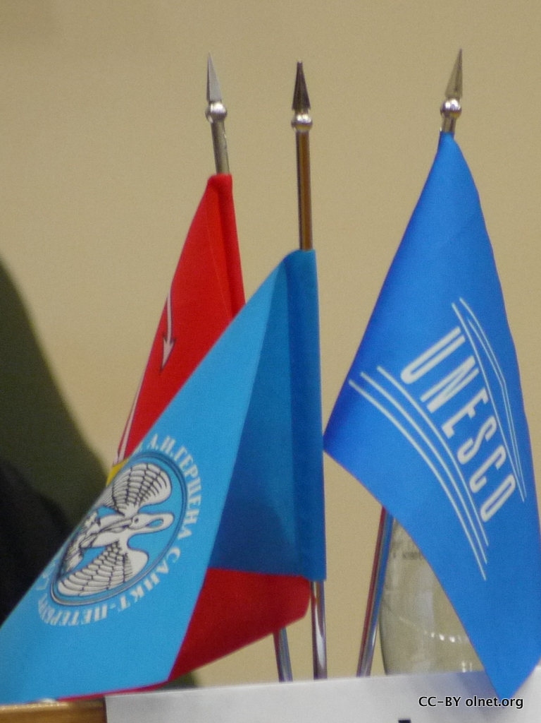
OER as Change agent
Individual
Institution
Discipline
Government

Slide 3
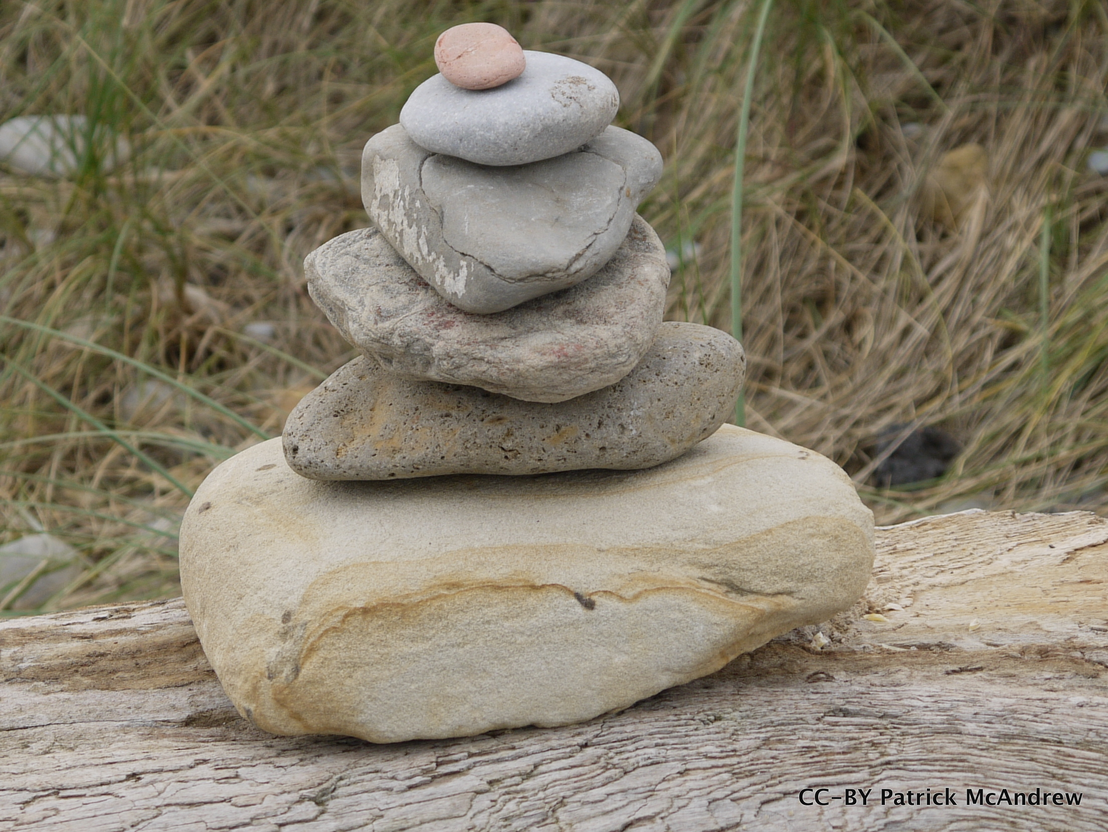
OER factors
Policy
Adoption
Design
Attraction/use
Infrastructure/tools
Contexts

Slide 4
The Culture impact
Biggest impact:
Thought leaders
Understanding and
Advocating OER
Vijay Kumar & Kim Thanos
OCWC Global 2011
Havelock & Huberman “ORACLE model of innovation”

Slide 5
OLnet is searching out the evidence for effective OER,
and building an Evidence Hub — a living map by, of and for the OER movement — and those we need to impact
http://www.flickr.com/photos/bartelomeus/4184705426/

Slide 6
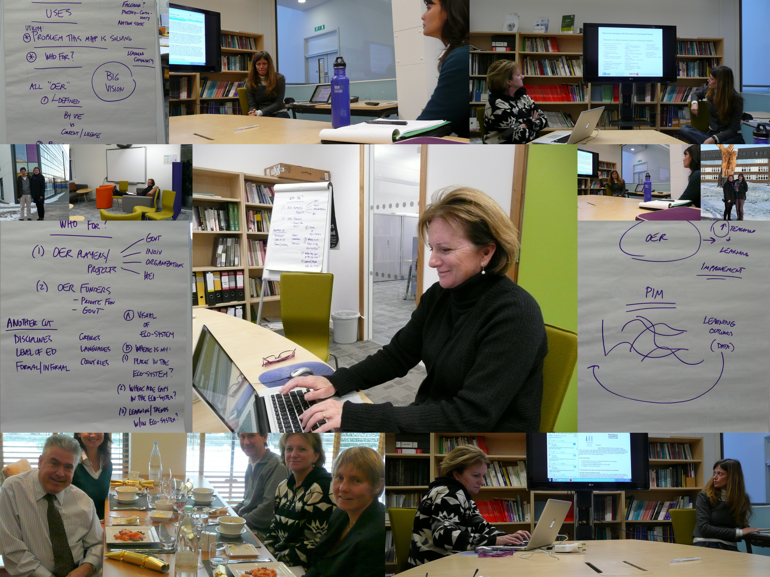

Slide 7
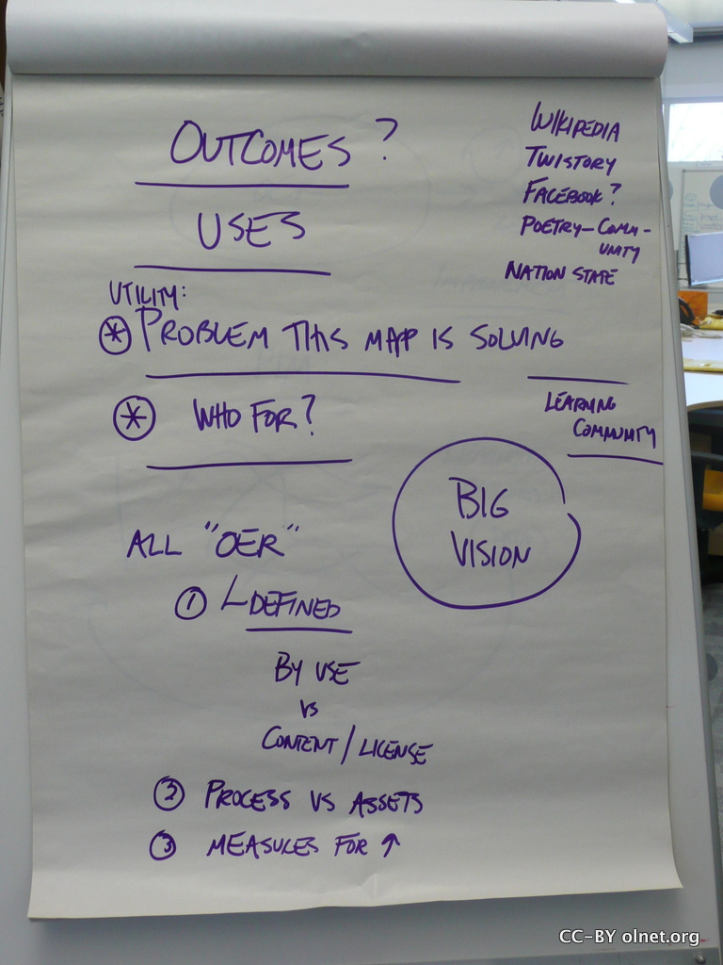
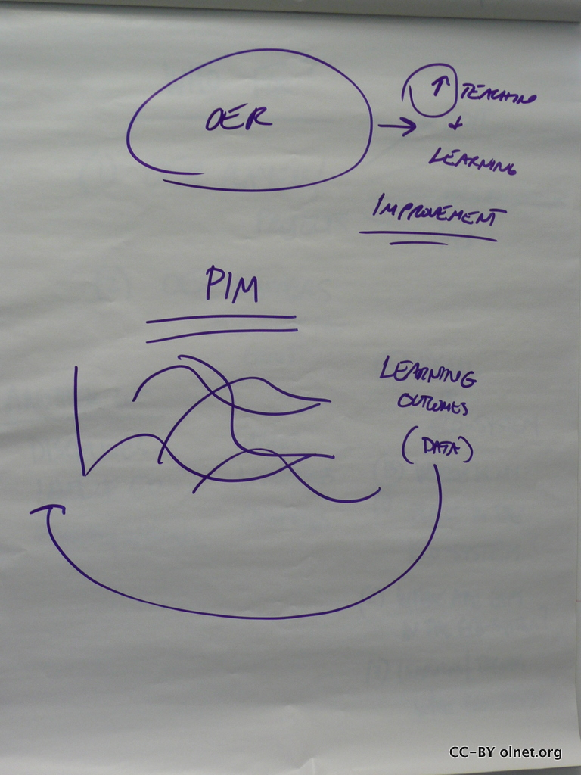
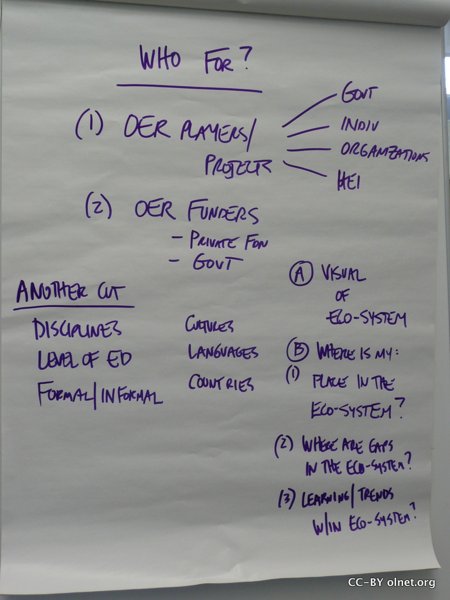

Slide 8
Stages in Open Content

Slide 9
Notes:
China – policy and context, Participatory – Social, Search & Discovery – location, OERopoly – awareness.

Slide 10
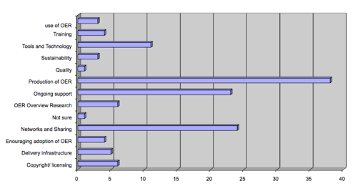
Investment in OER
Funding of OER projects (m$) 2001-2010
McAndrew, P. and Cropper, K. (2010). Open Learning Network: the evidence of OER impact. In: Open Ed 2010: The Seventh Annual Open Education Conference, November 2-4, 2010, Barcelona, Spain. http://kn.open.ac.uk/public/document.cfm?docid=13221

Slide 11
The Open Educational Practice cube model
THE DIMENSION: What?
Strategies and Policies
Barriers and Success Factors
Tools and Tool Practices
Skills Development and Support
THE CONTEXT: Where?
Macro level (society)
Meso level (organisation)
Micro level (individuals)
MATURITY: How well is it established?
Initial (not yet started)
Managed
Defined
Optimizing (embedded / advanced)
CONTEXT
MATURITY
DIMENSION

Slide 12
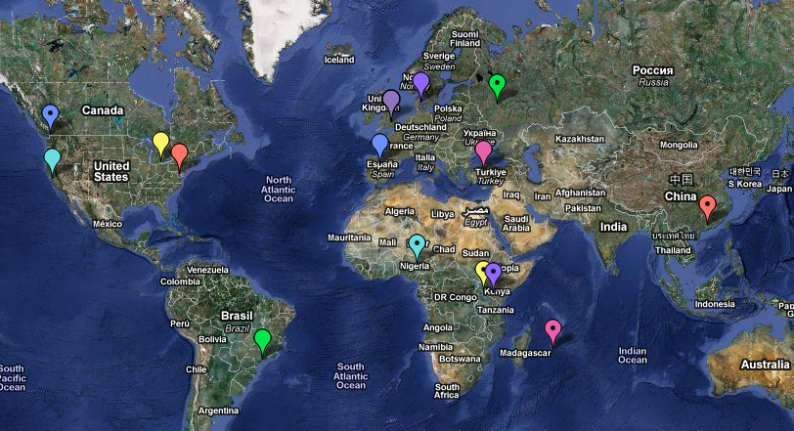
OER in different contexts

Slide 13
System
Information access & use
System user
Tools
Technological
level
Updated
Knowledge
Communication
Context
Learner
Semiotic
level
Control
Division of
Labour
Community
Rules

Slide 14
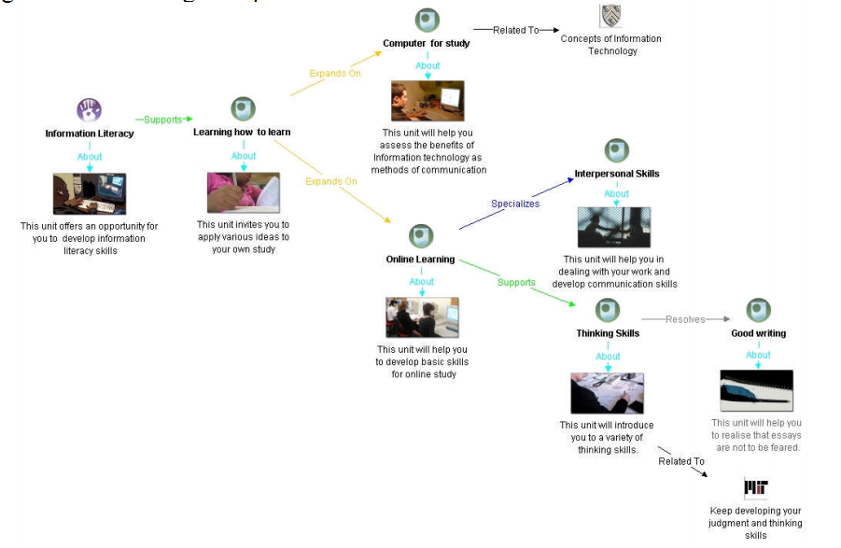

Slide 15
Open =
Unlimited
Freed
Free
AND
Available
Accessible
Connected
Empowered

Slide 16
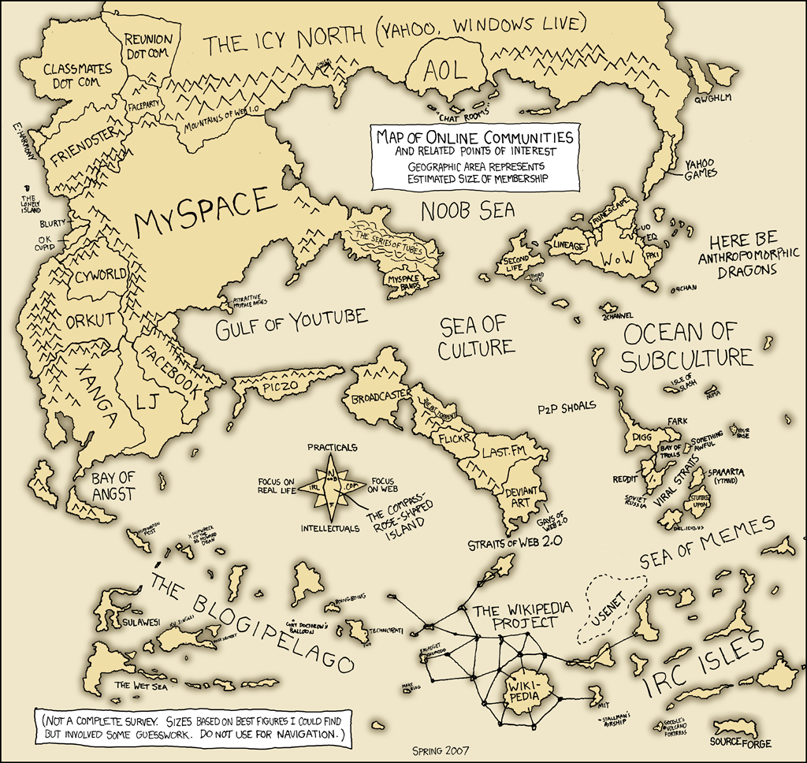
Social media

Slide 17
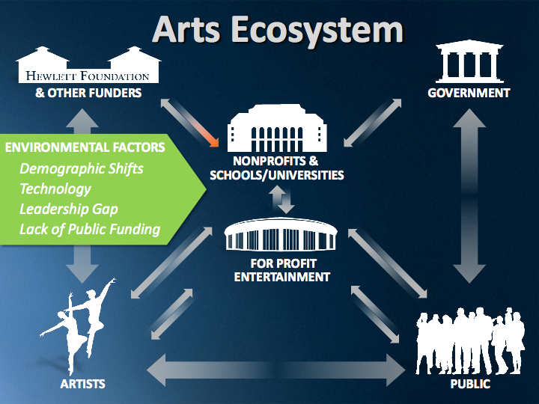

Slide 19
COMMON GOAL: To dramatically increase the proportion of community college students who are mathematically prepared to succeed in further academic study and/or occupational pursuits.
STUDENT CHARACTERISTICS
PROBLEM SPACE
COMMON
OUTCOMES
Mathematics skills, understanding
Math and school histories
Work-family factors affecting persistence
Reading & Writing proficiencies (all students)
Non-English-Background student characteristics
Social Capital; “College Knowledge”
Self-Efficacy; Motivation; Career & Educational Aspirations
Instructional System
Information Infrastructure
Content:
Numbers
Proportional reasoning
Probability/Statistics
Functions
“Adding it Up” Strands:
Conceptual understanding
Procedural fluency
Strategic competence
Adaptive reasoning
Productive disposition
Social Capital:
Study Skills
Motivation
Self-Regulation
Consequential Validity:
Success in later courses
Guiding student PLACEMENT & PROGRAM OF STUDY
Revisiting BELIEFS ABOUT LEARNING MATHEMATICS
MONITORING STUDENT PROGRESS
towards success
Focusing institutional RESEARCH ON INSTRUCTIONAL IMPROVEMENT
Aligning
LEARNING GOALS
w/ career opportunities
Minimizing COURSE SEQUENCE HURDLES
Creating a universal STUDENT-CENTRIC DATA SYSTEM
Strengthening DATA TO SUPPORT INSTRUCTION
Ideating the
SOCIAL ORGANIZATION OF TEACHING
Developing and embracing
EVIDENCE-BASED INSTRUCTIONAL PRACTICES
Student Support System
Smoothing the path I:
HS-CC ALIGNMENT
Strengthening
STUDENT CONNECTIONS to peers, college and a future
Strengthening GUIDANCE FOR STUDENT SUCCESS
Smoothing the path II: TRANSFER REQUIREMENTS
Strengthening CURRICULAR PACING & COHERENCE
for student learning
Building on-ramps to effectively TRANSITION students into college
Human Resource System
LEARNING TEACHING
ALLOCATING FACULTY RESOURCES
for student success
Governance
(affects all systems)
HIRING FOR EFFECTIVE TEACHING
FACULTY EVALUATION for improving instruction
REFORM INCENTIVES for improving teaching and learning
ALIGNING RESOURCES for student success
Key:
(Yellow)
(Pink)
(Green)
Challenges at the Instructional Level
Challenges at the Institutional Level
Challenges at the System/Field Level

Slide 20
“The map is not the territory”
Alfred Korzybski via Tim O’Reilly

Slide 21
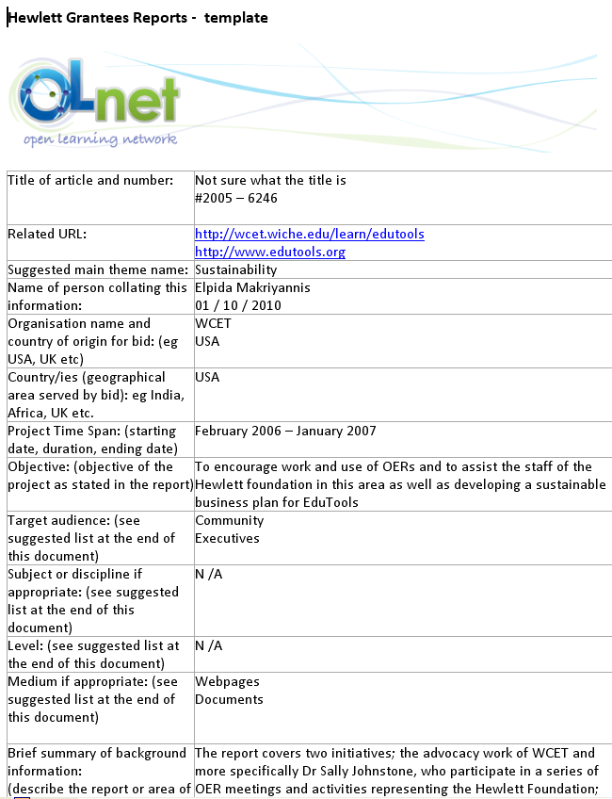
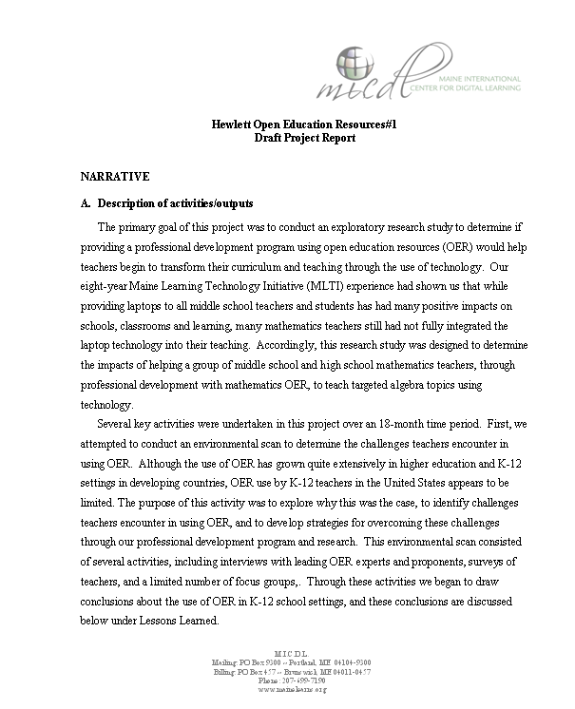
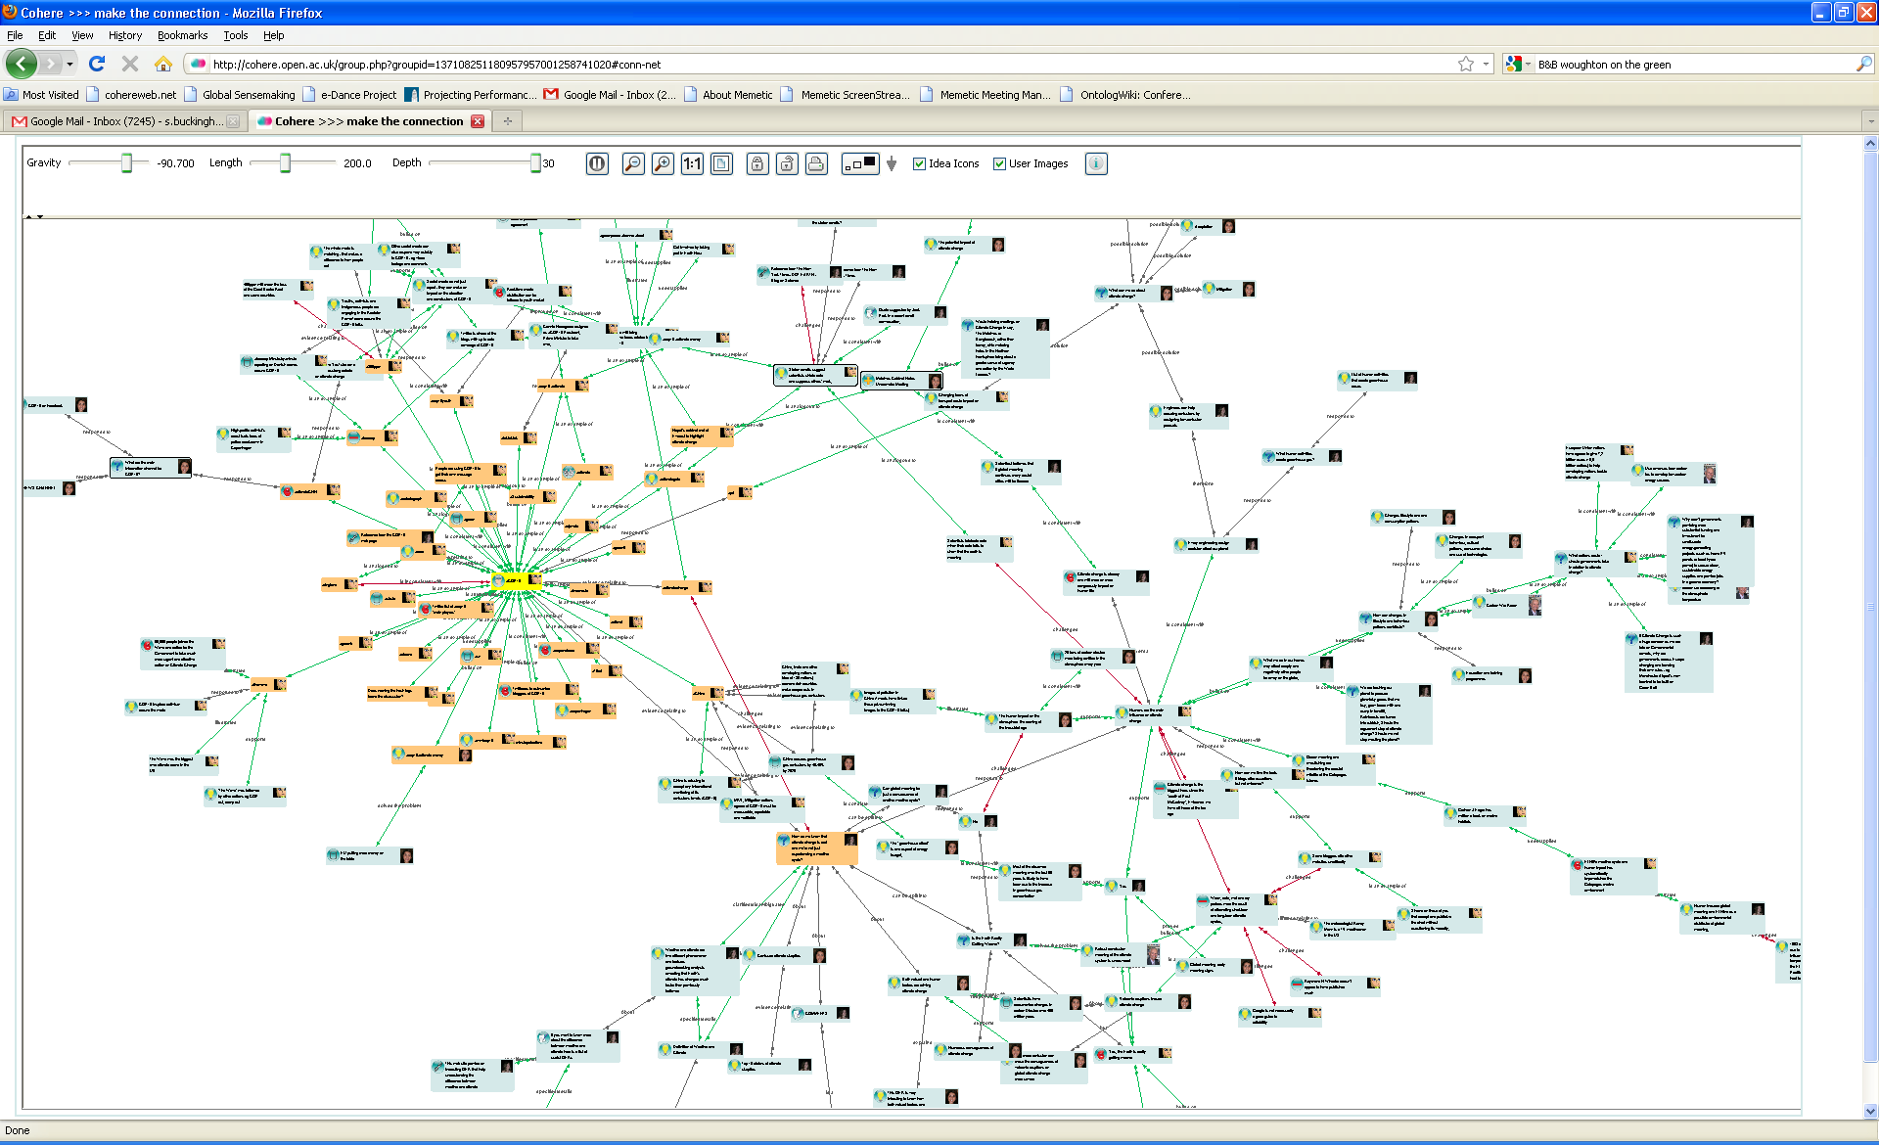
Hewlett Grantees – an exercise in mapping
Template-driven analysis by OLnet researchers
Panagiota Alevizou, Elpida Makriyannis, Tina Wilson, Andreia Inamorato dos Santos, Patrick McAndrew
Collective Intelligence tool
Hewlett Grantee Report (x125)
Evidence Hub
Annotation & visualization tools integrating all the analyses
Distilled Themes, Challenges, Claims, Evidence, & Documents via a simplified user interface for the wider community to browse and update
Michelle Bachler Anna De Liddo Simon Buckingham Shum
Automated textual markup (XIP)
Ágnes Sándor OLnet Fellow, Xerox
http://olnet.org/node/512

Slide 23
Characteristics for useful mapping
Needed – providing a service
For people – who care about OER
Dynamic – changes with new data
Flexible – can be viewed in different ways
Not just one answer
Owned by the community (not by *us*)

Slide 25
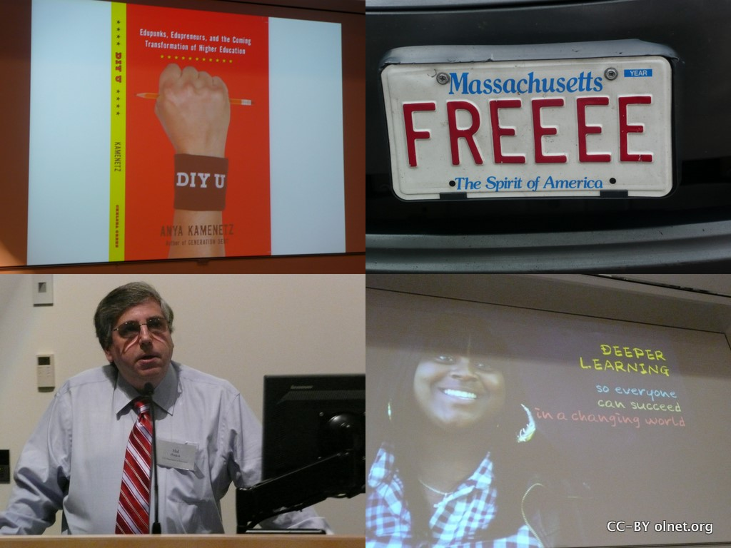
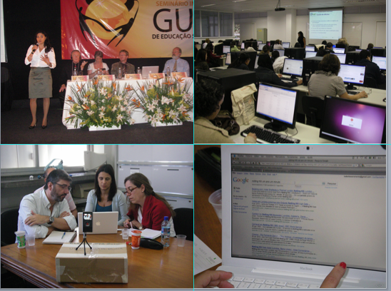
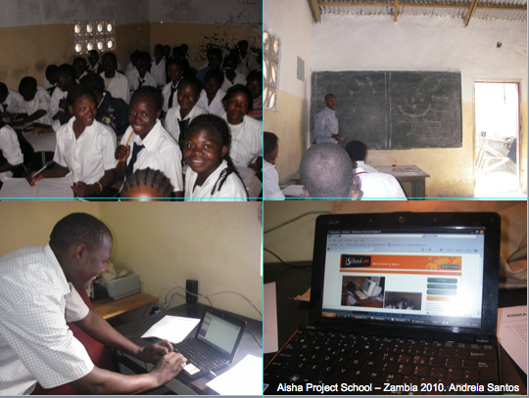
We need to pool our Collective Intelligence

Slide 26
Evidence Hub

Slide 27
http://learningemergence.net/projects/mapping-deeper-learning-lit/

Slide 28
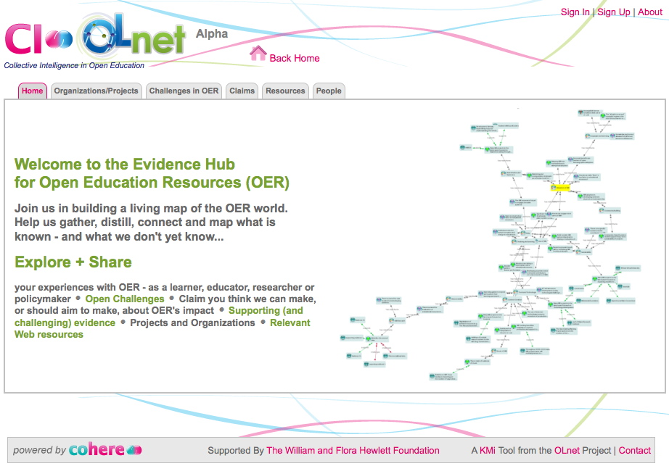
OpenEd Evidence Hub: ci.olnet.org … an alpha release website inviting your early feedback

Slide 29
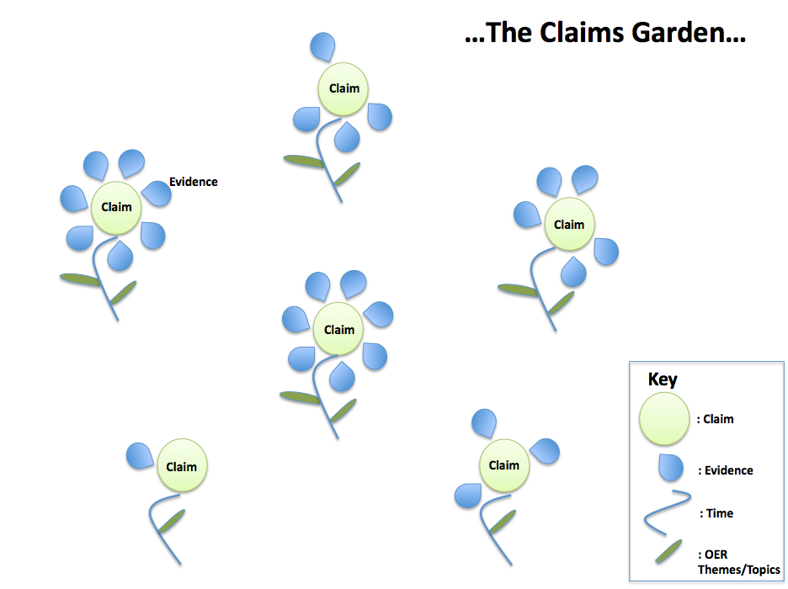
Communal Claims Gardening…

Slide 34
What can you do?
Ideas for how the hub should work
Designing the view for advocacy
Stories to tell
Log in for now:
Site: http://ci.olnet.org
User: ci.olnet3@open.ac.uk
Password: ocwc
Register on site (approval will follow)

Slide 35
Notes:
Show evidence hub and information from flowers

Slide 36
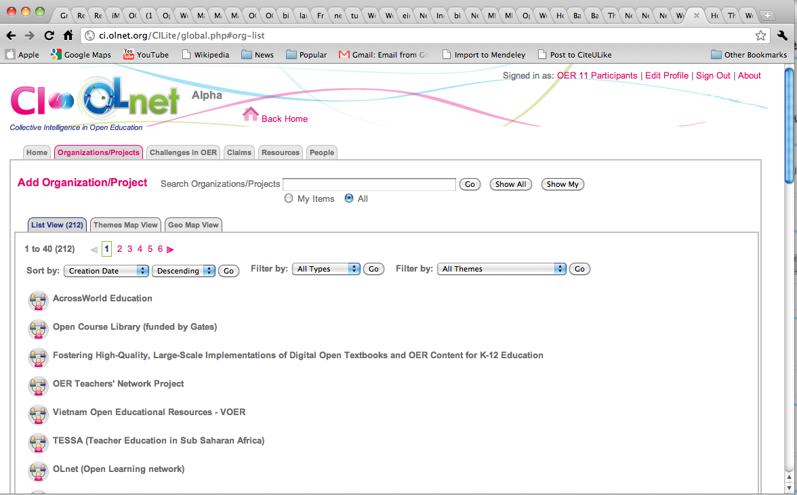

Slide 37
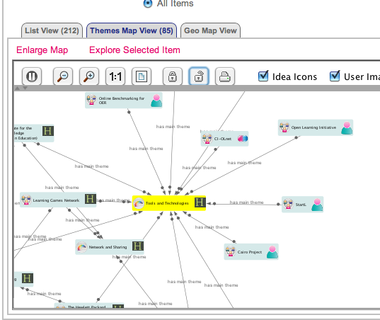

Slide 38
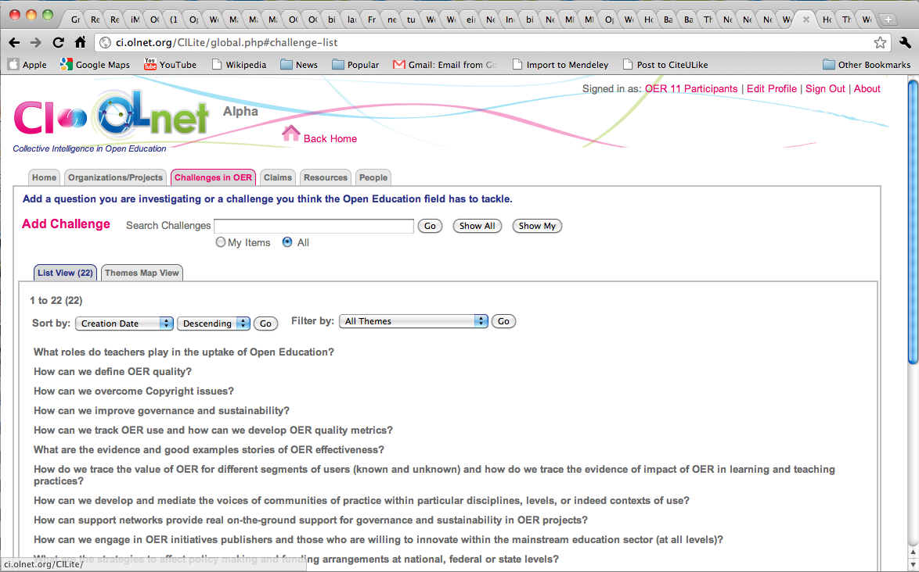

Slide 39
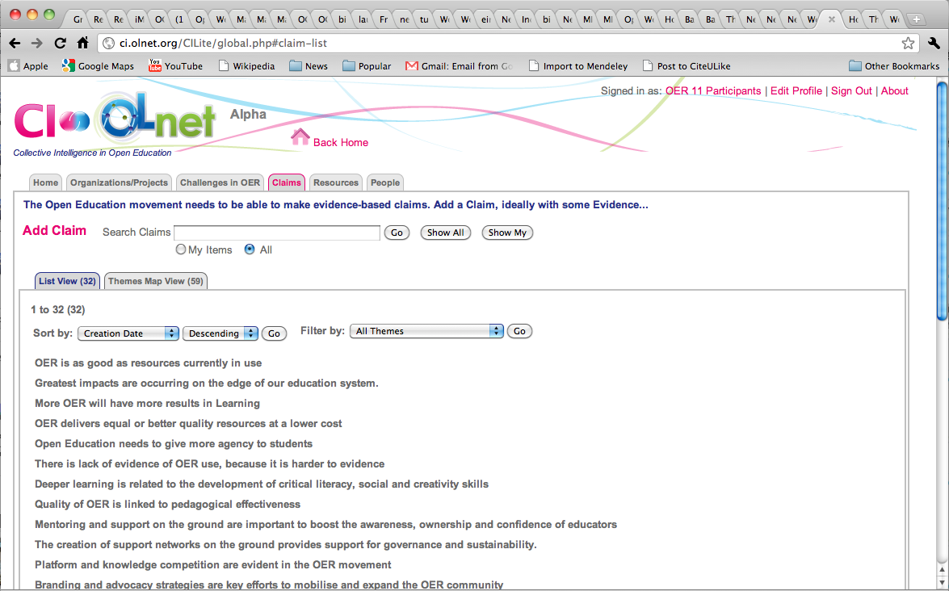

Slide 40
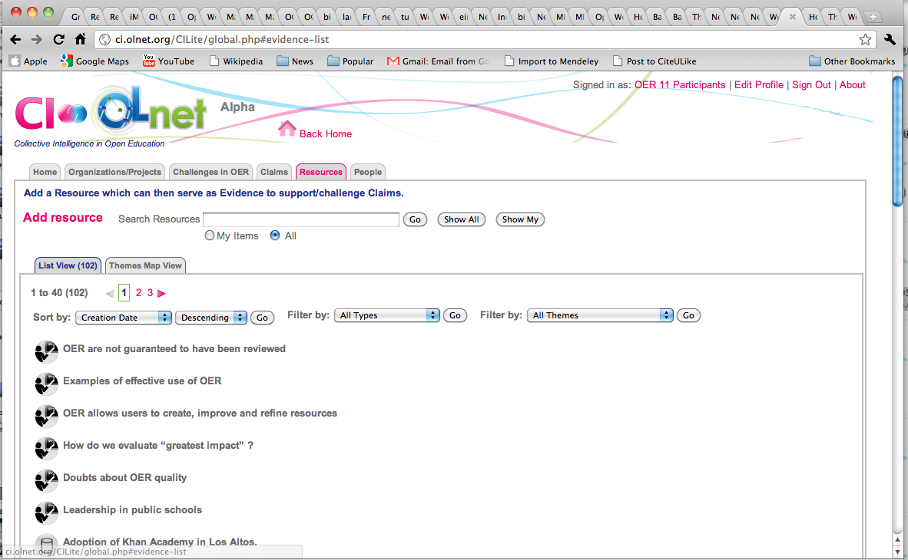

Slide 41
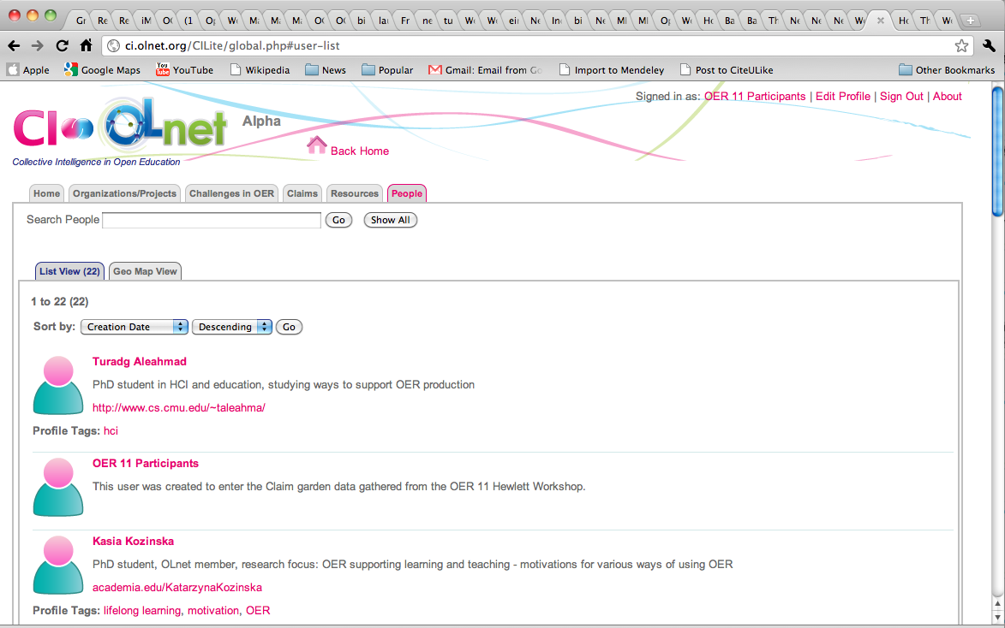

Slide 42
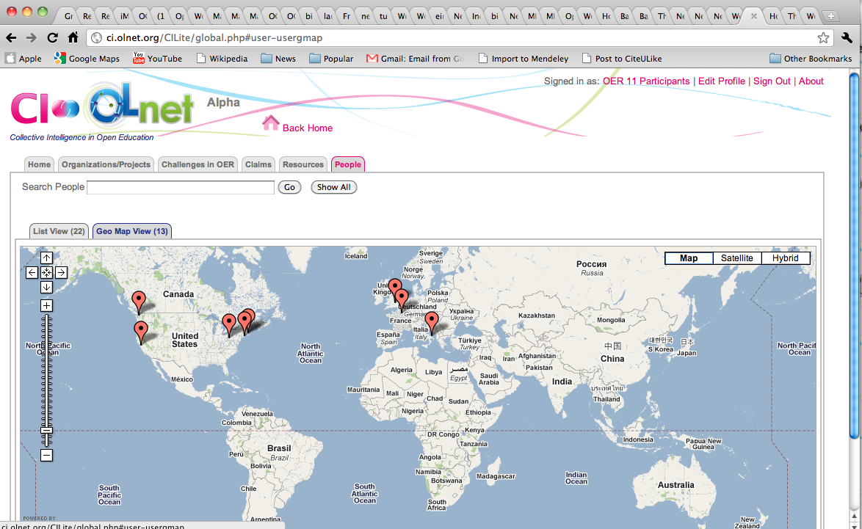

Slide 43
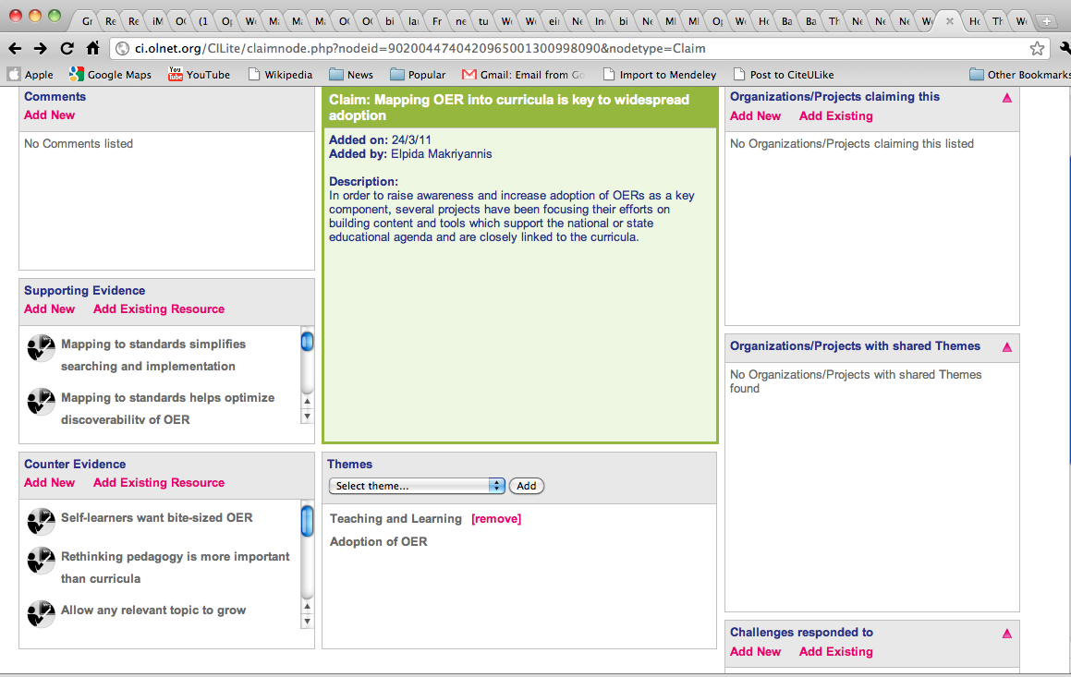

Slide 44
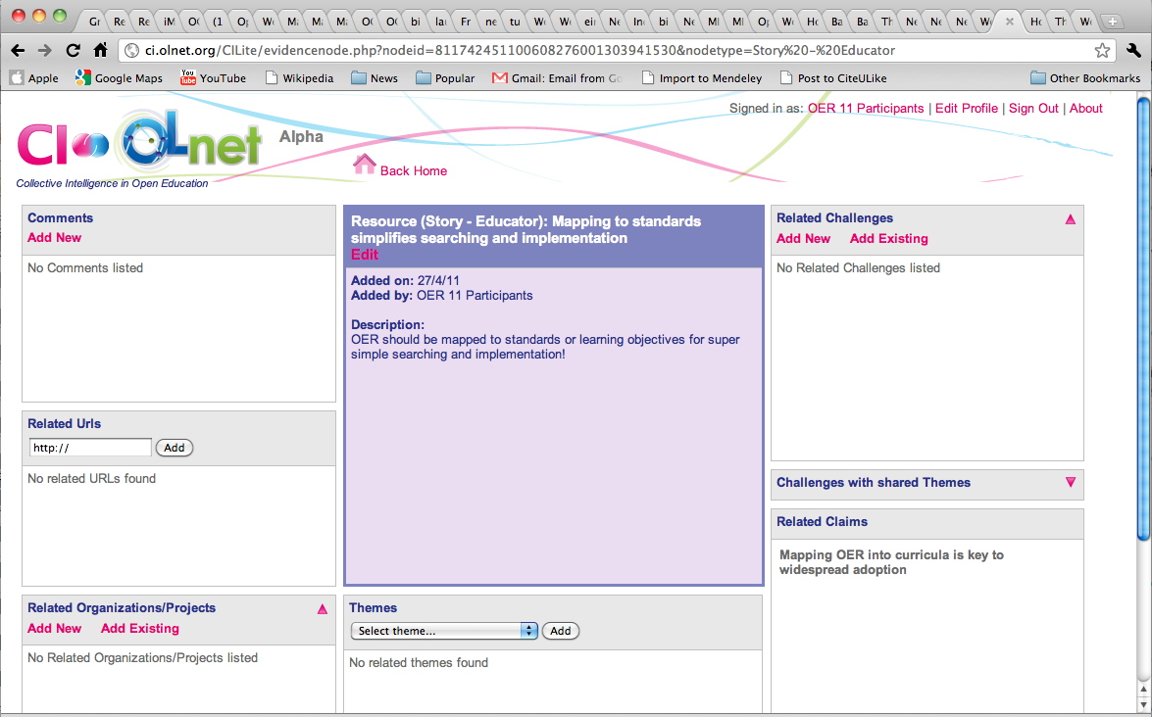

Slide 45
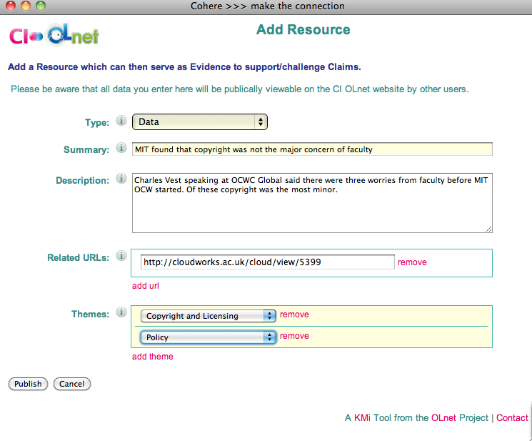

Slide 46
Evidence types
Design Reports
Contexts of Use
Anecdotes
Comparative Reviews
Illustrations of OER in use
Case study – anecdotal with informal evidence
Case study – structured
Controlled experiment
Learning Analysis Studies

Slide 47
Evidence types (simplified)
Data
Case studies
Experimental results
Literature analysis
Story – Educator
Story – Learner

Slide 51
Next steps…
Gathering the evidence
OER11
UNESCO community
OLnet fellowships
Opening up the system
Preparing views
Advocacy
Researcher
Educator
?

Slide 52
What can you do?
Ideas for how the hub should work
Designing the view for advocacy
Stories to tell
Register on site (approval will follow)

Slide 53
olnet.org
ci.olnet.org

