Slide 1
OLI and Knowledge Forum: Integrating pedagogies and technologies that support individual learning and group knowledge building
Marlene Scardamalia, Candace Thille, John Rinderle, Maria Chuy, Michaele Brown Presented by John Rinderle
Notes:
Question: How do we blend pedagogy and technology designed to support individual, independent learners with those intended to foster knowledge building communities?

Slide 2
OLI and Knowledge Forum
OLnet - gather evidence and methods about how we can research and understand ways to learn in a more open world
Collaboration between the Open Learning Initiative at Carnegie Mellon University and Institute for Knowledge Innovation and Technology at the University of Toronto
With funding from the William and Flora Hewlett Foundation

Slide 3
Open Learning Initiative
Produce exemplars of scientifically based online courses and course materials that enact instruction and support instructors
Provide open access to these courses and materials
Develop a community of use, research & development that contributes to the development evaluation and continuous improvement of the courses and materials
Notes:
OLI is an open educational resources project that began in 2002 with a grant from The William and Flora Hewlett Foundation. Like many open educational resources projects, ours makes its courses openly and freely available. However, our courses are not collections of material created by individual faculty to support traditional instruction. While our courses are often used by instructors to support classroom instruction, the most challenging goal of the project is to develop online courses that are the complete “enactment of instruction”. OLI online courses are designed to support an individual learner, who does not have the benefit of an instructor, to learn a subject at the introductory college level.
A fundamental goal of the project is to provide open access to these courses and course materials to learners world wide. The goals of providing greater access to education and improving the quality of education are, for us, inextricably tied together. In addition to our mission to improve access and quality, we also have a practical and research driven motivation for making these courses openly and freely available.
The continued development and evaluation process of OLI courses depends on the growing community of use and research and development.

Slide 4
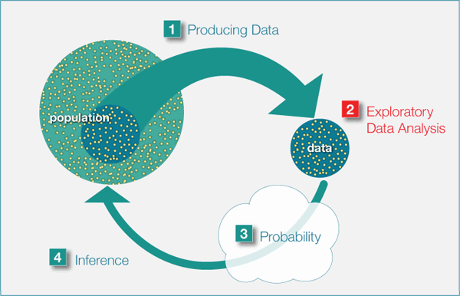
The OLI Statistics Course

Slide 5
What is Knowledge Building?
“Knowledge Building” is a pedagogical approach proposed by Marlene Scardamalia and Carl Bereiter (2003)
It involves creative, sustained work with ideas and is focused on “the production of knowledge of value to community” (Scardamalia & Bereiter, 2003)
Knowledge Building is much more than a simple collaboration or knowledge-sharing. Knowledge Building implies building a new understanding and continuous improvement of new understanding.
Knowledge Building is based on 12 main pedagogical principles
(Maria Chuy, University of Toronto, 2010)

Slide 6
Principle 1: Real Ideas, Authentic Problems
Knowledge problems arise from efforts to understand the world
Problems are the ones that learners care about (usually very different from textbook problems and puzzles)
Focus on authentic questions and problems that make sense to students

Slide 7
Principle 2: Idea Diversity, Principle 3: Improvable Ideas
Idea diversity is essential to the development of knowledge advancement
All ideas are treated as improvable. Participants work continuously to improve the quality, coherence, and utility of ideas
Learners must feel safe in taking risks – revealing ignorance, voicing half-baked notions, giving and receiving criticism

Slide 8
Principle 4: Rise Above
Creative knowledge building entails working toward higher-level formulations of problems
It means learning to work with diversity, complexity and messiness, and out of that achieve new syntheses
Encourage students to synthesize their current understanding

Slide 9
Principle 5: Epistemic Agency, Principle 6: Community Knowledge, Collective Responsibility
A key feature of Knowledge Building is the high level of responsibility given to students in conducting their inquiries
Participants share responsibilities not only for their own entries but for the growing body of ideas represented by their community
Encourage students in taking responsibility for their understanding, and dealing with goals and evaluation that are normally left for teachers and managers

Slide 10
Principles 7, 8 and 9: Democratizing Knowledge, Symmetric Knowledge, Advancement of Pervasive Knowledge Building
All participants are legitimate contributors to the shared goals of the community and all are empowered to engage in knowledge innovation
Symmetry in knowledge advancement results from knowledge exchange, and from the fact that to give knowledge is to get knowledge
Knowledge Building is not confined to particular occasions or subjects but pervades mental life – in and out of school

Slide 11
Principle 10: Constructive Use of Authoritative Sources
To know a discipline is to be in touch with the present state and growing edge of knowledge in the field
This requires respect and understanding of authoritative sources, combined with a critical stance on them
Encourage students to use OLI, OERs, and other authoritative sources as data for their own knowledge building and idea-improving processes

Slide 12
Principle 11: Knowledge Building Discourse
The knowledge is refined and transformed through the discursive practices of the community
In hybrid courses, organize face-to-face on-site discussions where students would reflect on the questions and problems posted in Knowledge Forum

Slide 13
Principle 12: Embedded and Transformative Assessment
Assessment is part of the effort to advance knowledge – it is used to identify problems as the work proceeds
The community engages in its own internal assessment and serves to insure that the community’s work will exceed the expectations of external assessors
Encourage students to assess their own work/progress on continuous basis

Slide 14
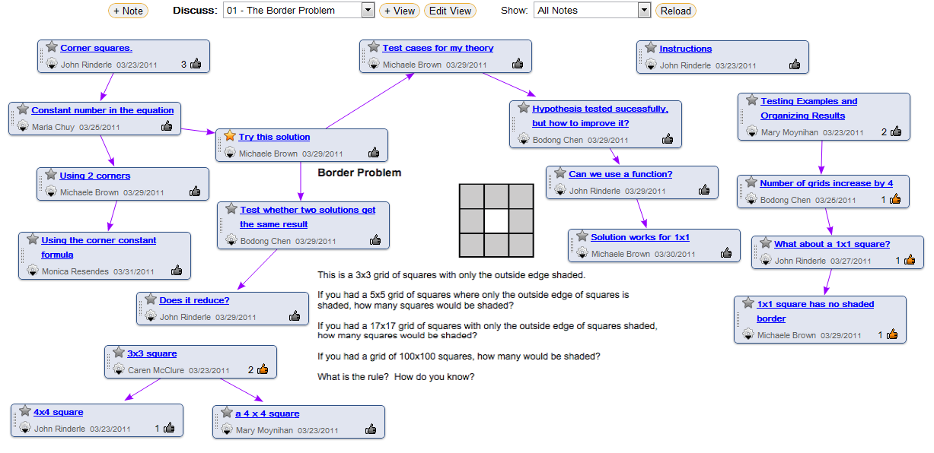
Knowledge Forum
A shared discourse space constructed and organized by the participants in support of community knowledge building
Promotes the creation and refinement of shared knowledge
Notes:
Knowledge building calls for community discourse to advance knowledge on shared problems of understanding. With Knowledge Forum, learners interact within a shared social space using tools designed to help structure and organize their ideas.
Used widely in over 19 countries and a variety of social contexts from elementary schools to graduate studies to professional settings.
Creating a new, web browser based version for this project to better integrate with OLI and take advantage of new technologies. Knowledge Forum will become an open source project when complete.

Slide 15
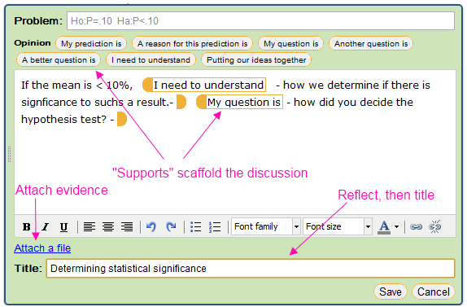
Notes – Representing Ideas

Slide 16
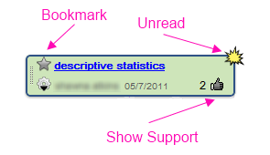
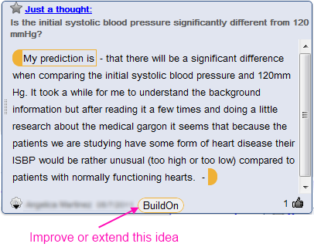
Notes – Representing Ideas

Slide 17
Views – Organizing Ideas

Slide 18
Goals for OLI/KF Environment
Prepare students to engage in the authentic discourse of the domain
Apply and integrate skill knowledge; Build critical thinking skills
Shorten the feedback loop to students; Create a safe place for students to ask questions, form and refine ideas
Aid students in seeing their peers and themselves as resources in the learning process; Offer virtual cohorts to unaffiliated learners
Provide richer measures of learning and new modes of feedback to instructors and students
Notes:
Learners in the blended OLI/KF environment will be encouraged to raise questions, share ideas, and engage in collaborative problem solving in KF as they progress through the OLI course. They will use the OLI course as an authoritative source in the shared discourse and observe how ideas in the discourse connect to instruction in the OLI materials. Learners will collaborate in virtual cohort groups to modify and extend each other’s ideas, creating public knowledge thereby transforming and extending the OER and building a community of support.

Slide 19
Blending of Environments
Lower barriers to participation in the discourse
Knowledge Forum cannot be perceived as an add-on to the OLI course; Seamless flow between OLI and Knowledge Forum
Provide engaging and authentic discourse activities which relate back to OLI course and offer perceptible benefit to the learner
Alert students to opportunities to engage with the community, notify students of recent and relevant ideas in the discourse space
Connect data from practice opportunities in the OLI course with the knowledge building discourse with easily to use reporting tools

Slide 20
Research Questions
How do we support instructors in establishing knowledge building communities around OLI?
If learning is enhanced for a few students, do their contributions to the collaborative space enhance the work of the group?
How can we assess growth and spread of ideas?
Can we keep ideas alive and improving in a worldwide open community?
Notes:
We will collect real-time, interaction level data of all student use in the combined OLI/KF environment. We will examine and relate data from the frequent assessment opportunities in the OLI course with the semantic space and social network connections formed by the knowledge building discourse. We will explore ways these data can be used to provide feedback to students, instructors, and course designers to influence student achievement of desired learning outcomes.

Slide 21
Spring 2011 Pilot
2 institutions, 3 course sections, approximately 60 students Larger pilot planned for Fall 2011
Gather initial feedback on new Knowledge Forum tool to guide further development
Explore opportunities for blending OLI and KF pedagogies, evaluate instructor support materials
Collect initial data to investigate research questions

Slide 22
Spring 2011 Pilot
Solve a statistical data analysis problem:
Reflect on Question → Analyze the Data → Draw Conclusions
Students given dataset showing body measurements and generate the questions to investigate
Activity connects back to previous in classroom activity
Peers take place of scaffolding provided in course by StatTutor
Students self-assess against a rubric; support self-evaluation with evidence from the Knowledge Forum discourse

Slide 23
Next Steps, Work in Progress
Incorporate discussion prompts and shared problems of understanding into the OLI courses
Improved instructor support materials and discussion management tools
Create a note from any page of OLI course; Draw explicit connections between OLI and Knowledge Forum
Activity stream, keep students informed of how the discussion is proceeding
Integrated search; Search OLI course from Knowledge Forum, search Knowledge Forum notes from OLI course

Slide 24
“Improvement in Post Secondary Education will require converting teaching from a ‘solo sport’ to a community based research activity.”
—Herbert Simon
Notes:
24

