Slide 1
Sharing Practices and Experiences on the Authoring and Adaptation of Open Educational Resources
Alexander Mikroyannidis, Alexandra Okada, Teresa Connolly
Knowledge Media Institute, The Open University, UK

Slide 2
Open Educational Resources
Open Educational Resources (OER) have emerged as an answer to the need for open and reusable educational material, freely available online
OER are freely available on the web and can be accessed through common web sites, Virtual Learning Environments (VLEs), or Personal Learning Environments (PLEs)
They can be used, edited and shared by any interested party, such as learners, teachers, institutions, and learning communities

Slide 3
Motivation
Educational institutions, private organisations, as well as individual learners and educators have embraced the OER initiative
Bringing these stakeholders together and supporting them in collaboratively adapting OER is critical for the success of this movement

Slide 4
The OpenScout project
Skill based scouting of open user-generated and community-improved content for management education and training - www.openscout.net
Providing a bundle of online education services that enable users to easily find, access, use and share OER for management education and training
Search
Validate re-usability
Re-use / adapt
Validate solution
Re-publish

Slide 5
The OpenScout tool library
Supporting the collaborative adaptation of OER
Connecting people, stories, resources
Resources
Stories
People
5

Slide 6
Stakeholder clusters
Developers
OER
Educators
Strategy
Enrichers
(Social) Learners
Legal frame
Partners
Collaboration
Computers
Friends
Communities of Practice

Slide 7
Scenario 1 – Developers & Educators
Objective: Integrate more interactive learning objects to fulfill curriculum needs
Interests in using OpenScout:
Select the most recent OER published from different OER repositories (but published in one place via OpenScout)
Find particular types or styles of new media objects from a wide variety of interconnected OER repositories (but published in one place via OpenScout)
Access new authoring tools for adapting content into new structures and learning environments

Slide 8
Scenario 2 – Collaboration / Communities of Practice
Objective: Promote student engagement and associated social learning through communities of practice around OER
Interests in using OpenScout:
Locate an appropriate space for creating and supporting such a community
Disseminate their degree programme materials
Establish new international partnerships to add value to their existing degree programme provision
Access ratings and social metadata for research purposes
Use social metadata tools to expand and further engage learning communities around their existing OER

Slide 9
Scenario 3 – Social Learners
Objective: to extend current social network by engaging new members with similar interests from other parts of the world
Interests in using OpenScout:
Access new social metadata tools that help them to locate like-minded learning communities with similar interests
Gain more information about OER, tools and best practices from a variety of interconnected environments (presented in one place via OpenScout)

Slide 10
Implementation
The OpenScout tool library has been implemented with the use of the Elgg open source framework and is available at: http://openscout.kmi.open.ac.uk/tool-library
It allows users to:
build a profile
connect with other users
create a personalised environment
work with widgets
share stories and resources
create and join groups
…

Slide 11
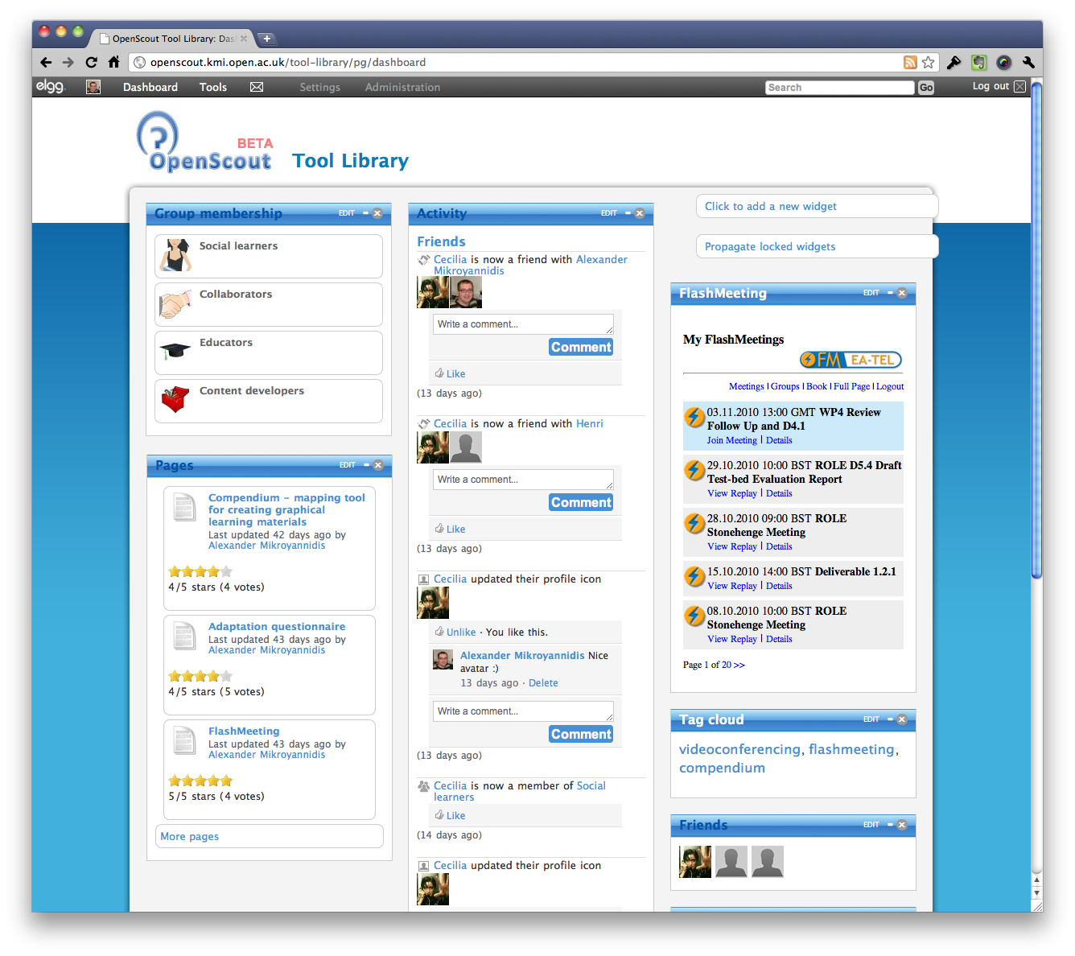
Demo

