Slide 1
Mapping the curriculum: representations of our intentions to teach
Richard Pountney
Sheffield Hallam University
r.p.pountney@shu.ac.uk

Slide 2
Context
C-SAP OER Project Phase 1
Helping to expose and reveal pedagogical decisions about the creation and use of OER
Overcoming the barriers to re-use, re-construction and re-contextualisation
Developing understanding of sharing as exchange (borrowing) of resources and practice

Slide 3
Towards an analysis
The organising device for framing and classifying knowledge in education is the curriculum itself (Bernstein, 1990)
The relationship between discipline knowledge and student learning, institutional frameworks, and sector requirements reveals gaps and spaces constituting a ‘field of recontextualisation’ (Rosie 2009)
The structure of the contextual field, and the relations between positions held by the agents involved reveals power relationships (Bourdieu and Waquant, 1992)
The development of a language of description (set of rules) for reading empirical texts can be used to describe a model of course planning (Bernstein, 2000)

Slide 4
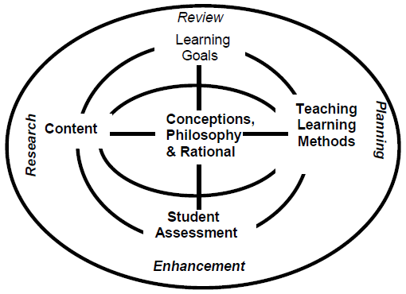
How do we make (sense of) the curriculum?
Jackson and Shaw (2002)
Notes:
1. simple rational model of a curriculum as a means of
organising information about the curriculum - six elements:
conceptions, philosophy and rationale; learning goals; content; teaching and learning methods
and learning experiences; student assessment; and the processes of curriculum review,
evaluation, research, redesign or transformation as a linear structure
2. Visual representations that reflected the interconnectivity and interactivity between the different
Domains
3. The near universal adoption of a modular/unitised curriculum means that most institutions have
developed a ‘curriculum framework with rules which control the way programmes and courses
are constructed.

Slide 5
Representations of course planning
Submission Document approved by University Standing Panel:
Section A: Programme specification
Section B: Intermediate Awards
Section C: Rationale
Section G: Module descriptors

Slide 7
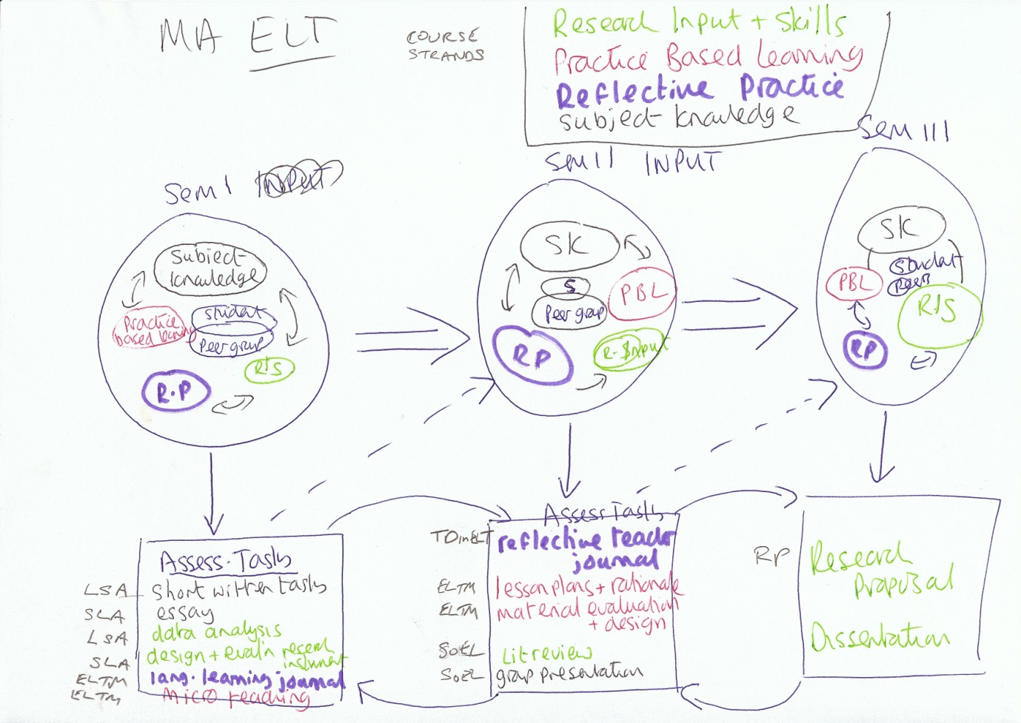

Slide 8
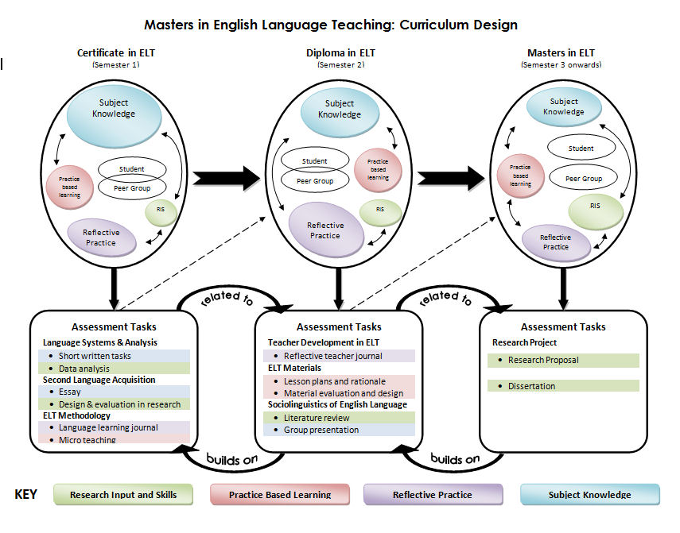

Slide 9
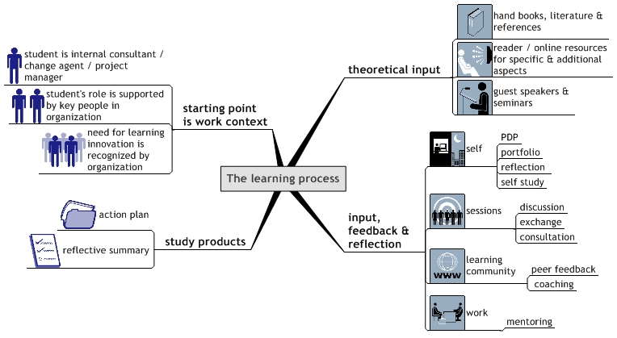
MSc Technology Enhanced Learning, Innovation and Change

Slide 10
