Slide 1



Pathways for Open Resource Sharing through Convergence in Healthcare Education (PORSCHE)
Kate Lomax eLearning Repository, The London Deanery
Lindsay Wood
Higher Education Academy Subject Centre for Medicine Dentistry and Veterinary Medicine, Newcastle University
Sharing resources and best practice across the NHS/HE divide
cc: by Tony the Misfit
http://www.flickr.com/photos/tonythemisfit/2580913560/
contact: lindsay@medev.ac.uk
www.medev.ac.uk/ourwork/oer/
#porscheoer #ukoer #medev

Slide 2

eLearning in the NHS
established, albeit limited use
access is complex - many different systems, security, ownership
local and national content, local and national infrastructure
2

Slide 3

NHS infrastructure
now and in the future
Notes:
Authentication, data security, interoperability, quality assurance

Slide 4
Lightweight technical solutions

Slide 5
Good practice in a complex world
Sharing resources and best practice across HE/NHS divide

Slide 6

PORSCHE :
Working in partnership to:
identify and overcome barriers to OER creation and use
promote sustainable best practices in a changing NHS
document issues and raise awareness of mutually useful resources and tools
Some rights reserved by te.esce
Notes:
What are the barriers to OER adoption
What are the solutions - now and in the future
how might we customise and promote these processes

Slide 7
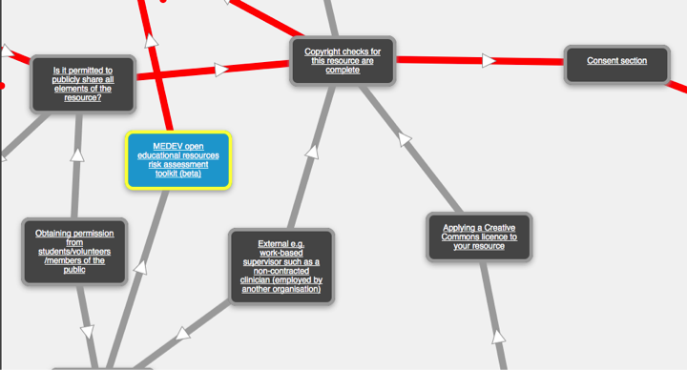
www.medev.ac.uk/oer/register/

Slide 8

www.medev.ac.uk/oer/register/

Slide 9



www.elearningrepository.nhs.uk/
richard.osborn@londondeanery.ac.uk
kate.lomax@londondeanery.ac.uk
twitter.com/nhselearning
www.medev.ac.uk/oer/
suzanne@medev.ac.uk
lindsay@medev.ac.uk
twitter.com/hea_medev
www.medev.ac.uk/blog/oer-phase-2-blog/
Notes:
On the website you can find reports, the toolkit – version 3 will be significantly better in terms of the single interface, and available in November 2010. You can find information about OER2, PORSCHE and ACTOR projects, and find an increasing number of case studies – about 10 so far, though we have done about 60.
Do get in touch with us and follow us on Twitter…..

