Slide 1
Supporting the teacher as learner Diana Laurillard London Knowledge Lab Institute of Education
11-13 May 2011, Manchester

Slide 2
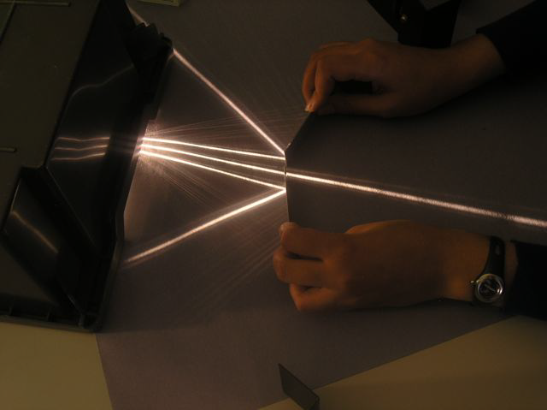
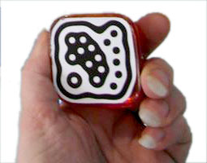
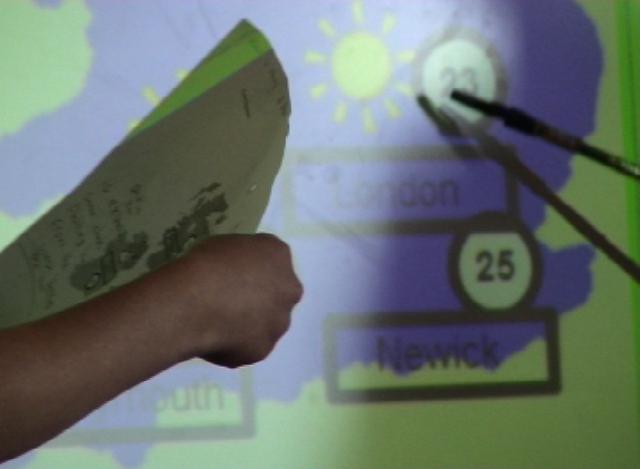
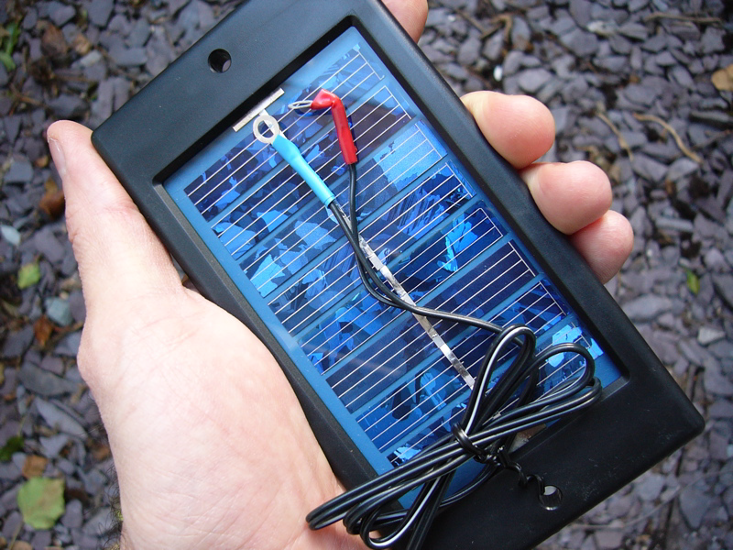
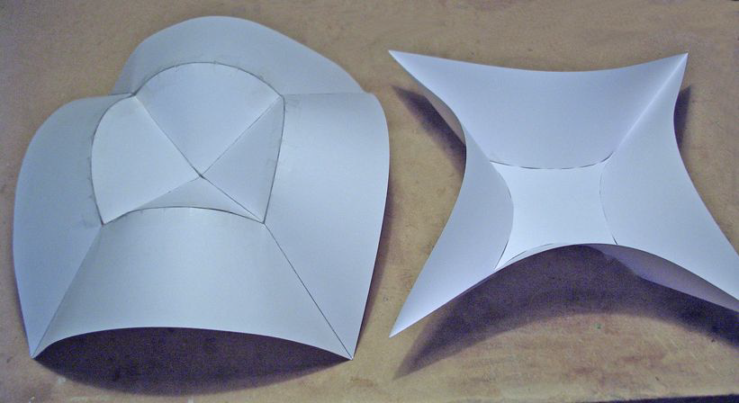
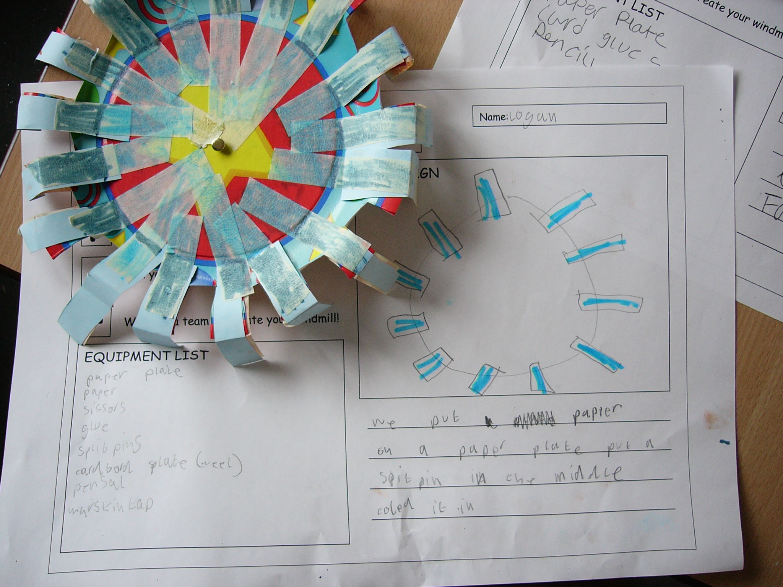
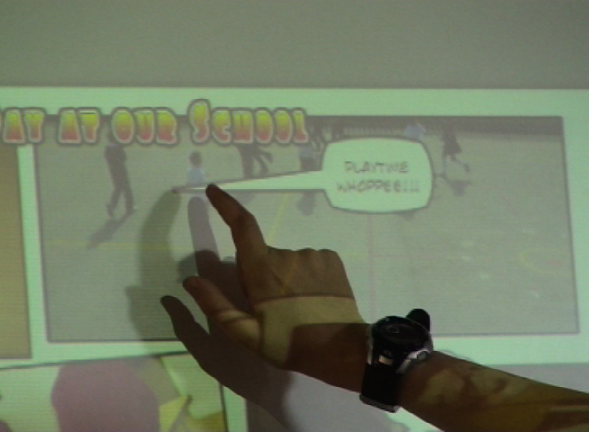
Outline
What does the sector expect?
High expectations of teachers
Teacher development needs and challenges
What is the model for using LT to improve student learning?
Development programmes (NDPCAL, TLTP, CTI and Subject centres, NLN, Curriculum online, … OER)?
Collaboration for sustainable and effective innovation?
Capturing good pedagogy
Enabling the community to build its knowledge
www.lkl.ac.uk

Slide 3
What does the sector expect?
Recommendation 6: Investment is needed for the development and exploitation of open educational resources to enhance efficiency and quality
Institutions can build on the existing open educational resources initiative … to achieve economies of scale and efficiencies … pull in the best content and openly available learning resources from around the world and adapt them
Recommendation 2: Investment is needed to facilitate the development and building of consortia to achieve scale and brand in online learning
Through collaboration, institutions can achieve significant economies of scale and more rapid development and adoption of technologies… (HEFCE 2011)
Our priority is to build a professional workforce which can both collaborate and innovate.
Enable practitioners to create, adapt, re-use and share resources through common access to digital resources for e-learning.
Encourage partnerships and collaboration among institutions and organisations through the use of ICT...
(DfES 2005)
Notes:
HEFCE. (2011). Collaborate to compete: Seizing the opportunity of online learning for UK higher education: Higher Education Funding Council for England
DfES. (2005). Harnessing Technology: Transforming Learning and Children's Services. The Stationery Office

Slide 4
Teacher development challenges
Difficulties for Academic and Support Staff using TEL:
Mainly using learning technology to supplement rather than transform learning and teaching practices
Lack of time to devote to pedagogy
Lack of time to reflect on learning and teaching practice.
Lack of confidence to change learning and teaching practices.
Need for practitioner case studies to inspire others
(Project on Transforming Student Experience via Pedagogy, JISC, 05-07)
Planning infrastructure, resources and business models for ODL
Little substantive financial information about running ODL
(Study of UK Online Learning, Oxford, 2010)
Notes:
http://www2.napier.ac.uk/transform/transformation_pc.htm
White, D., Warren, N., Faughnan, S., & Manton, M. (2011). Study of UK Online Learning. Report to HEFCE.

Slide 5
Teacher development challenges
Difficulties for teachers:
Many studies of educational innovation have concluded that the key factors needed to change teacher behaviour are
additional time,
additional training,
cultural change,
senior staff involvement,
a link to personal reward
(e.g. Dowker 2009, Griffin 2004, Knight, Tait, and Yorke 2006, Dobbins 2008)
Notes:
Dowker, A. D. (2009). What works for children with mathematical difficulties? The effectiveness of intervention schemes: Department for Children, Schools and Families
Dobbins, K. (2008). Enhancing the Scholarship of Teaching and Learning: A Study of the Factors Identified as Promoting and Hindering the Scholarly Activities of Academics in One Faculty. International Journal for the Scholarship of Teaching and Learning, 2(2).
Gibbs, G. (2010). Dimensions of Quality. York, UK: The Higher Education Academyo. Document Number)
Griffin, S. (2004). Building number sense with Number Worlds: a mathematics program for young children. Early Childhood Research Quarterly, 19(2), 173–180. Knight, P., Tait, J., & Yorke, M. (2006). The professional learning of teachers in higher education. Studies in Higher Education, 31(3), 319-339.

Slide 6
A model for sustainable and effective innovation?
Top-down - Strategies and policies? – Rhetoric is good, but no follow-through on initial investment, no planned ROI
Development programmes - NDPCAL, TLTP, NLN,… OER
Support mechanisms – CTISS, Subject centres, JISC, Becta, LSC/LSIS, e-Guides and e-Mentors, ALT, HEA…
Bottom-up – Technology will drive innovation? Users will discover solutions for themselves? the Market will provide? – Activity is plentiful, but not necessarily sustainable or improving
Collaborate to Compete (HEFCE 2011) – i.e. share flexible tools and resources
Notes:
HEFCE. (2011). Collaborate to compete: Seizing the opportunity of online learning for UK higher education: Higher Education Funding Council for England

Slide 7
What to do?
→ Focus on supporting teachers as collaborating innovators
→ Provide tools and resources for collaborative innovation
OER programme will generate the resources
How do we capture the pedagogy of effective innovation?
- ‘a resource can be used in various ways’ (Jim Greeno)
- but what are they? That knowledge is useful too – this is how we help students learn
- ‘to expose and reveal the pedagogical practice’ (Richard Pountney)
How to articulate pedagogic discoveries so that the community can build its knowledge of teaching and learning?
Notes:
Isa formal articulation of pedagogy similar to guitar tablature (David Kernohan)?

Slide 8
Requirements analysis for a design tool
Relevant
Will adopt others’ designs only if clearly relevant
Provide ‘context-aware’ links to relevant research findings
Must be very easy to find existing designs that are relevant and adaptable
Enable fit with their own workflows of designing and editing learning
Allow personalised terminology
Existing designs must be easily adapted
Support constructive alignment of outcomes – activities – assessment
Provide an analysis of each learning design to enables comparisons
Flexible
Validation
Assistive
Notes:
Laurillard, D., Charlton, P., Craft, B., Dimakopoulos, D., Ljubojevic, D., Magoulas, G., et al. (Forthcoming). A constructionist learning environment for teachers to model learning designs Journal of Computer Assisted Learning, (Accepted).

Slide 9
Supporting teacher collaboration
Aims
Design tools
Build on the work of others (BOTWOO)
Import ‘pedagogical patterns’ of good teaching and OERs to populate the patterns
Adopt - Adapt - Analyse – Trial – Redesign - Re-test – Publish
Develop knowledge of using TEL
Offer TEL versions of conventional designs
Model pedagogical and logistical benefits/disadvantages
A microworld for teachers to adopt, adapt, analyse, experiment, trial in practice, redesign, and share designs
Supported by a learning design ontology, structured pedagogical patterns, and a self-configuring system to represent the developing community knowledge base
Build on the work of others (BOTWOO)
Import ‘pedagogical patterns’ of good teaching and OERs to populate the patterns
Adopt - Adapt - Analyse – Trial – Redesign - Re-test – Publish
Develop knowledge of using TEL
Offer TEL versions of conventional designs
Model pedagogical and logistical benefits/disadvantages
A microworld for teachers to adopt, adapt, analyse, experiment, trial in practice, redesign, and share designs
Supported by a learning design ontology, structured pedagogical patterns, and a self-configuring system to represent the developing community knowledge base
Notes:
Laurillard, D., and, Ljubojevic, D. (2011). Evaluating learning designs through the formal representation of pedagogical patterns, Investigations of E-Learning Patterns: Context Factors, Problems and Solutions, (86-105), Eds. Kohls, C. and Wedekind, J. IGI Global.

Slide 10
Pedagogical patterns: Form and Content
Content
Black text is pedagogy
Coloured text is content-specific
Tutorial: The water cycle
Learning Outcome: A clear understanding of the role of the critical factors in the system
Summary: through preparing their own animation of the water cycle, to demonstrate the role of the critical factors, using their lecture notes; presenting it to their group; defending it against questions and comments; and revising their account in the light of the tutor’s summary of the discussion
Tutorial: Using a search engine
Learning Outcome: A clear understanding of the role of the critical factors in the system
Summary: through preparing their own account of using a search engine, to demonstrate the role of the critical factors, using the Library guidelines; presenting it to their group; defending it against questions and comments; and revising their account in the light of the tutor’s summary of the discussion
Tutorial: The water cycle
Learning Outcome: A clear understanding of the role of the critical factors in the system
Summary: through preparing their own animation of the water cycle, to demonstrate the role of the critical factors, using their lecture notes and book; presenting it to their group; defending it against questions and comments; and revising their animation in the light of the tutor’s summary of the discussion
Tutorial: Using a search engine
Learning Outcome: A clear understanding of the role of the critical factors in the system
Summary: through preparing their own account of using a search engine, to demonstrate the role of the critical factors, using the Library guidelines; presenting it to their group; defending it against questions and comments; and revising their account in the light of the tutor’s summary of the discussion
Tutorial: Using a search engine
Learning Outcome: A clear understanding of the role of the critical factors in the system
Summary: through preparing their own account of using a search engine, to demonstrate the role of the critical factors, using the Library guidelines; presenting it to their group; defending it against questions and comments; and revising their account in the light of the tutor’s summary of the discussion
‘capturing pedagogy’ (Laurillard, 2008)
Notes:
Laurillard, D. (2008) ‘The teacher as action researcher: Using technology to capture pedagogic form’, Studies in Higher Education, 33(2), 139-154

Slide 11
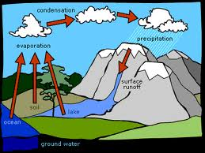
Sharing pedagogical patterns
Tutorial: Using a search engine
Learning Outcome: A clear understanding of the role of the critical factors in the system
Summary: through preparing their own account of using a search engine, to demonstrate the role of the critical factors, using the Library guidelines; presenting it to their group; defending it against questions and comments; and revising their account in the light of the tutor’s summary of the discussion
Tutorial: On a system or process
Learning Outcome: A clear understanding of the role of the critical factors in the system
Summary: through preparing their own account of the system/process, to demonstrate the role of the critical factors, using the resources provided; presenting it to their group; defending it against questions and comments; and revising their account in the light of the tutor’s summary of the discussion
OE Patterns library
Tutorial: Using a search engine
Learning Outcome: A clear understanding of the role of the critical factors in the system
Summary: through preparing their own account of using a search engine, to demonstrate the role of the critical factors, using the Library guidelines; presenting it to their group; defending it against questions and comments; and revising their account in the light of the tutor’s summary of the discussion
Tutorial: On a system or process
Learning Outcome: A clear understanding of the role of the critical factors in the system
Summary: through preparing their own account of the system/process, to demonstrate the role of the critical factors, using the resources provided; presenting it to their group; defending it against questions and comments; and revising their animation in the light of the tutor’s summary of the discussion
Tutorial: The water cycle
Learning Outcome: A clear understanding of the role of the critical factors in the system
Summary: through preparing their own animation of the water cycle, to demonstrate the role of the critical factors, using the OER cycle; presenting it to their group; defending it against questions and comments; and revising their animation in the light of the tutor’s summary of the discussion
Tutorial: The water cycle
Learning Outcome: A clear understanding of the role of the critical factors in the system
Summary: through preparing their own animation of the water cycle, to demonstrate the role of the critical factors, using the OER cycle; presenting it to their group; defending it against questions and comments; and revising their animation in the light of the tutor’s summary of the discussion
OER repository

Slide 12
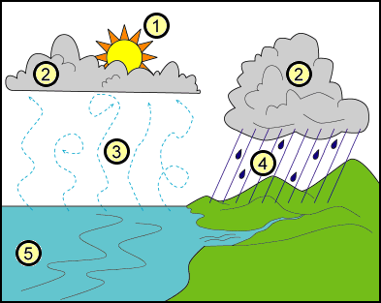
Sharing pedagogical patterns
Tutorial: On a system or process
Learning Outcome: A clear understanding of the role of the critical factors in the system
Summary: through preparing their own account of the system/process, to demonstrate the role of the critical factors, using the resources provided; presenting it to their group; defending it against questions and comments; and collaborating to produce a better animation to post on their website
Tutorial: The water cycle
Learning Outcome: A clear understanding of the role of the critical factors in the system
Summary: through preparing their own animation of the water cycle, to demonstrate the role of the critical factors, using the OER cycle; presenting it to their group; defending it against questions and comments; and collaborating to produce a better animation to post on their website
Tutorial: Using a search engine
Learning Outcome: A clear understanding of the role of the critical factors in the system
Summary: through preparing their own account of using a search engine, to demonstrate the role of the critical factors, using the Library guidelines; presenting it to their group; defending it against questions and comments; and collaborating to produce a better account to post on their website
Tutorial: On a system or process
Learning Outcome: A clear understanding of the role of the critical factors in the system
Summary: through preparing their own account of the system/process, to demonstrate the role of the critical factors, using the resources provided; presenting it to their group; defending it against questions and comments; and revising their account in the light of the tutor’s summary of the discussion
Tutorial: The water cycle
Learning Outcome: A clear understanding of the role of the critical factors in the system
Summary: through preparing their own animation of the water cycle, to demonstrate the role of the critical factors, using the OER cycle; presenting it to their group; defending it against questions and comments; and revising their account in the light of the tutor’s summary of the discussion
Tutorial: The water cycle
Learning Outcome: A clear understanding of the role of the critical factors in the system
Summary: through preparing their own animation of the water cycle, to demonstrate the role of the critical factors, using the OER cycle; presenting it to their group; defending it against questions and comments; and collaborating to produce a better animation to post on their website
and collaborating to produce a better animation to post on their website
OER repository
Notes:
More challenging activity has been inserted by second teacher and the improved pattern is returned to the Patterns Repository for the original teacher to download and use

Slide 13
Education as a learning system
Teachers as ‘learners’ must be able to ‘learn by doing’ – to experiment, share and collaborate
Collaboration on form (learning designs, pedagogical patterns, lesson plans) should generate a demand for collaboration on content (OERs)
Teachers need the means to experiment, share and collaborate on using ICTs – a knowledge-supported microworld for collaborative learning design (CSCL)
Notes:
Laurillard, D. (2008) ‘The teacher as action researcher: Using technology to capture pedagogic form’, Studies in Higher Education, 33(2), 139-154

Slide 14
Pedagogical patterns: Assumptions
Form must be separable from content specifics for the pattern to adapt to a new context
There is a one-many relationship between learning outcome and teaching-learning activity sequence
If the pedagogic form is well-specified, alternative topics and resources can be inserted
For learning designs to be searchable, exchangeable, and improvable in terms of pedagogy, they need a formal description

Slide 15
Elements of a pedagogical pattern
C-SAP
Overview
Content
Benchmarks
Pedagogy
Materials
Assessment
Rationale
Comments
Title
Summary
Topic
Learning outcome
Sequence and timing of types of teaching and learning activities/tasks
Resources
Assessment
Rationale
Learning Approach
Designer’s Reflection
Employability.org
Inform
Apply
Assess
Read/watch/listen
Investigate
Discuss
Practice
Share
Produce
Notes:
C-SAP OER Project toolkit- http://www.c-sap.bham.ac.uk/oer/ Anna Gruszczynka
bleeds@uclan.ac.uk employability.org.uk
The categories of learning types (read, investigate, discuss, etc) are derived from the Conversational Framework – see Laurillard, D. (2002). Rethinking University Teaching: A Conversational Framework for the Effective Use of Learning Technologies (2nd ed.). London: RoutledgeFalmer.

Slide 16
Supporting teachers designing learning
Building on the work of others
Articulating pedagogy
Adopting, adapting and trialling designs
Improving designs
Sharing designs
→ A learning design support environment
“scientific criticism is the engine of science … the criticism of teaching practices is the engine of progress in teaching” (Benedet, 2010)
Notes:
Benedet, M. J. (2010). Unmasking the Spanish University: Cultivalibros.

Slide 17
The Learning Designer A TLRP-TEL project
Build on the work of others – import relevant designs and patterns

Slide 18
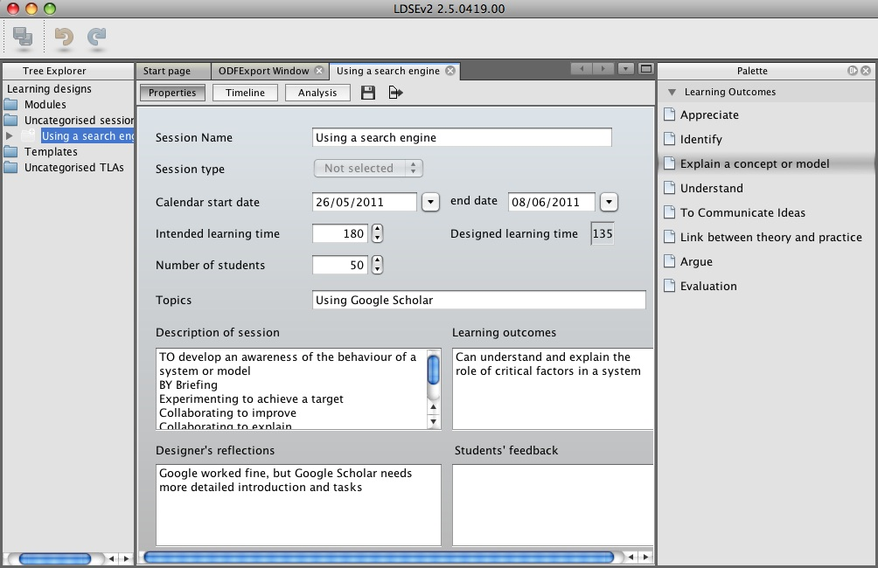
The Learning Designer A TLRP-TEL project
Build on the work of others – find relevant designs and patterns
Select from a menu of Learning Outcomes and Learning Approaches
Edit and trial the learning design

Slide 19
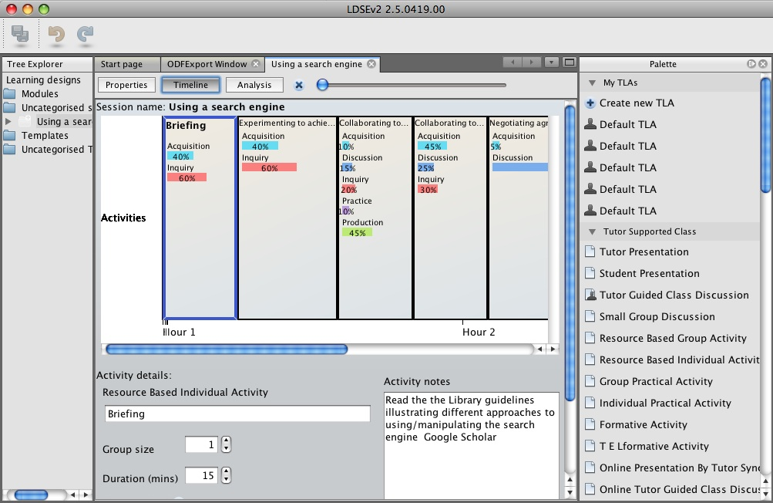
Timeline representation
T-L Activities
Tutor-supported Class
Tutor-supported Group
Tutor-supported Individual
Independent Group
Independent Individual
Resource-based activity
TEL-based activity
….
Summative Assessment
Properties
Resource-based Activity
Acquisition 40%
Inquiry 60%
Prep time/hr 2hrs
Contact time/hr 0hrs
Teacher’s titles, text, time, group size, resources, etc.
Blended learning design, online and classroom-based activities

Slide 20
Modelling costs and benefits
The designed learning experience
Model returns effect of design on ‘type of learning’ elicited, ‘learning experience’, ‘teacher time’, and ‘learner time in class’
Teacher time = 125 hours
Learner time in class = 50 hours
Other contact = 5 hours
[Laurillard 2006]
Notes:
Laurillard, D. (2006). Modelling benefits-oriented costs for technology enhanced learning. Higher Education, 54, 21-39.

Slide 21
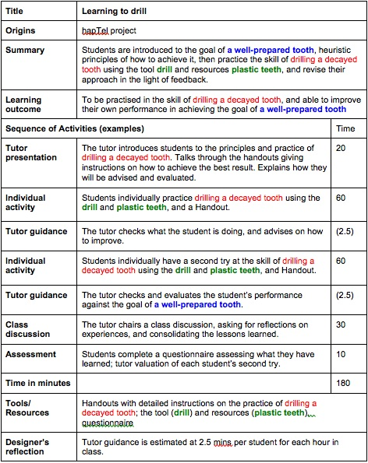
Structure of a pedagogical pattern
Short description
Colour-coded content
Learning outcome
Timings
Categorised teaching-learning activities

Slide 22
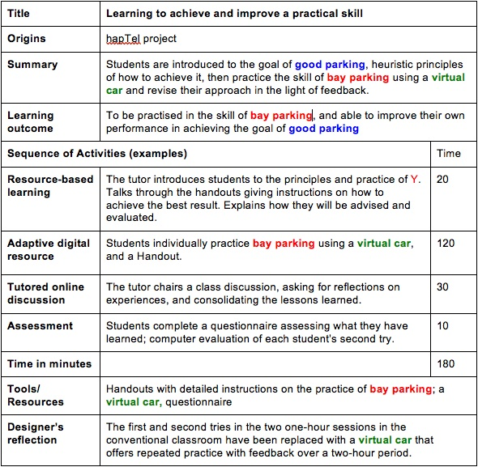
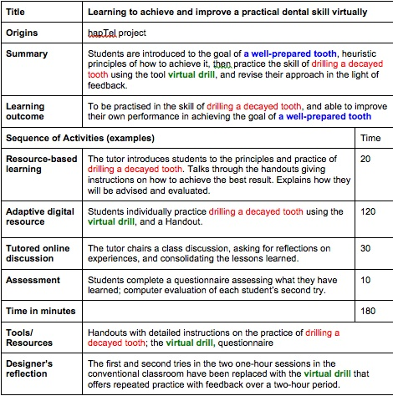
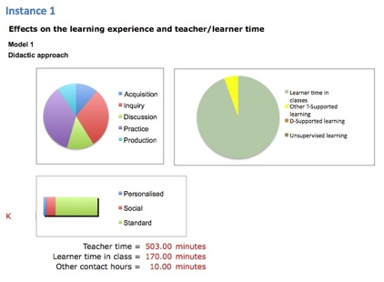
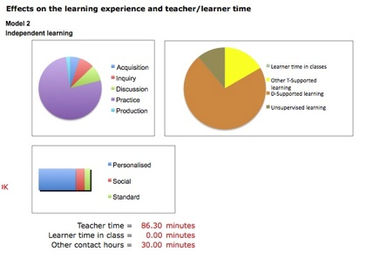
Evolution of a pedagogical pattern
topic
outcome
resource
From Conventional lab to Virtual lab
Notes:
Original pattern derived from hapTEL project presentations.

Slide 23
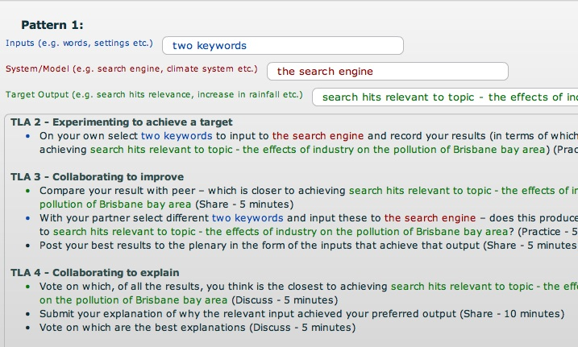
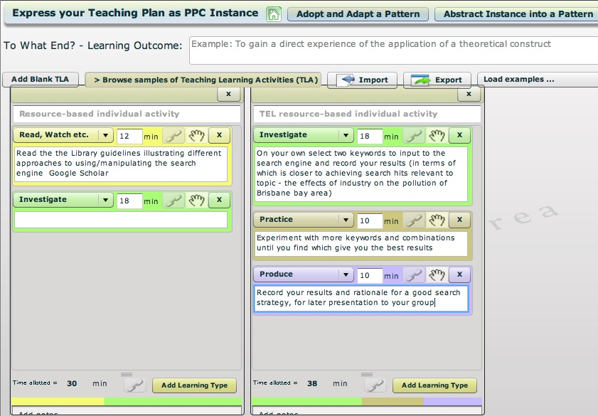
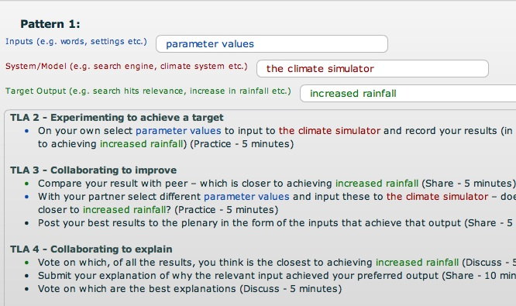
Capturing pedagogical patterns
http://tinyurl.com/ldsepatterns

Slide 24
Comparing pedagogy
Compare the effects of
group size
alternative teaching methods
use of TEL
on
the learning experience
types of learning,
teacher time,
learner time in class, independent learning…
to focus attention on the quality of learning design and the appropriate use of TEL
Notes:
Gibbs, G. (2010). Dimensions of Quality. York, UK: The Higher Education Academy

Slide 25
Can pedagogy be quantified?
Assumptions include:
Personalised learning, group work, and whole class teaching offer different kinds of learning experience
The tutorial, the group project, the lecture can be contrasted quantitatively in terms of ‘personalised/social/one-size-fits-all’
Different teaching methods support different kinds of learning: through acquisition, inquiry, discussion, practice, etc
Student group size affects the learning experience
Online discussion enables a higher proportion of student input than face-to-face discussion groups
There is no assumption of greater or lesser value – the microworld model uses your parameters to analyse your design

Slide 26
Some interesting issues
What kinds of constraints does a pedagogy pattern place on the resource being inserted?
In what ways does a resource change the nature of the pedagogy within a pattern (e.g. conventional to digital)?
Can we enable teachers to articulate the essence of their best pedagogical discoveries?

Slide 27
Summary
Build on the work of others; share ideas, designs and lessons
Capture the good pedagogy in a pedagogy pattern
Populate the well-designed pattern with good OERs
Articulate the pedagogy embedded in good OERs
Adopt – adapt – test in theory – test in practice - share
→ Making teaching like research: collaborative learning
→ Giving academics the means for exploring new pedagogies
https://sites.google.com/a/lkl.ac.uk/ldse/Home
http://tinyurl.com/ldsepatterns

