Slide 1
MIT Core Concept Catalog (MC3)
Linking Learning Objectives with Open Educational Resources and More

Slide 2
Trend Toward Concept Models
While much attention has been focused in recent years on developing and cataloging content, we now see a growing trend in developing and cataloging conceptual models and pathways within and across the subjects and disciplines of the Institute. Through this project OEIT intends to support this trend by providing systems and tools to our community.

Slide 3
The MAPS LON-CAPA based educational web site models MIT Professor David E. Pritchard’s MAPS physics concept space structurally but the underlying concept model is not re-usable nor programmatically accessible outside of LON-CAPA. Additionally, within the MAPS LON-CAPA pages we see concept related links to external resources, like Wikipedia. This approach won’t scale well to multiple resources across subjects.

Slide 4
Example #2– MIT Mathlets – Professor Haynes Miler. http://math.mit.edu/mathlets/courses/
Relationships between mathematical concepts and content (in this case simulations) exist only in HTML and can’t be reused.
Notes:
Example of trend toward concept mapping of curriculum – MIT Mathlets – Professor Haynes Miler.
http://math.mit.edu/mathlets/courses/
Relationships between mathematical concepts and content (simulations) exist only in HTML and can’t be reused.

Slide 5
MIT Core Concept Catalog
The MIT Core Concept Catalog (MC3) project is designed to explore and enhance re-use of Open Educational Resources, like OCW and other on-line educational content or activities, from the perspective of core curricular concepts and learning objectives/outcomes. In addition to supporting deeper learning, this project will help us to begin to answer the question “How can OERs be more effectively used by MIT faculty and students for instruction and learning?”

Slide 6
Benefits
Ability to search, browse and/or otherwise navigate educational resources based on educational objectives and their relationships for a particular class, discipline or field of study
For teachers, MC3 facilitates the re-use of cross-disciplinary content in the preparation of course materials
For students, MC3 is designed to allow for efficient navigation of the vast and growing collection of OER content to help augment and deepen understanding based on learning objectives.

Slide 7
Scaling: Architectural Considerations
Educational content that is stored and managed in multiple places and supplied by multiple providers at multiple institutions must be supported.
Curricular Concepts and Educational Objectives data will also be managed in multiple places within the Institution and across institutions, and educational tools will need to federate across all of these.
Programmatic access to Learning Objective data is as important as programmatic access to content in fostering the independent development of new applications that leverage concept/content relationships.
Educational Objectives will need to be mapped to things other than static content, such as assessments, classroom response systems, or for tracking student performance.

Slide 8
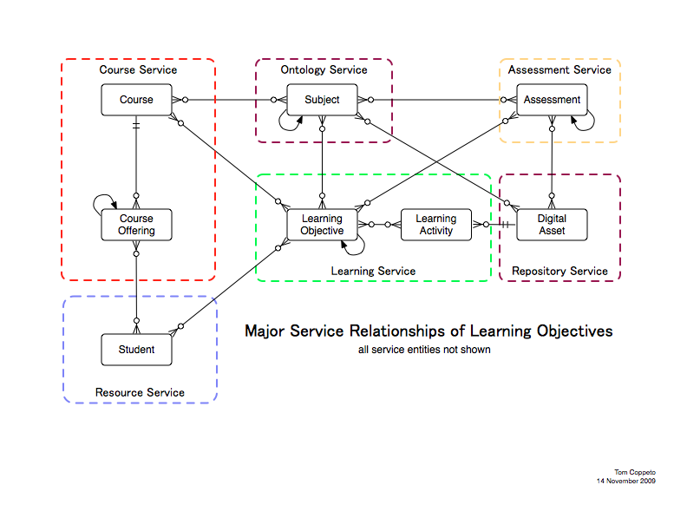
Architectural Framework for
Concepts and Services

Slide 9
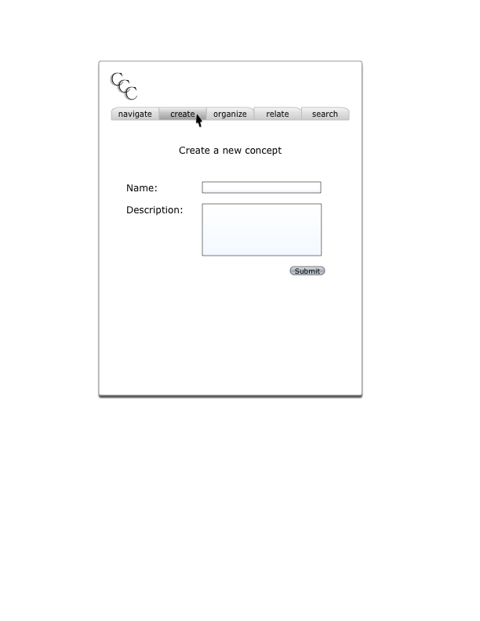
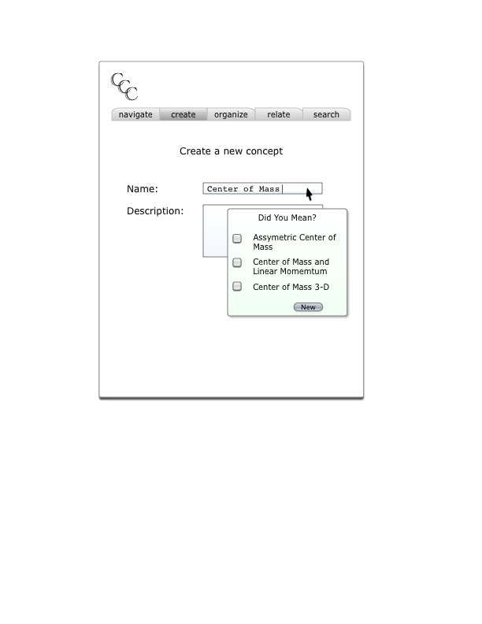
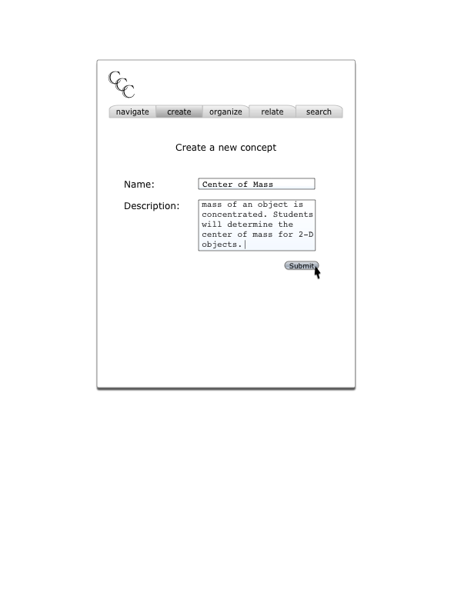
MC3 Tools Mockups
These wireframe mock-ups (continued on the next two slides) illustrate the kinds of functionality to be developed during initial prototype development.

Slide 10
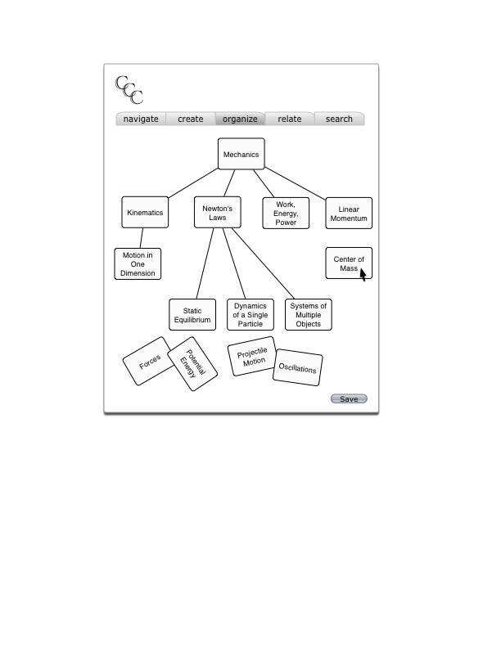
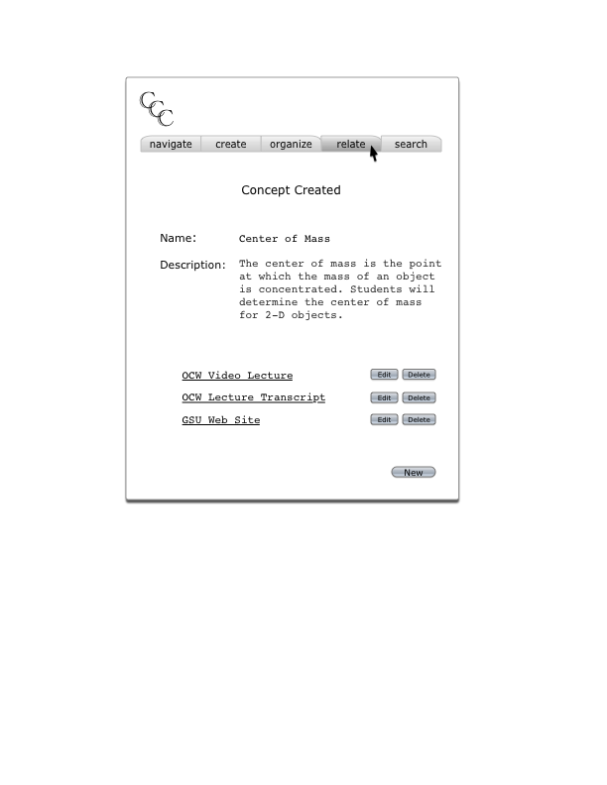
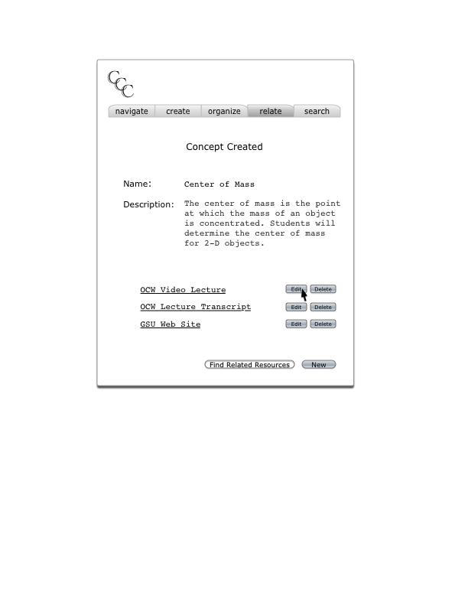
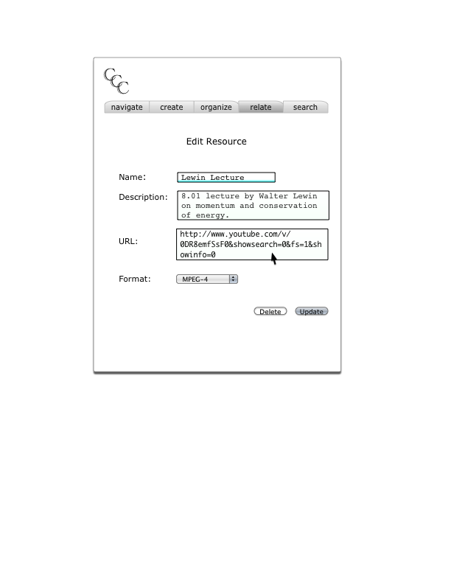
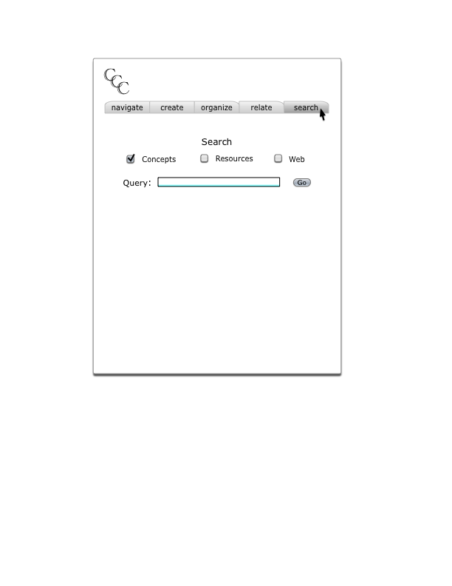
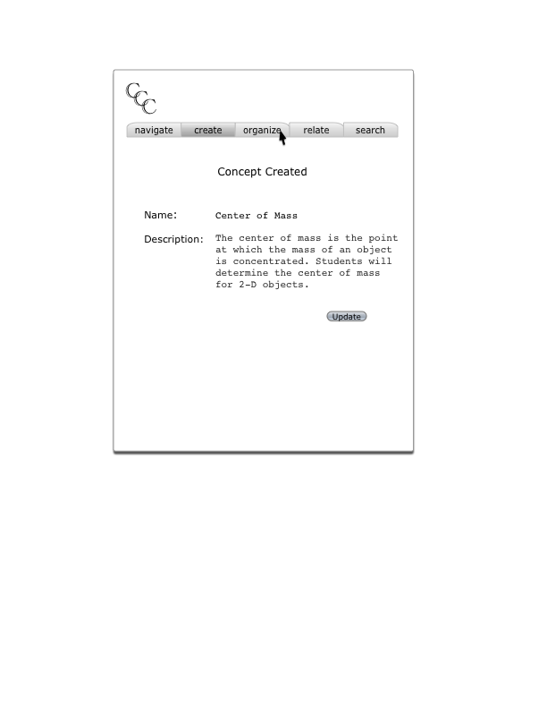
MC3 Tools Mockups

Slide 11
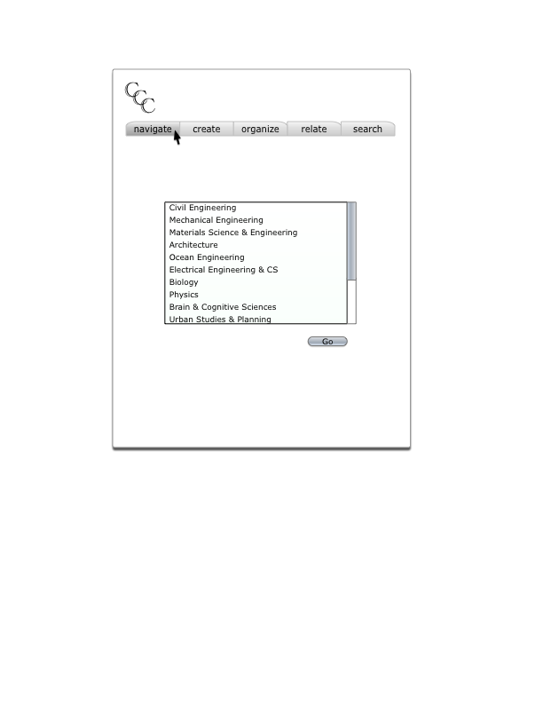
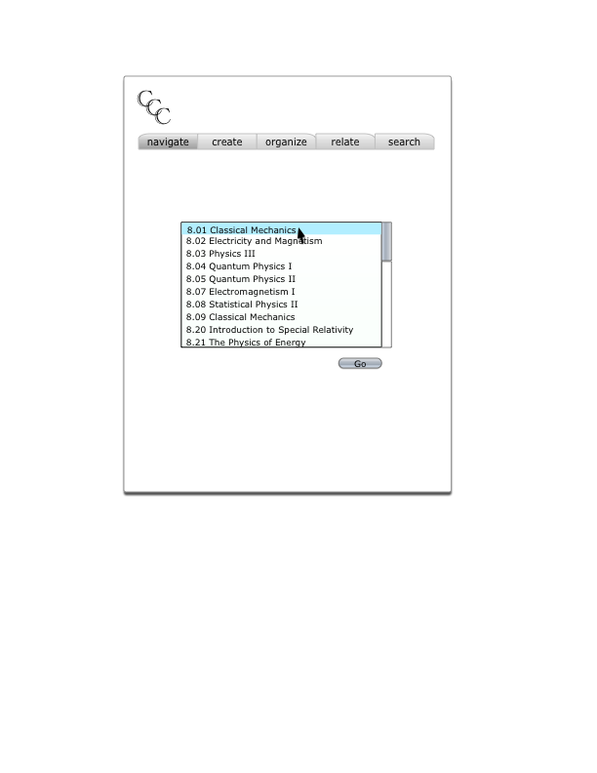
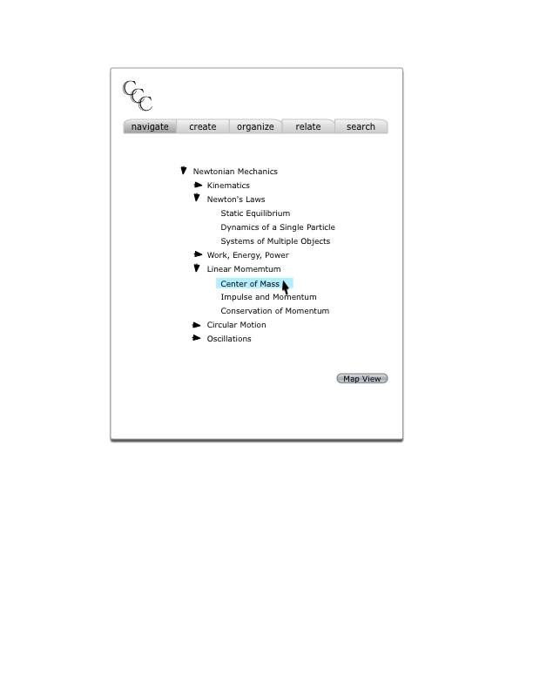
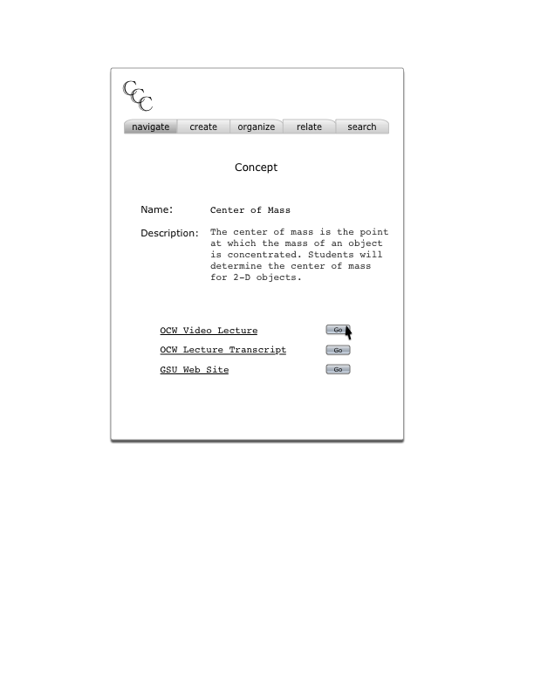
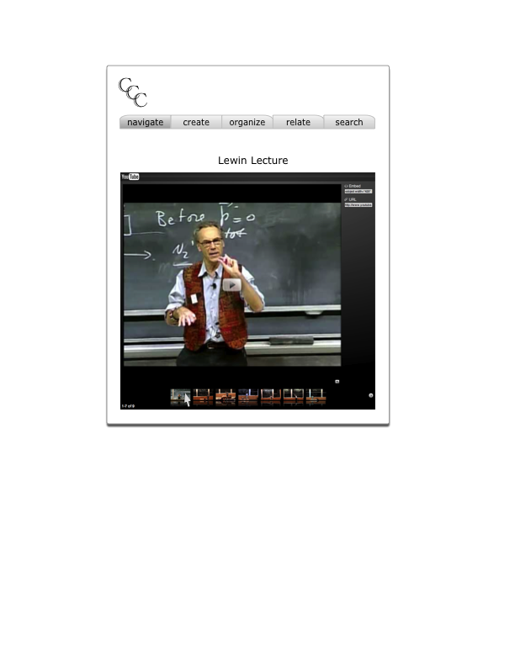
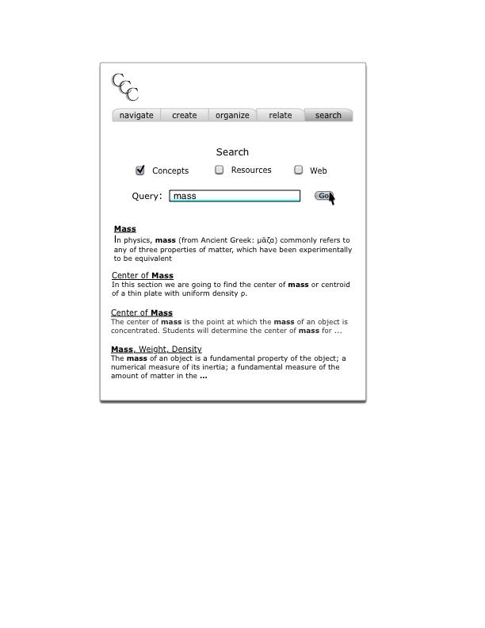
MC3 Tools Mockups

Slide 12
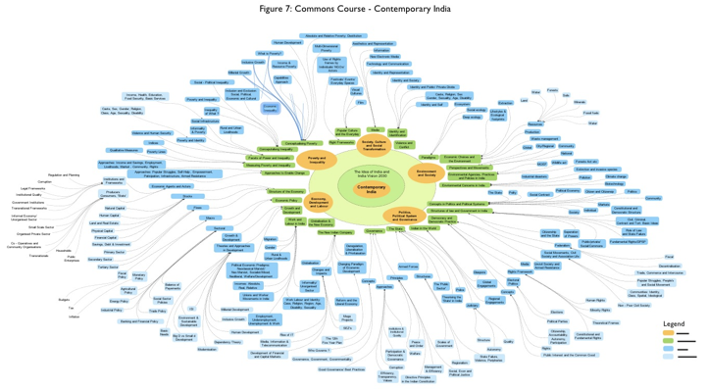
Another Example of trend toward concept mapping of curriculum – India Institute for Human Settlements curricular development. Faculty have developed a number of concept maps like this to define curriculum.
Notes:
Another Example of trend toward concept mapping of curriculum – IIHS.

Slide 13
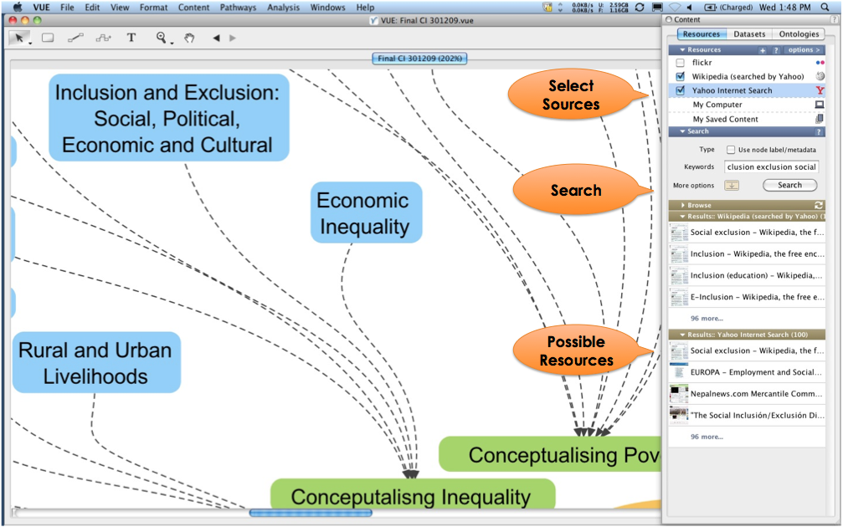
They used Tufts University’s Visual Understanding Environment (VUE) to model concept maps. VUE allows for content to be associated with nodes in a graphical map.
Notes:
Example of relating concepts to content VUE

Slide 14
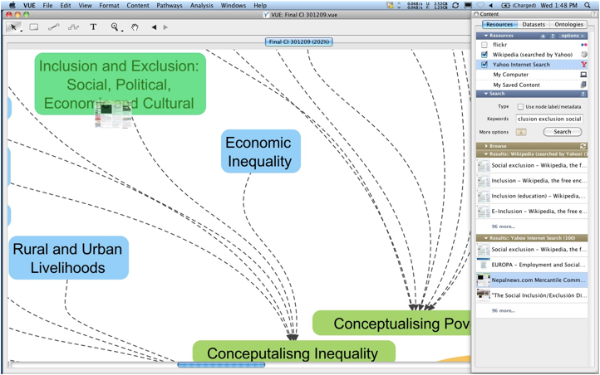
They used Tufts University’s Visual Understanding Environment (VUE) to model concept maps. VUE allows for content to be associated with nodes in a graphical map.
Notes:
Example of relating concepts to content using VUE

Slide 15
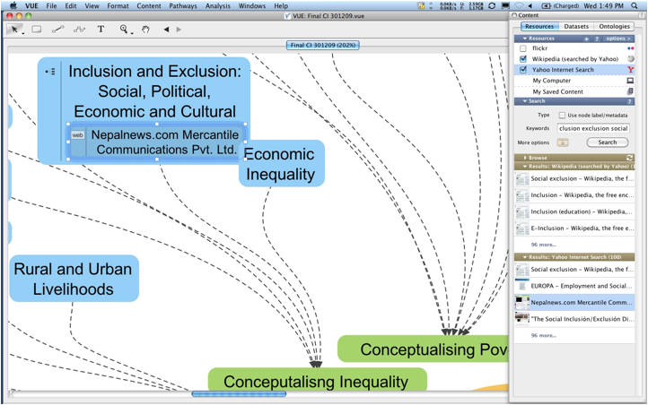
They used Tufts University’s Visual Understanding Environment (VUE) to model concept maps. VUE allows for content to be associated with nodes in a graphical map.
Notes:
Example of relating concepts to content VUE

Slide 16
Magic Occurs…
…transition from content linked to concept map to a student view…

Slide 17
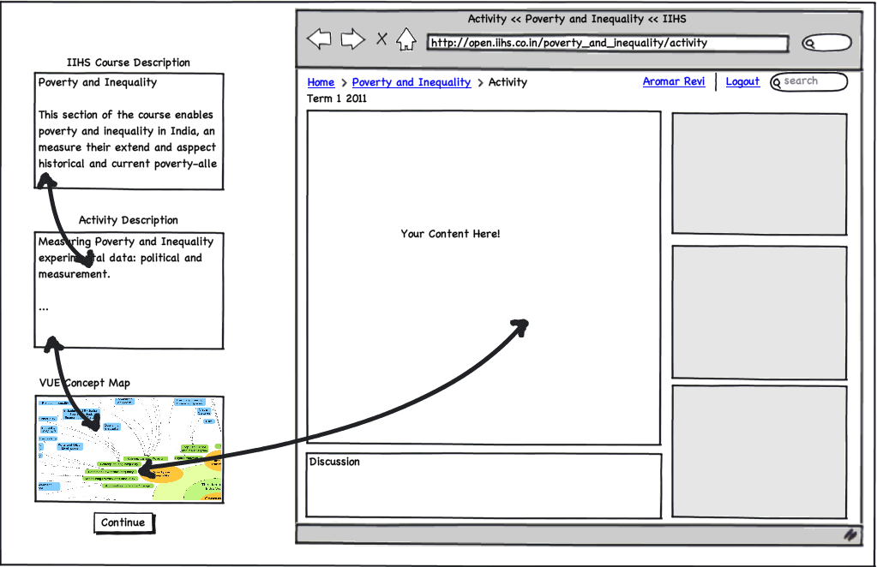
Process
The goal of MC3 is to enable various kinds of educational applications to re-use concept-content relations. In this case we can imagine a student guided learning application that shared the same concept model with the map that the faculty used to develop the curriculum.
Notes:
The goal of MC3 is to enable various kinds of educational applications to re-use concept-content relations

Slide 18
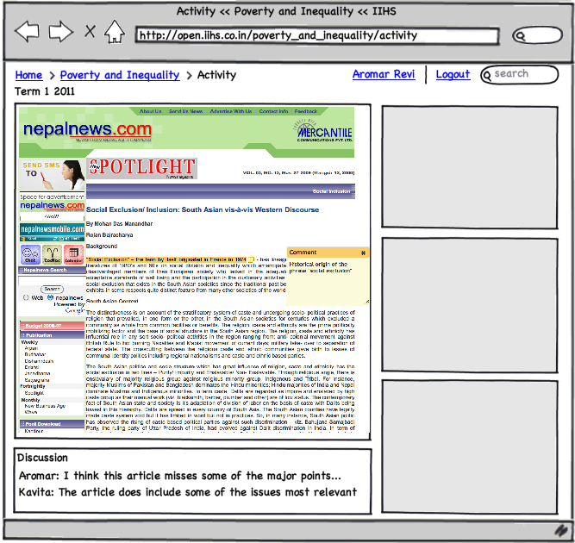
Student Experience

Slide 19
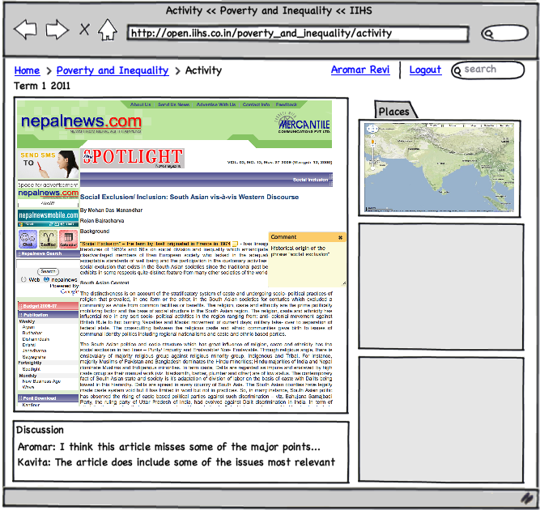
Student Experience-Add Places

Slide 20
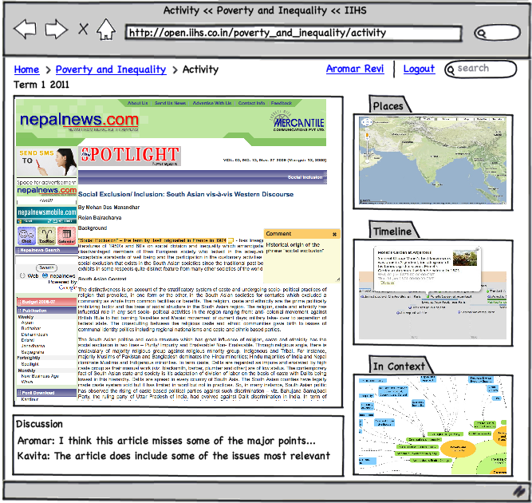
Student Experience-Add Timeline, Context

Slide 21
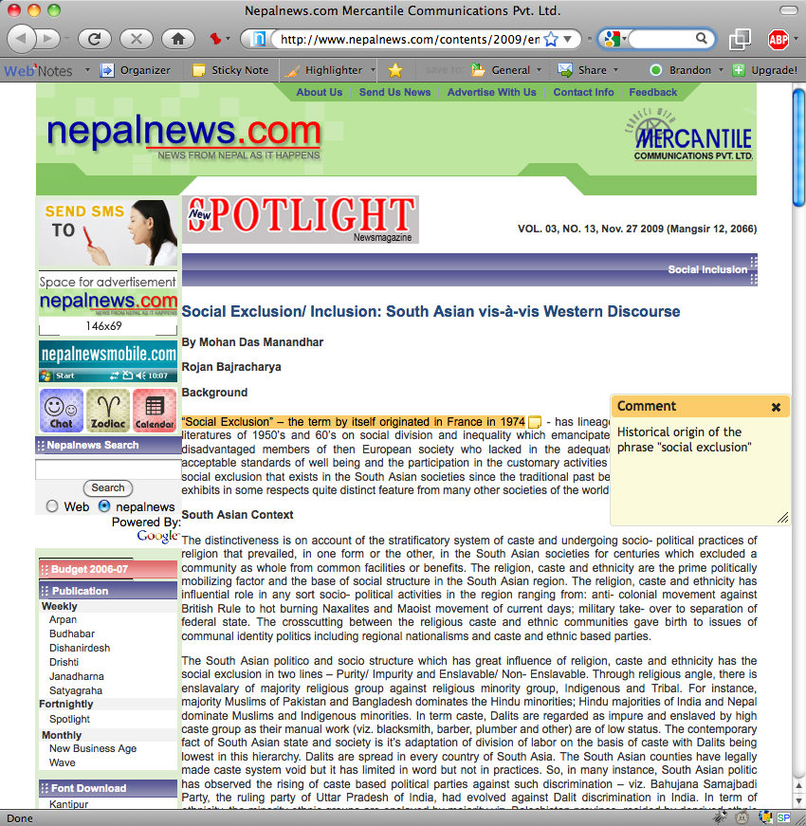
Annotation and Collaboration

