Slide 1
CSI:Milton Keynes In search of the OER user
Chris Pegler
Open University and ORIOLE

Slide 2
ORIOLE project
Open Resources: Influence on Learners and Educators
orioleproject.blogspot.com
By: Perpetualplum http://www.flickr.com/photos/perpetualplum/3729882822/
Investigating sharing
& use of open resources
MEET ORIOLE
Phase 1 will explore reuse of resources via survey and a retreat. Chris Pegler: National Teaching Fellowship
Community
Practice
ADVISORY: IT’S A VERY NEW PROJECT
Research
Sharing
Using

Slide 3
Forensic examination … ?
Good News : Good News
Impact of OER study lead by Oxford University (David White & Liz Masterman) oerblog.conted.ox.ac.uk
National Teaching Fellowship
The keen team: Helen Beetham, Isobel Falconer, Allison Littlejohn, Lou McGill + on the home team Patrick McAndrew and Karen Cropper +++
By Roscoe Van Damme http://www.flickr.com/photos/alcoholicaman/2131779428/
12. SPEED/TIME
Do you need a resource fast? Don’t have the time to make one? Do you search and reuse? If so, does time searching really pay off?
Purpose
Concerns
Quality
Technology
By RambergMediaImages http://www.flickr.com/photos/rmgimages/4881843809/
Resources
5. FUNDING
If funding is available to get involved in using, making or sharing resources, then perhaps that is reason enough to get involved?
Purpose
Concerns
Quality
Technology
Resources

Slide 4
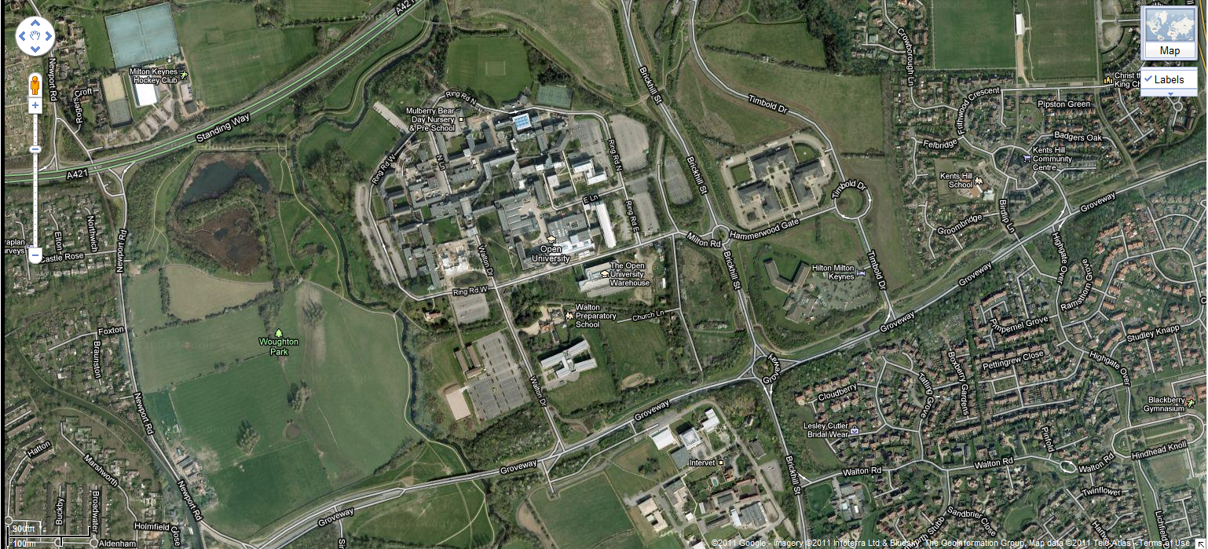
The view from MK7 6AA

Slide 5
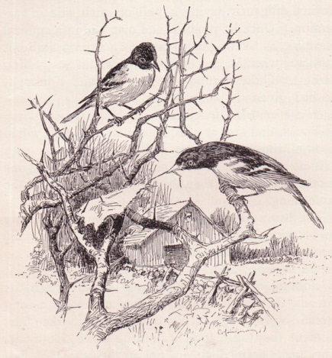
Where are we coming from?
Promise
Practice
What we think/say
OER
will offer
Where we find out what OER
offers
By: Perpetualplum http://www.flickr.com/photos/perpetualplum/3729882822/
ORIOLE PROJECT

Slide 6
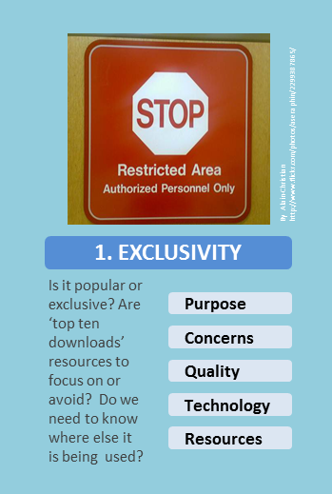
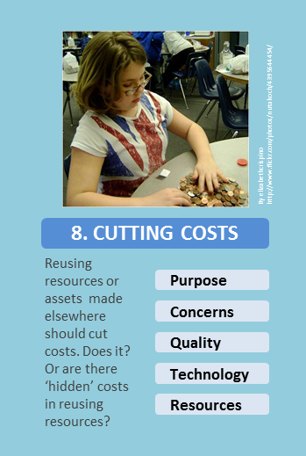
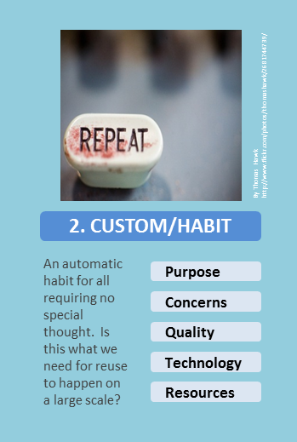
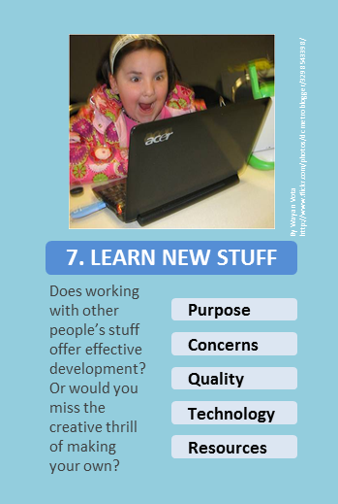
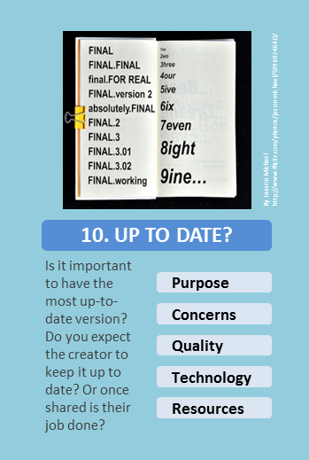
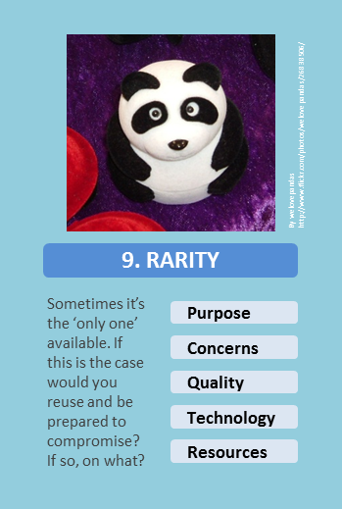
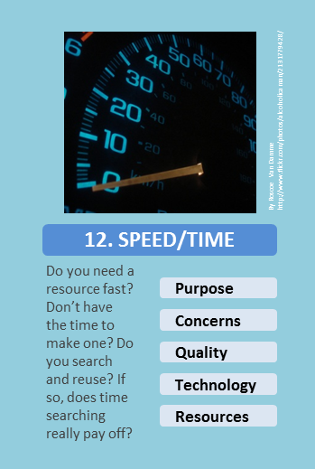
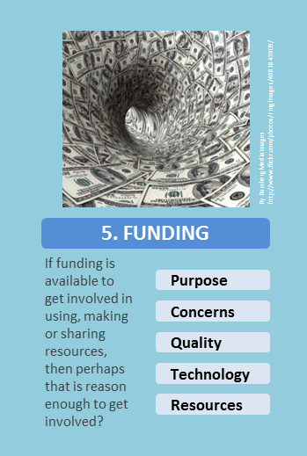
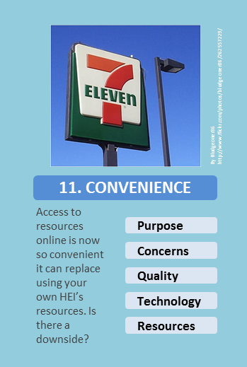
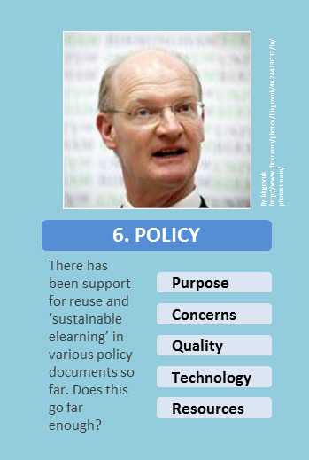
Who is using? Where? Why?
36 cards = aid to trigger discussion with teachers/learners
A reusable resource within ORIOLE’s ‘shop’
Use of open licensed images from Flickr (with attribution)
Technical, Quality & Motivation categories (Pegler, OER10)
Design influence…?
Here is the Why set

Slide 7
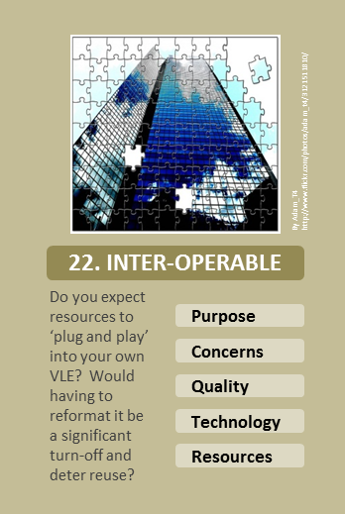
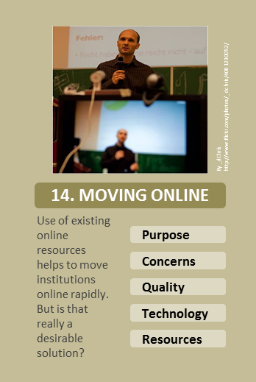
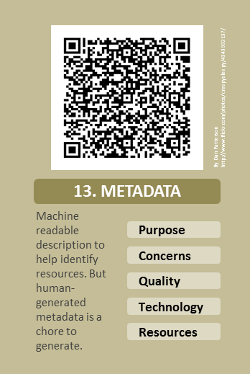
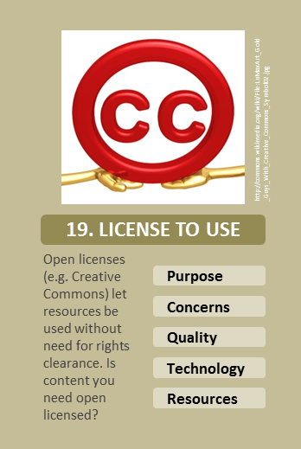
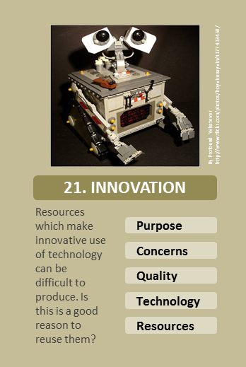
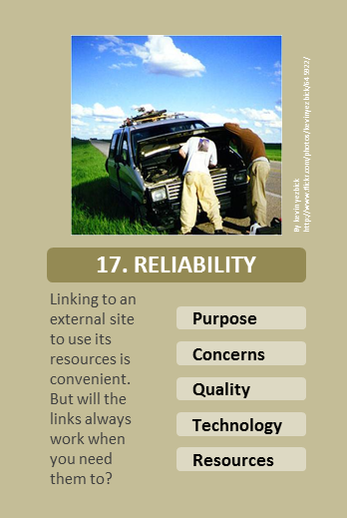
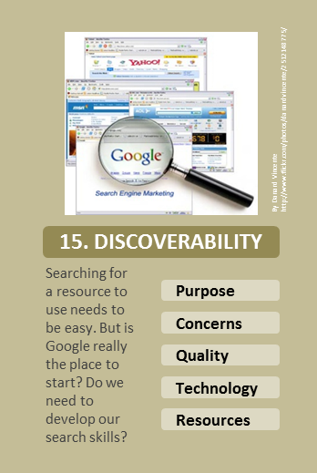
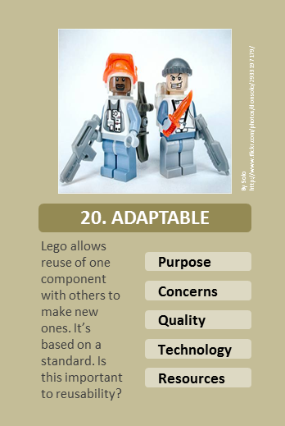
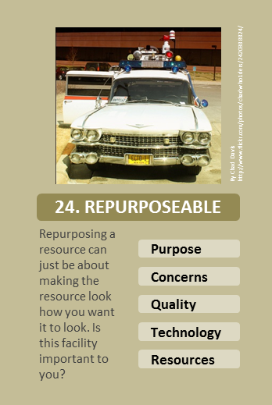
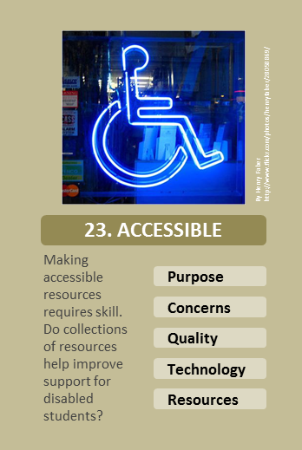
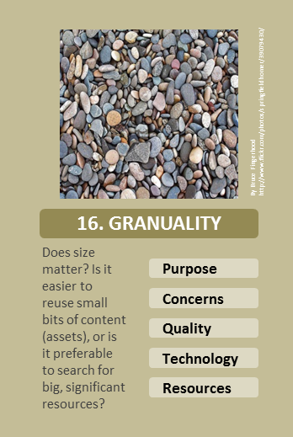
How are they using?
Three types of answer:
Technically
Pedagogically
Business model
are inter-connected … but we can over-focus on tech. These cards focus on the tech problems and promises of reuse

Slide 8
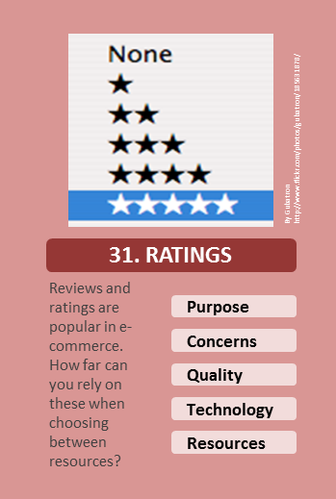
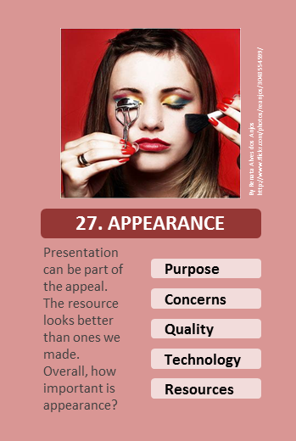
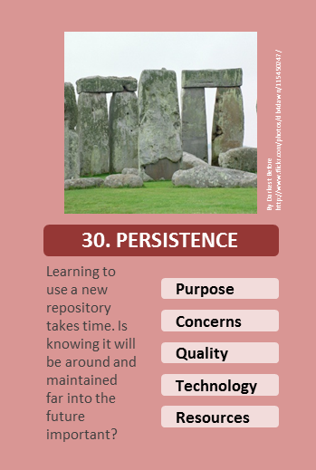
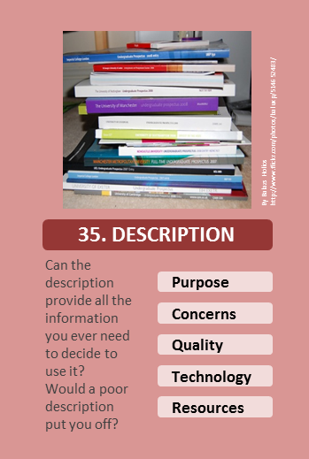
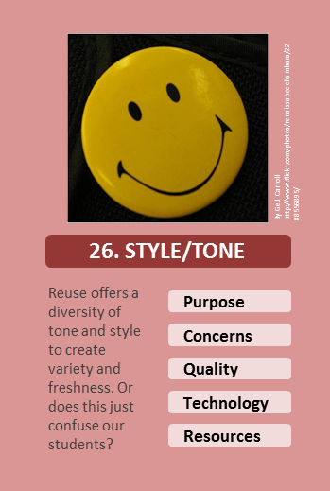
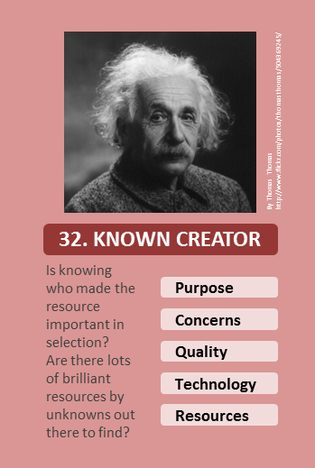
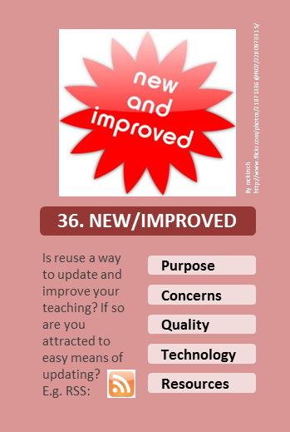
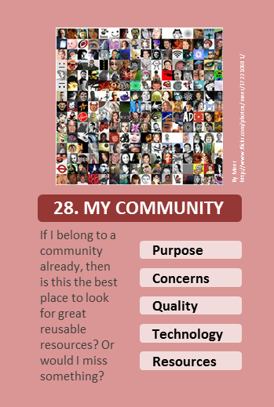
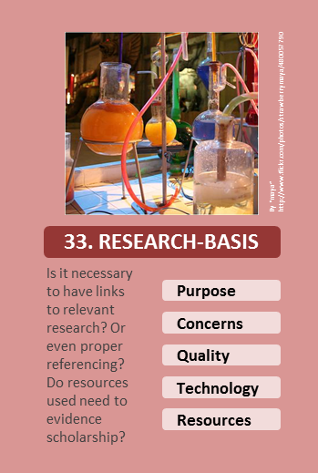
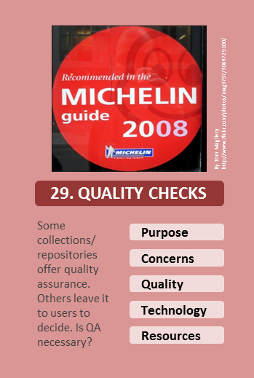
Not just using but choosing?
Initially we talked of ‘critical mass’
We have ‘mass’, unequal in parts
How do users locate the most appropriate option?
These cards focus on quality - in the ‘fit for purpose’ sense

Slide 9
Survey: The research focus
At orioleproject.blogspot.com we are trying to answer:
Are sharers and users the same people?
Is the ‘transaction cost’ different across different groups?
Is distance learning in a (reuse) category of its own?
Do pro-OER people reuse differently than others?
What do people say motivates them to reuse?
Comparing with CD-LOR – has reuse changed?
Is there willingness to share work in progress?
What do people mean when they use the term OER?
Is it possible to get these answers in a survey?
Please, please, PLEASE do the survey
Its open 5-26 May 2011, spread the word
- Results will be shared + you could help a charity

Slide 10
So where is the user? Who is it?
Repurposed from Policy-Police.blogspot.com by Steve Davies (aka Fevered_Steve)

Slide 11
Just about everyone?
Repurposed from Policy-Police.blogspot.com by Steve Davies (aka Fevered_Steve)

Slide 12
Resources were reused in the making of this presentation: Thanks to …
Flickr users:
aseraphin; rmgimages; thomashawk; welovepandas; dcmetroblogger; bisgovuk; nutakoch; atomicbartbeans; tobanblack; alcoholicaman; bludgeoner86; dullhunk; jasonmichael; creepysleepy; _dchris; danardvincente; springfieldhomer; kevinyezbick; donsolo; hoyvinmayvin; adam_t4; henryfaber; chadwho1ders; warrenski; sludgeulper; renaissancechambara; reanjos; el_ramon; mag3737; db4dawn; gubatron; thomasthomas; martin-kliehm; baluxp; strawberrymaya; Masked_Bob and mckirsch
Fevered_steve of Policy-Police (Steve Davies)
As well as Creative Commons, Google Maps, Moo and commons.wikimedia.org
Also thanks to the National Teaching Fellowship Scheme

Slide 13
Plans & questions
‘resourceful’?
05-26 May Survey is LIVE 13-14 June Really Reuseful Retreat,
Woburn
July onwards Reporting + comment Community building
c.a.pegler@open.ac.uk
Cards can be accessed and reused from the ORIOLE SHOP @ orioleproject.blogspot.com

