Slide 1


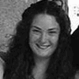


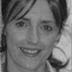
Sustainable OER Provision
“all that glisters is not gold”
Bob Strunz
NDLR

Slide 2
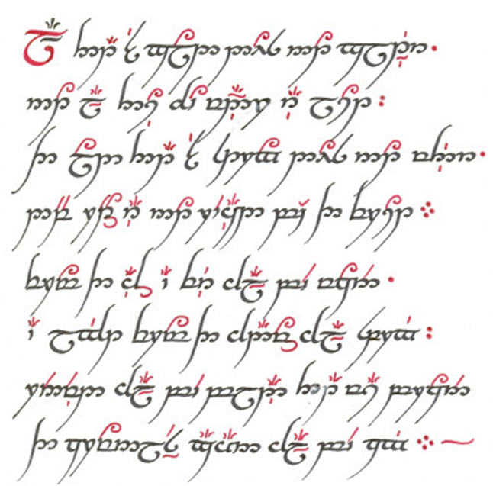
A Recipe for Success?

Slide 3
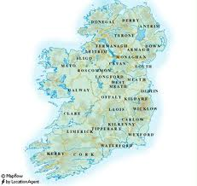
Some Terms
NDLR – National Digital Learning Resource service
HEA – Higher Education Authority
  (Equivalent to HEFCE, HEFCW or SFC)
  7 Universities and 14 IOT’s (21 Partners)
IOT – Institute of Technology
IOTI – Institutes of Technology in Ireland
IUA – Irish University Association
No Equivalent to JISC

Slide 4
A Messy Business …
“…many accounts, fail to capture the messy realities of influence, pressure, dogma, expediency, conflict, compromise, intransigence, resistance, error, opposition and pragmatism in the policy process …
… It is easy to be simple, neat and superficial and to gloss over these awkward realities. It is difficult to retain messiness and complexity and still be penetrating.”
  Stephen Ball (1990) Politics and Policy-making in Education
Quality
Good Enough
Time Enough
Time Spent

Slide 5

Sustainability
Sustaining a National Service
What is meant by sustainability?
What does sustainable mean to the NDLR?
Is the NDLR model a sustainable one?
Is there a simple formula for sustainability?

Slide 6
What do I mean by Sustainability?
The capacity to endure
  Whilst still remaining relevant and excellent
The capacity to withstand shocks
  Whilst still retaining stakeholder engagement
  And without destroying what we want to protect

Slide 7
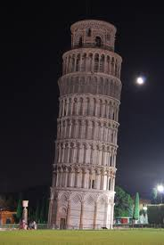

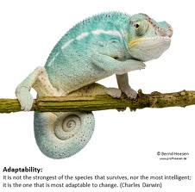
Sustainability Values
We place a high value on
  Foundations
  Engagement
  Adaptability
Review and Renew
Independent Oversight

Slide 8
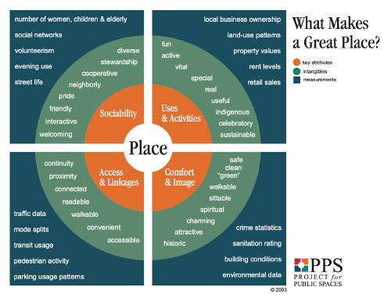
Foundations
Relevance & Sense of Place
Can we take a shock, or does it kill us?
  Die of old age
    Remain relevant
    Know “our place” in the educational ecosystem
Why are we providing a service?
  Pragmatism
  Subversion
  Altruism

Slide 9
L
Diversity
Social Networks
Volunteers
24/7 Usage
National Resource
Quality
Leadership
Sharing
Inclusive
Indigenous
Welcoming
Sustainable
Special
Interactive
Uses
& Activities
Useful
Friendly
Sociability
Fun
Helpful
NDLR
Unique
Close By
Safe
Access
& Linkages
Comfort
& Image
Clean
Useable
Green
Accessible
What Makes
A Great NDLR?
Challenging
Bandwidth
Hits
Traffic
Readability
Interoperable
Attractive
Crime
Quality
Availability
Credibility
Connected
Provocative
Key Attributes
Intangibles
Metrics

Slide 10
Foundations
Organisational Values
Can we take a shock, how do we react?
  Depends on our agreed values
“Attacks” on the Organisation
  Internal tensions
  External pressures
  Consensus, Democracy, Planning
  Shifts in technology

Slide 11
Foundations
Technology
Gartner ‘Hype Cycle’
Inflated Expectations
Trigger
  Inflated Expectations
  Disillusionment
  Enlightenment
  Productivity
Balance Between
  Early Adoption
  Late Adoption
Technology Agnostic
Productivity
Enlightenment
Disillusionment
Technology
Trigger

Slide 12
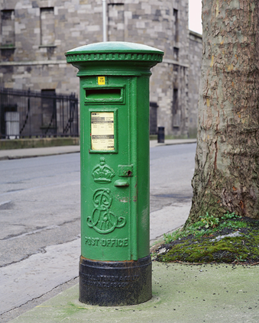
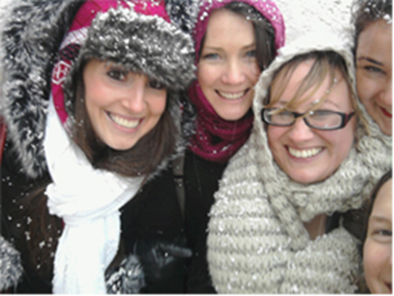
Engagement
Stakeholders
“I’m not just a post box”
Citizens
  Open Access
Universities, IOT’s
  Not a zero-sum-game
Funding Body
  LIPS , LINCS
  Transparency and Trust
Our Staff
  Young at heart

Slide 13
Engagement
Content Providers & Consumers
Academic Staff
  SMART CopS
  Institutional Representatives
Repository Colleagues and Technology Partners
  The Repository Community
  The Technology Community

Slide 14
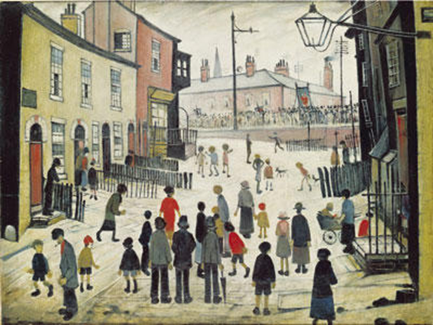
Engagement
Learners I
How will learners use OERS in the future?
  More Sophisticated Search Tools
  Peer-Supported Networks
    Informal
    Ephemeral
    Cross-Institutional
    International
    Multi-Lingual
    Multi-Disciplinary
    Multi-Aged

Slide 15
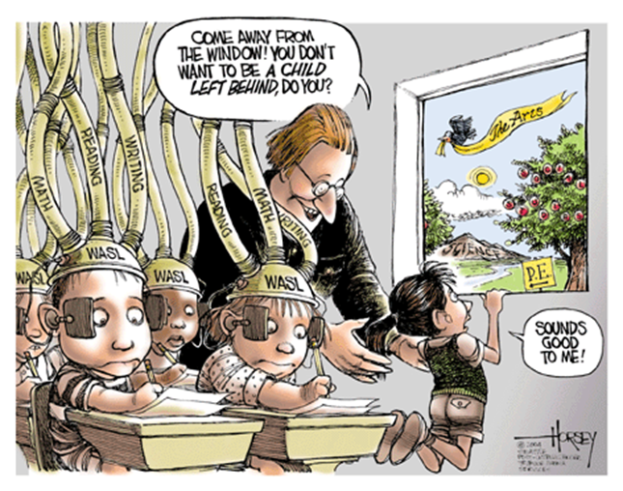
Engagement
Learners II

Slide 16

Adaptability
Stakeholders
We adapt to stakeholder needs
  Review and Renew
  Light Touch Engagement
Stakeholders adapt their needs to us
  Shift to Openness and CC
  Reputation is everything

Slide 17



Adaptability
Technology
Technology
  A Cornerstone or a Stumbling Block
  Open Source but we use a Technology Partner
  Systematic deployment of new technology
Managing Expectations
  I really hate this term !
  We like to have something new and interesting to show

Slide 18
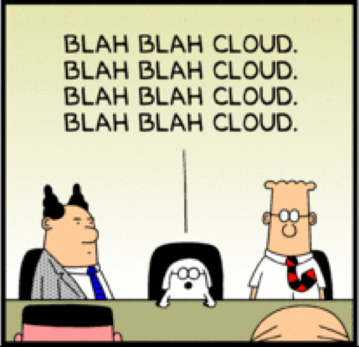
Adaptability
Technology II
Standards Compliance
  More than just interoperability
  Rigorous peer-review of technology
Code Sharing
Technical Discourse
  Sense of place
  Good technology is often invisible

Slide 19

A Recipe for Success ?
  All that is gold does not glitter,
  Not all those who wander are lost;
  The old that is strong does not wither,
  Deep roots are not reached by the frost.
                Jrr Tolkien, Lord of the Rings

Slide 20
Conclusions
All that is Gold does not glitter
  Simplicity is a great virtue
Not all those who wander are lost
  Sustainability is not straightforward
The old that is strong does not wither
  Know your strengths, review and renew
Deep roots are not touched by the frost
  Establish and maintain your foundations

