Slide 1
Towards the Triumph of the Commons
Martin Hall, University of Salford
Open Educational Resources
11 May 2011

Slide 2
What is the case for open access to educational resources, both as a set of principles for the ways in which we use information and communication technologies for teaching, research and engagement in higher education, and also as a formative concept for the university, now and into the future?

Slide 3
Education: public good, or private benefit?
The now-standard assumption: education provides a return on investment (the “graduate premium”. The burden of responsibility for payment rests on the individual
The role of the state is to underwrite finance for students, against their future earnings
Education provision should be open to commercial, for-profit providers
An open market for education provision drives quality up, prices down, and ensures choice
As with any commodity system in a market economy, there are those who cannot afford the price

Slide 4
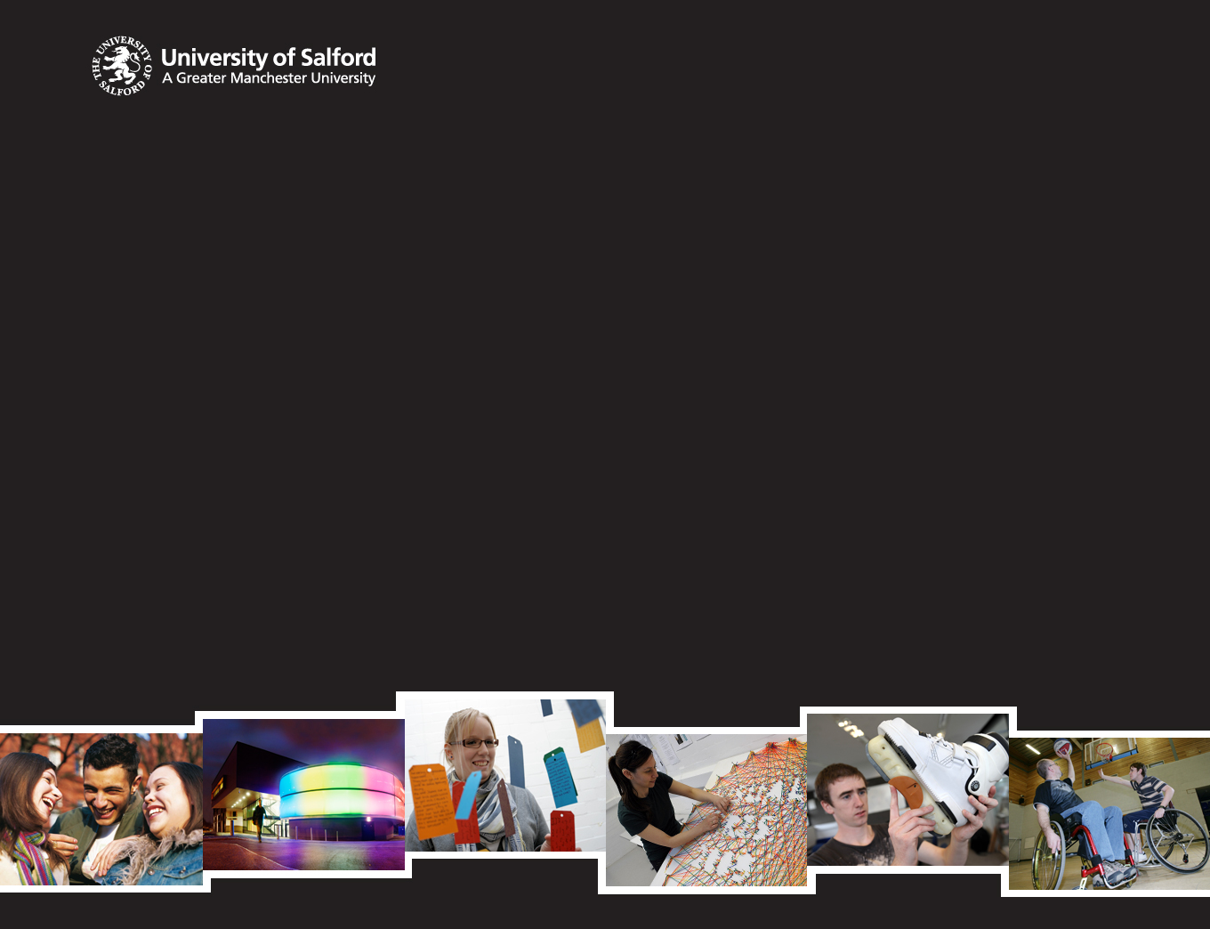
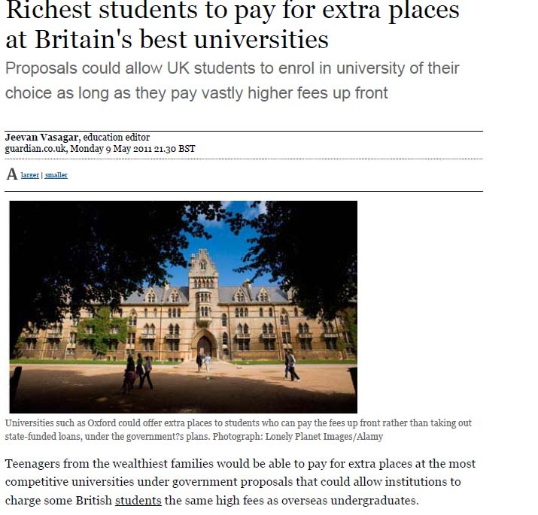
“Travelling the distance from being a child in East London to working in the City skyscrapers you can see from the school playground may require a journey of almost epic proportions. The competition for jobs in the professions is like English tennis, a competitive game, but largely on the middle-classes play against each other”
who wrote this?

Slide 5
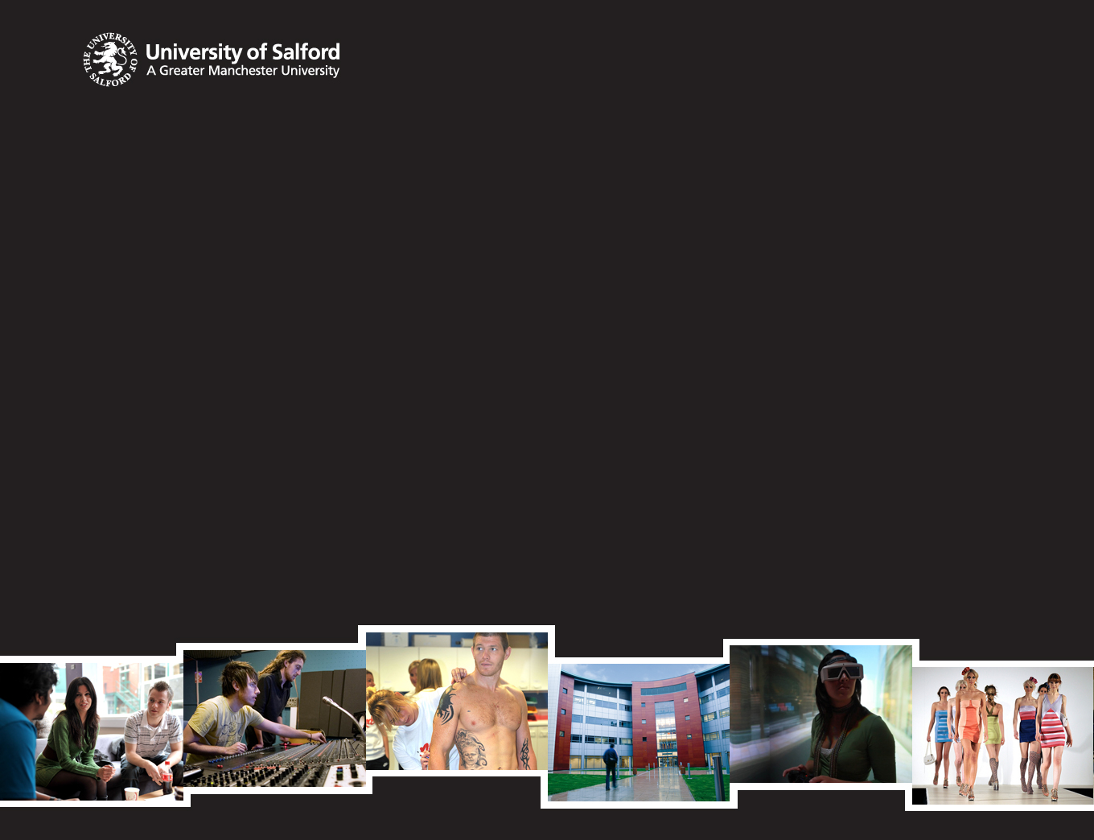
Education as a public good: the counter argument
Education brings collective advantages, shared at the community, or population, level (World Bank and education provision in Africa, Korea and Kenya compared, Ragged Schools)
At a functional level, the provision of a skilled workforce is a key factor in inward and foreign investment
Our Manchester vision: integrated post-16 education to drive economic recovery and growth in the City Region

Slide 6
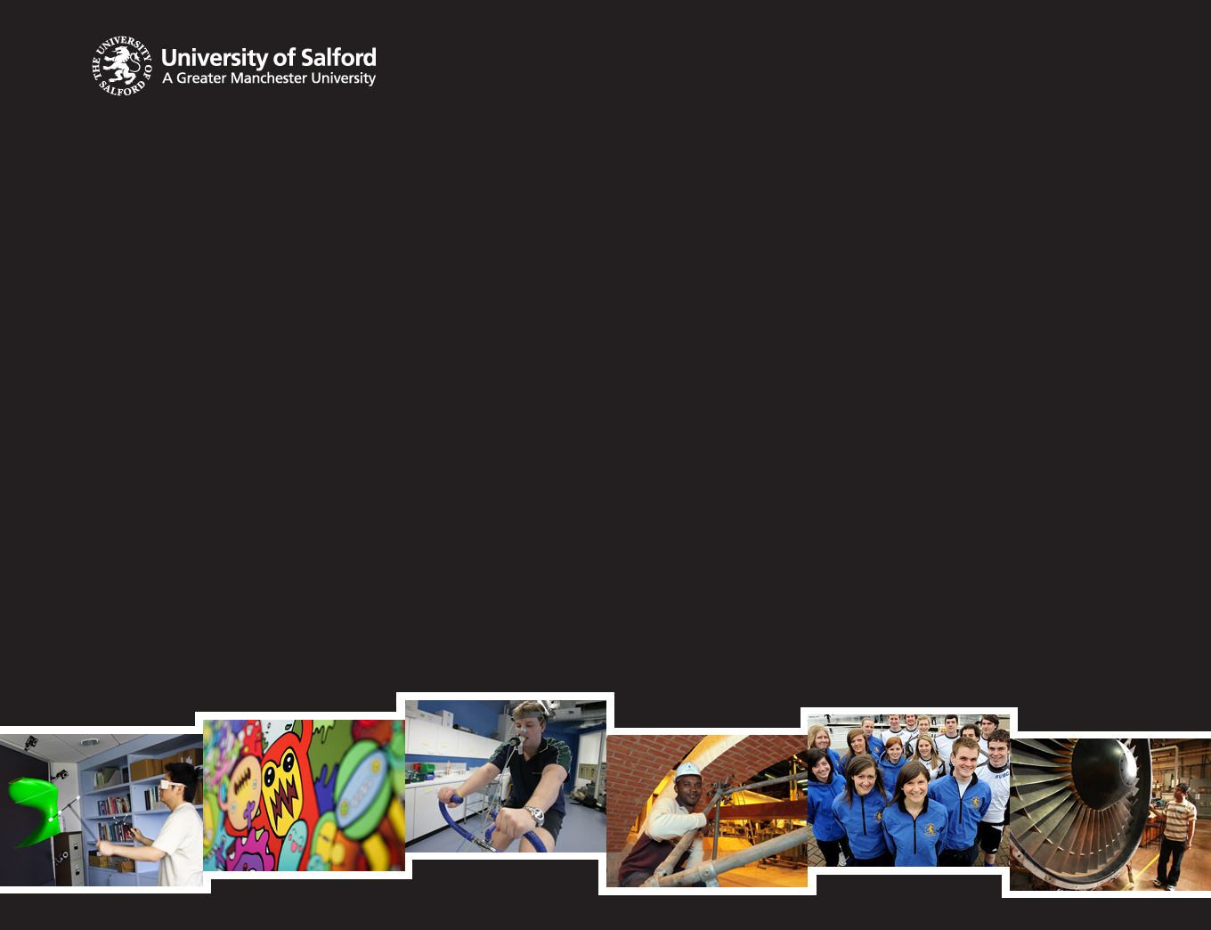
The tragedy of the commons?
The argument: individuals (or groups) are inherently self –interested in making choices. This will lead them to knowingly destroy an obvious asset. From the destruction of communal grazing, to the erosion of public education?
But knowledge is not like grass: it is “non-excludable”, and miraculous to a shepherd
The essence of the digital revolution is that it makes knowledge available everywhere, anytime, in any quantity, and at a steeply diminishing price (Manuel Castells,)
In praise of Wikipedia – a triumph of the commons

Slide 7
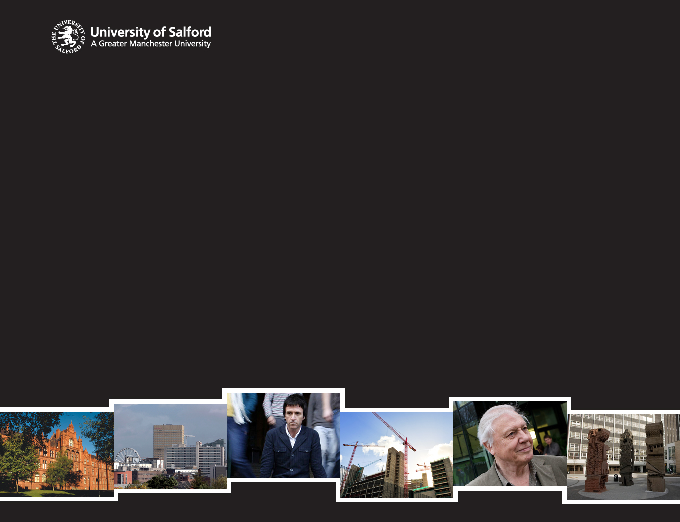
Open Education Resources: the new Public University
The core: Open Access Repository: research, resources, open data
Revenue generation; from added value, rather than from rents and tolls (Open Access publishing)
Public finance to facilitate access (as with other forms of infrastructure) rather than to tax future earnings
New learning technologies to widen opportunity and deepen quality

Slide 8
Who Wrote This?
“Travelling the distance from being a child in East London to working in the City skyscrapers you can see from the school playground may require a journey of almost epic proportions. The competition for jobs in the professions is like English tennis, a competitive game, but largely on the middle-classes play against each other”
David Willetts, The Pinch. How the baby boomers took their children's future - and why they should give it back. London, Atlantic Books, 2010

Slide 9
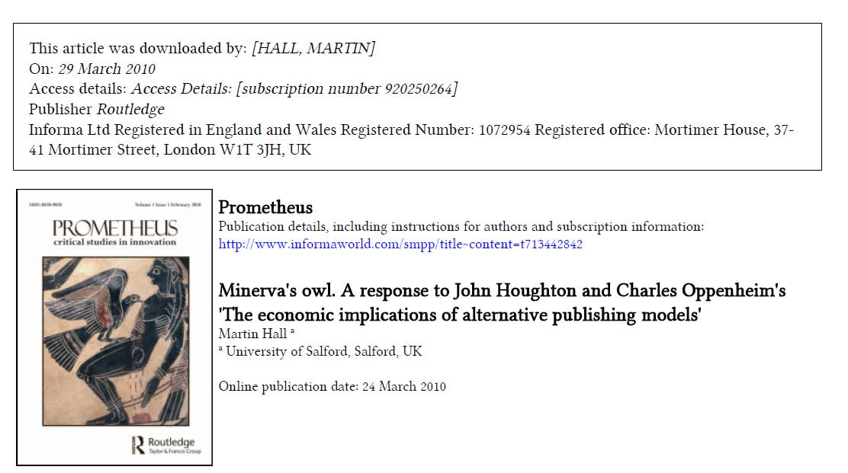
Thank you
www.salford.ac.uk/vc
Available at https://usir.salford.ac.uk

